Slide 1
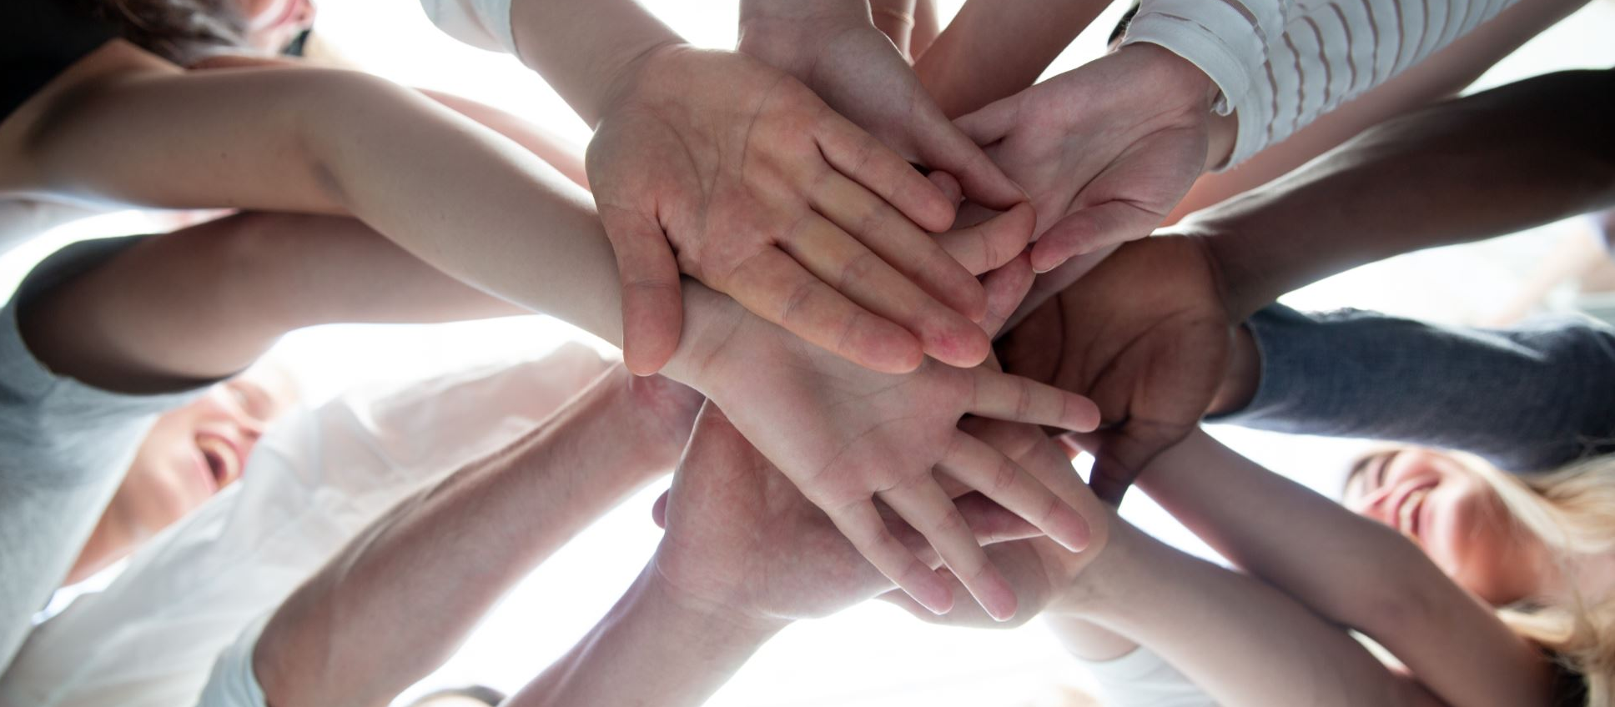
Team development session

Slide 2
Team Development Session
Intention of today is to share insights into the team’s collective strengths and create an action plan to target the biggest opportunities to create a positive improvement.
Results Summary
Capability Results
Detailed Capability Results
Culture Results
Engagement Results
Customer Feedback
Team Action Plan & Commitment Board

Slide 3
Team Development Session
A relationship building activity: eg: share something about yourself that you enjoy doing when you’re not at work?
Show relationship triangle and explain key points – foundation of success
Connect to our relationship with our Key Purpose – fill in on TDP
Notes:
Warm up the room

Slide 4
Results - Care Capability
Turn to page 8 of the report.
Reflection Questions:
Can you share some examples of how strengths show up in the workplace?
Review the areas to improve, what do you notice?
Spend a few minutes working in pairs or small groups to identify some common beliefs that underpin these strengths and areas to improve
Notes:
Animated. Start with Strengths then move to areas to improve
Reflection Questions:
Can you share some examples of how strengths show up in the workplace?
Review the areas to improve, what do you notice?
Spend a few minutes working in pairs or small groups to identify some common beliefs that underpin these strengths and areas to improve

Slide 5
Team Development Session
Quality Audit
Performance is = to Potential – Interference
In small groups list as many individual/group qualities, skills, attributes that form the groups potential and enable the groups strengths.
We’re going to need to be really conscious of these so that we can put them to work on the dev opps.

Slide 6
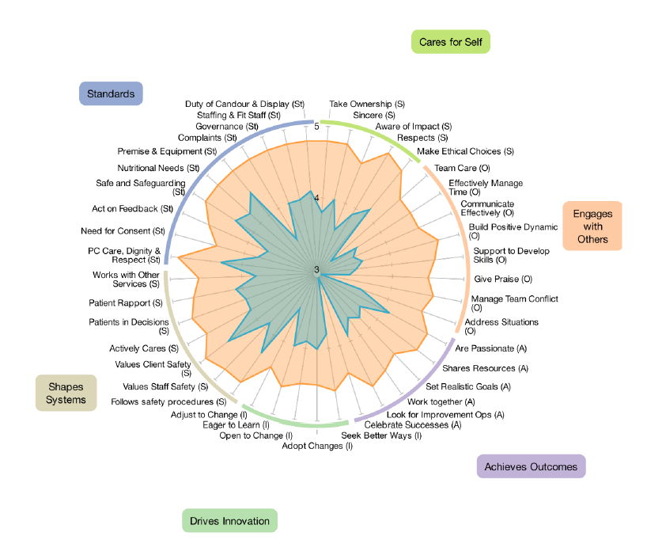
Results - Care Capability
Turn to page 9 of the report.
Take note of the capability areas within each Domain;
Cares for Self
Engages with Others
Achieves Outcomes
Shapes Systems
Standards
Reflection Questions:
How does this sit with you?
What stands out to you?
Notes:
Outline difference between current (blue line) and desired (orange line) capability.
Reflection Questions:
How does this sit with you?
What stands out to you?
Discussion about what they notice, help them understand the domains, the results and the strengths (small gaps) and areas to improve (large gaps)

Slide 7
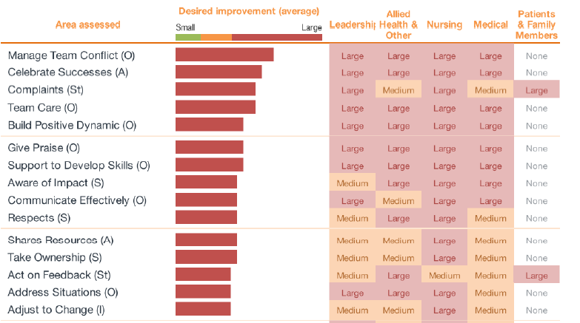
Results - Care Capability
View pages 11-12 of the report.
Reflection Questions:
What different views do you notice? Why do you think there are differences?
What is the impact on yourself and others of the improvement areas?
Notes:
Reflection Questions:
What different views do you notice? Why do you think there are differences?
What is the impact on yourself and others of the improvement areas?

Slide 8
Results - Culture
Turn to page 30 of the report.
Reflection Questions:
What positive things are the team already doing to achieve this score?
What could be better? If we were to see a shift + 1 what would we be doing?
5.93
Notes:
Explanation: Culture is the shared values, belief systems, attitudes and the set of assumptions that people in a workplace share. It’s how we ‘fit in’ and get ahead in the organisations. A positive workplace culture improves teamwork, raises the morale, increases productivity and efficiency, and enhances retention of the workforce.
Animated. You were asked to rate the current team’s culture score out of 10. Any predictions? Reveal score.
Explore the positive things that the team is already doing to achieve the score of X – expand on the list, brainstorm on butcher’s paper
What could be better? If I were to see a shift from X to X (+1) what would we be doing?
Reflection Questions:
What positive things are the team already doing to achieve this score?
What could be better? If we were to see a shift + 1 what would we be doing?

Slide 9
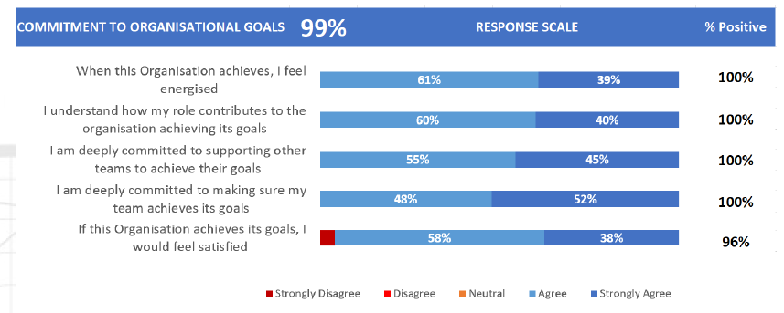
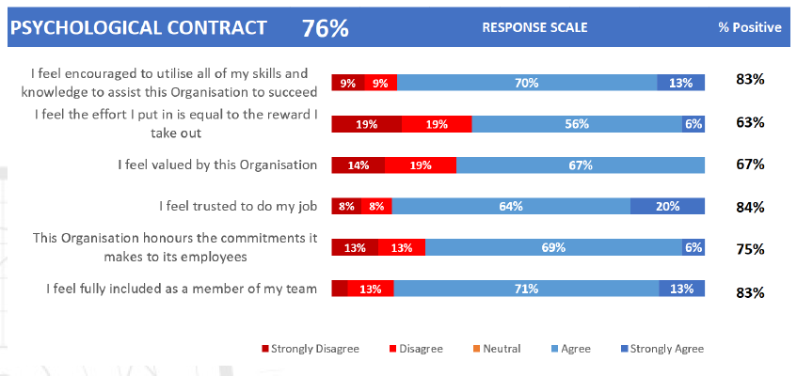
Results - Engagement
Review pages 34-38 of the report.
Reflection Questions:
Spend a few moments reading through factors. What do you notice?
What picture does this paint for your team?
How does this tie into your team’s strengths and improvements areas?
Notes:
Employee engagement is the emotional commitment an employee has to their organisation and its goals. While employee satisfaction is a component of engagement, it is not simply how ‘happy’ they feel at work or how ‘satisfied’ an employee is because a very satisfied or happy employee may not go the extra mile.
There is a range of factors that are important to employee engagement, the following pages go through each of these things in more detail.
The percentage represents how many people responded positively to the questions.
Reflection Questions:
Spend a few moments reading through factors. What do you notice?
What picture does this paint for your team?
Point out some of the trends and help the team join the dots.

Slide 10
Results – Customer (Patient) Feedback
Turn to page 42 of the report.
Reflection Questions:
1. What does this score mean to us?
2. How does this score make you feel?

Slide 11
Team Development Plan and Commitment Board
So, what are we going to do with this feedback?
1. Considering all the feedback we’ve gone through what would you say are the team’s biggest strengths?
2. What are the greatest opportunities, or areas to improve?

Slide 12
Key Learnings
Current Views
Intended impact of this view
Unintended impact of this view
Question: Spend a few minutes working in pairs or small groups to identify some common beliefs that underpin these Strengths and Areas of Opportunity.

Slide 13
Default Future
What’s predicted if we continue working together in the same way as we currently work together?
Consider the Strengths and Areas of Opportunity and spend a few minutes working in pairs or small groups to brainstorm some dot points to describe the default future.
Expand
Question: How does this ‘default future’ sit with you, or fit with the team?
Notes:
What’s predicted if we continue working together in the same way as we currently work together

Slide 14
Preferred Future
What future do you want?
How committed are you to development?
Visualise what the preferred future looks like
What would people be doing?
What would you hear others say?
What would you see/hear from your leaders?
What would you feel encouraged to do?

Slide 15
Transformed Beliefs
What beliefs are required to enable this preferred future to become a reality?
What do you need to ‘let go of’ to enable this?
What individual or shared beliefs need to be created?

Slide 16
Commitments
What are you committed to doing to make the preferred future a reality?
What would this actually look like?
What would the impact be?
What support for you need?

Slide 17
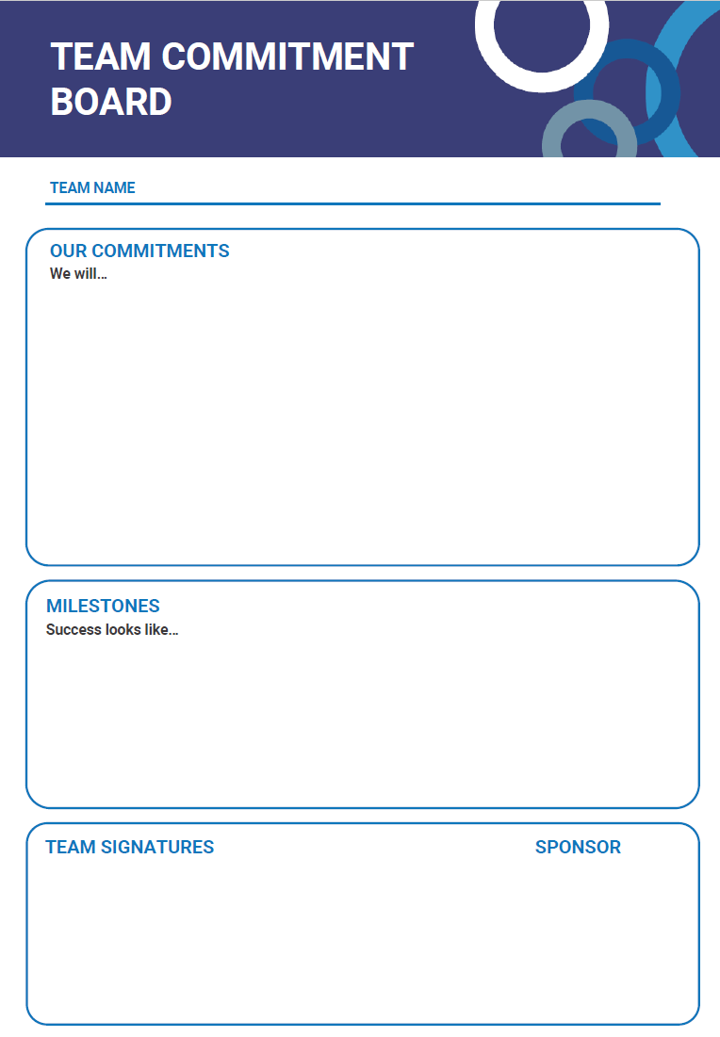
Team Commitment Board
Embedding the team commitments
Transcribe the commitments created through XX to the team commitment board including what success looks like.
Personal Reflection
On a post-it note, write down your own individual commitment – what can you be personally responsible for?
Notes:
Aim: For the team to have a customised Team Commitment board at the end of the session, that clearly states agreed actions the tea can implement to achieve a great workplace culture.
Purpose: The board will act as a sign post you can place in a workplace common room, that staff can refer, hold themselves and others accountable to, as a guiding statement. It will enable each team to identify their contribution to the current situation and articulate the preferred behaviours that will enable them to support the structure moving forward, build trust between the team and management and improve the overall engagement and culture of the team. Each member of the team (including leaders) will be encouraged to take responsibility for creating a more engaged, high performing team.

Slide 18
Head Office
10B, 151 – 153 Herdsman Parade,
Wembley, Perth
Western Australia 6014
+61 8 9287 1041
info@datadrivesinsight.com
datadrivesinsight.com
Creating thriving organisations

