Slide 1
Health Team & Leadership Develop with HILCA & HISCA

Slide 2
Health Industry Assessment Suite
HILCA360 Exec
HILCA360
HISCA
Based on:
National Safety & Quality Health Service Standards and
Health LEADS Australia Framework
360 for Executive Leaders
(Boards, CEO’s, Executive Directors.)
Quality Standards and LEADS Framework
360 For Teams, incl. patient feedback
360 for Leaders on the front line up to executive directors.

Slide 3
What makes a great Health Leader Health LEADS Capability Framework
Specifically designed for Health Care Industry – based on Health LEADS Australia – nationally agreed health leadership framework in 2013.
Includes National Safety Quality Health Service (NSQHS) standards
Notes:
The HEALTH LEADS Australia: the Australian health leadership framework (2013) describes the knowledge, skills and abilities that underpin such leadership and that are commonly required by leaders across Health Care.
Developed in 2013 by Health Workforce Australia through collaboration with over 700 industry experts and organisations. In June 2013 the Australian Health Ministers’ Advisory Council approved Health LEADS Australia as a nationally agreed health leadership framework and the Australia Medical Association endorsed the framework theoretically and called for a plan to operationalise its intent, with buy in from all stakeholders. In 2014, Health Workforce Australia closed and the essential functions were transferred to the Department of Health.

Slide 4
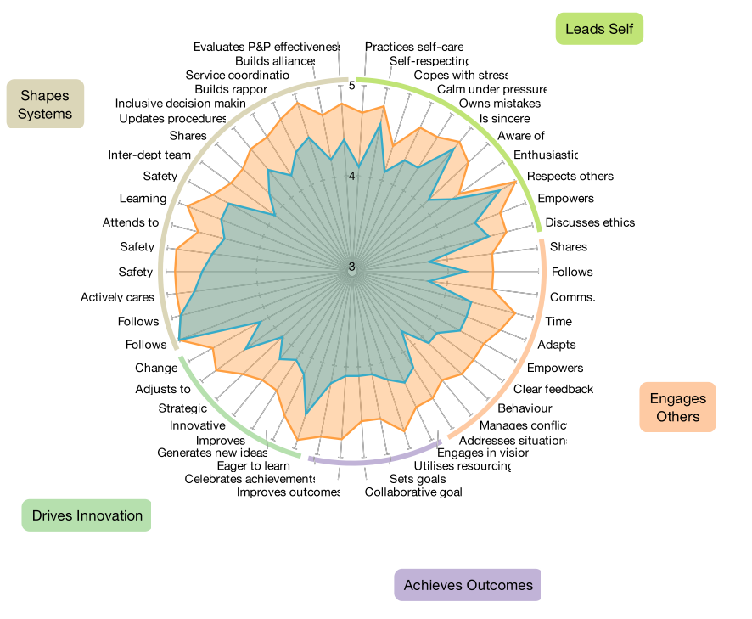
How do we measure it?
HILCA 360 is a leadership capability assessment tool that enables transformation for Health industry leaders.
Captures feedback on current performance and desired performance.
Identifies greatest strengths and opportunities for improvement across all the leadership domains.
Developed by Psychologists, HR professionals, Performance Coaches and industry experts including Chair of the WA Faculty of the Royal Australian College of General Practitioners in partnership with two Australian Universities.

Slide 5
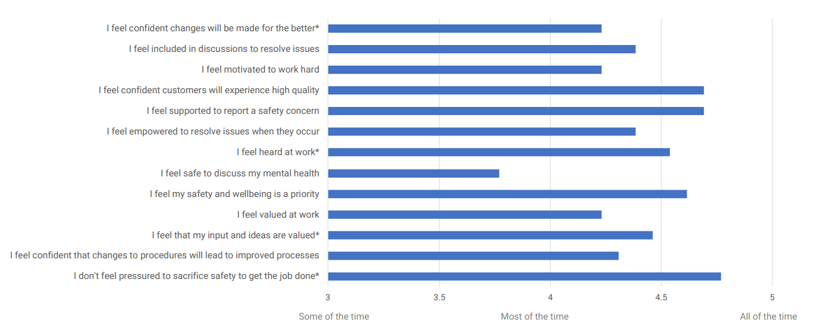
How do we measure it?
HILCA360 measures a leaders impact on those around them
Get insight into your impact and where and how you can grow that impact

Slide 6
How do we measure it?
HILCA360 measures a leaders impact on the levels of psychological safety others experience when working with them
Get insight into your impact and where and how you can grow that impact

Slide 7
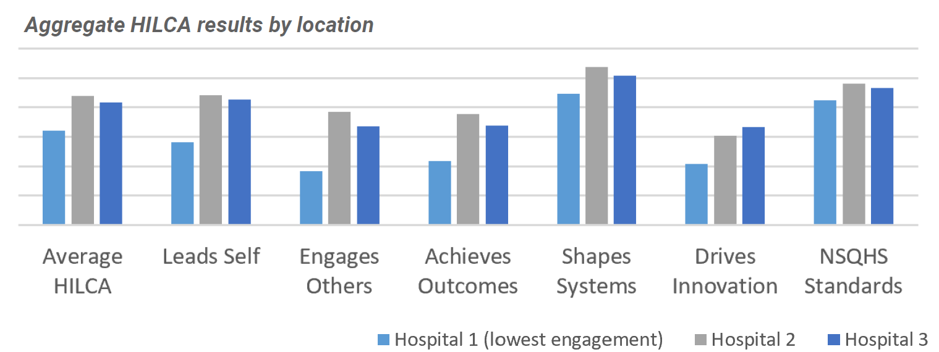
HILCA360 - Why do it?
Grow leaders and the organisations ability to meet standards and engage staff
The HILCA 360 results provided evidence that the wards with the lowest staff engagement also had leaders with the lowest capability across all HILCA domains and the NSQHS standards.
HILCA360 performance predicted how well they performed against the NSQHS Standards
84.6% of NSQHS performance can be explained by HILCA result

Slide 8
HILCA360 – Why do it?
HILCA 360 is designed to provide health leaders with unique insights into how they are performing as a leader by identifying their strengths and development gaps.
It is purely designed for self-development. The participant is the only person that sees your individual results, which will be debriefed to you in a confidential and supportive session with a Veraison coach.
You will be provided with a HILCA Self-Development Guide that includes models, resources, activities and videos/TED talks to transform your leadership and overall effectiveness.
The organisation can receive aggregate reports of leadership groups to help identify common opportunities and focus leadership investment.

Slide 9
HILCA Executive
How is it different to HILCA360?
The questions reflect this extra level of responsibility and assess behaviours and capabilities at the more strategic and cultural level.
Who is it for?
CEO’s, Executive Directors and Board Members.
Leaders that often play a role in influencing community or stakeholders beyond their organisation.
How is it the same as HILCA360?
Correlated to the Health LEADS Capability Framework and Quality standards - same six domains and subdomains.
Survey process and report.
Self Development Guide content is relevant to leaders at all levels.

Slide 10
HILCA Executive
Comparing HILCA and HILCA Executive questions (some examples)
Domain | HILCA360 Sample of questions | HILCA360 Exec Sample of questions
Engages Others | Provides clear feedback | Leads effective performance development strategies
Achieves Outcomes | Collaborates with others to set goals | Creates sustainable organisational plans
Shapes Systems | Follows policies and procedures to achieve organisational goals | Ensures the organisational governance framework is effective
Drives Innovation | Regularly looks for a better way of doing things | Encourages others to improve existing approaches
Standards | Ensures that staff have adequate skills to do their job | Ensures effective staff skill development strategies are in place

Slide 11
How does it work?
Select your Participants
Nominate your 7-10 raters.
Complete your own HILCA
Reports are generated.
Choose your coach to give you feedback.
Receive your report, debrief results and receive self-development guide
Organisation receives the Aggregate Report
Note: HILCA 360 can be completed on any device and takes 10-15mins
Be as honest as possible

Slide 12
HISCA – Team Assessment
What is HISCA?
Using the LEADS Capability Framework, HISCA is an assessment tool:
specifically designed for teams in the health industry
helps understand where their biggest risks and opportunities lie in relation to capability
can replace employee engagement or staff satisfaction surveys with a more comprehensive measure
enables patients, clients and families to provide feedback
An integral element of any
health care provider is the
capability of health service
teams at all levels to create
and sustain a culture that
supports the achievement of
high quality patient care.
What it does for Health Organisations
tick off the requirements of Standards 2 (g)
measure capability and employee engagement and customer satisfaction; and performance against the health standards.
benchmark each team's performance and engagement across the organisation
combined with organisational performance data, determine correlations with capability and performance.
in time, benchmark entire health industry and target key areas in team and organisational development.

Slide 13
HISCA – Team Assessment
What it measures | Feedback by | The Learning & Value
Front line health capability The entire team's performance in 6 Domains that enable great quality care; Cares for Self, Engages with Others, Achieves Outcome, Shapes Systems, Drives Innovation and the NSQHS Standards. | Team Supervisor/Leader All staff | Links with HILCA – same domains. Focus team development on areas of greatest risk and opportunity.
Patient Satisfaction The team's performance on delivering the NSQHS Standards plus patient satisfaction scores and open text feedback from patients and their families. | Patients/Clients & Family members if appropriate | Requirements of Standards 2 (g) Auditing & Feedback Link to care capability NPS – Utilise in marketing for organisation
Staff Engagement Staff engagement information to understand at a deeper level what they are currently experiencing in the workplace, provided as an engagement % | Team Supervisor/Leader All staff | Engagement predicts capability and work performance. Can replace staff satisfaction/engagement surveys most organisations already do.
Staff Culture Analysis of the overall culture at a team or site level. score and open text comments. | Team Supervisor/Leader All staff | Understanding specific needs/team situation

Slide 14
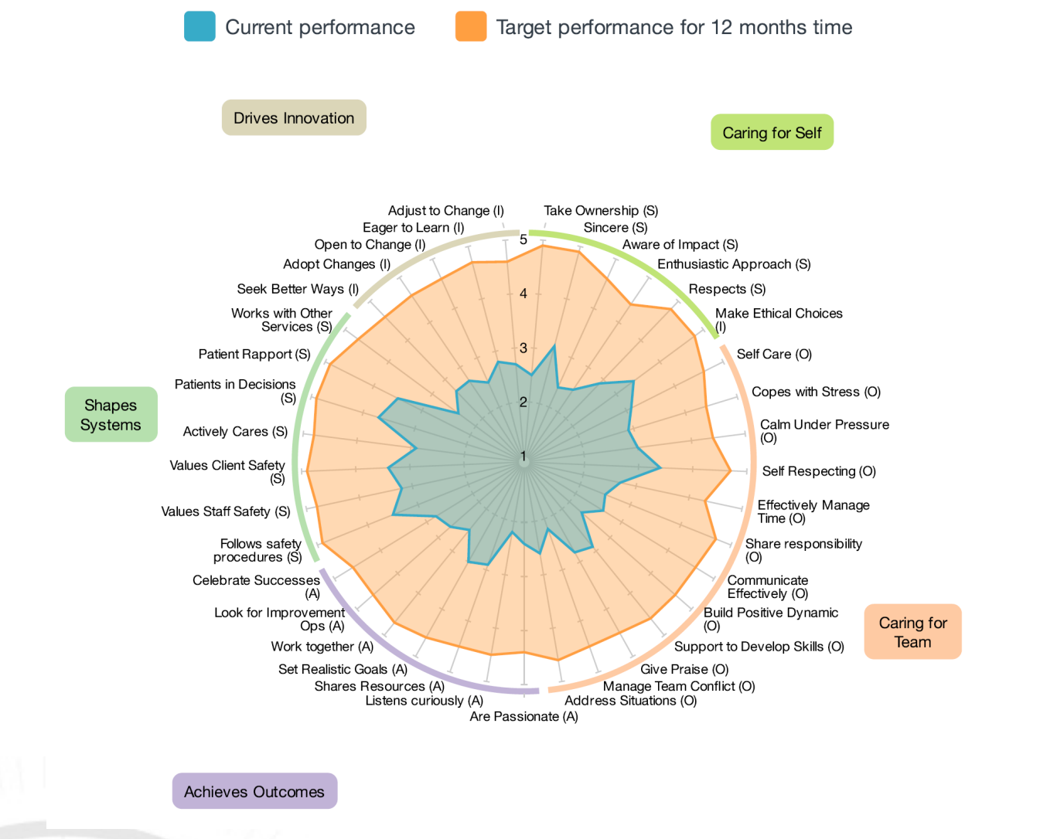
What it looks like
Staff Capability
Shows combined feedback of leaders, staff and customers
Compare current performance to desired performance

Slide 15
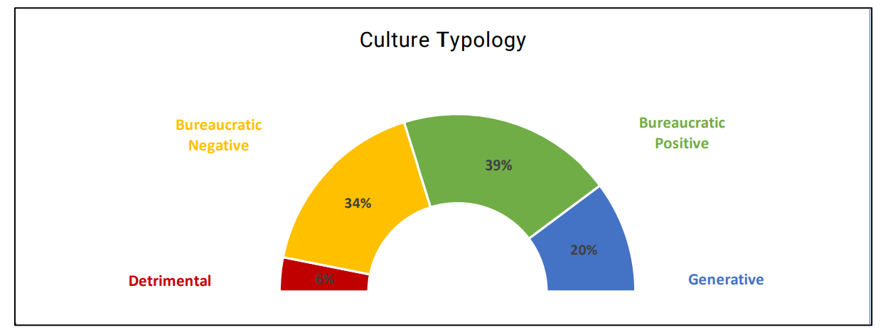
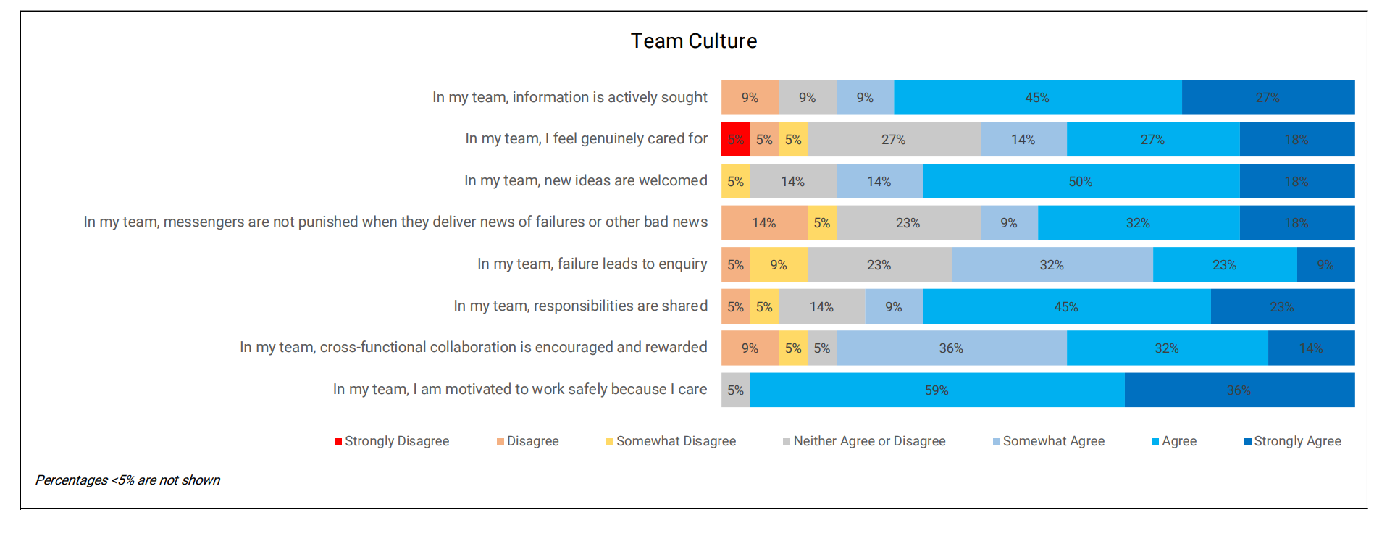
What it looks like
Culture

Slide 16
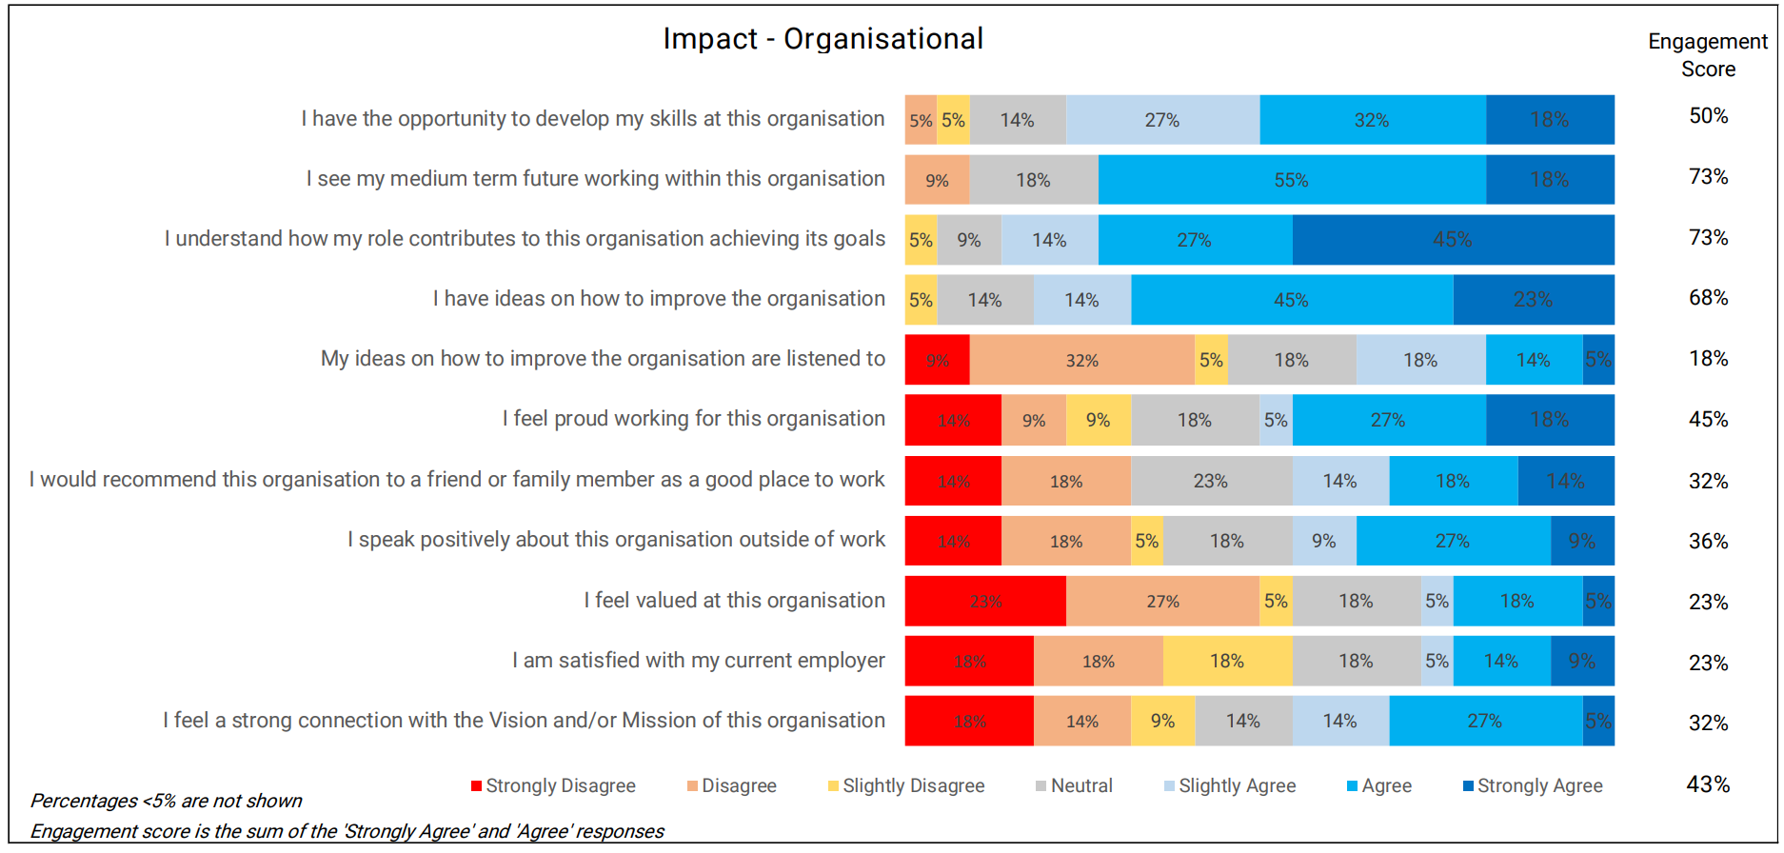
What it looks like
Engagement
Example only

Slide 17
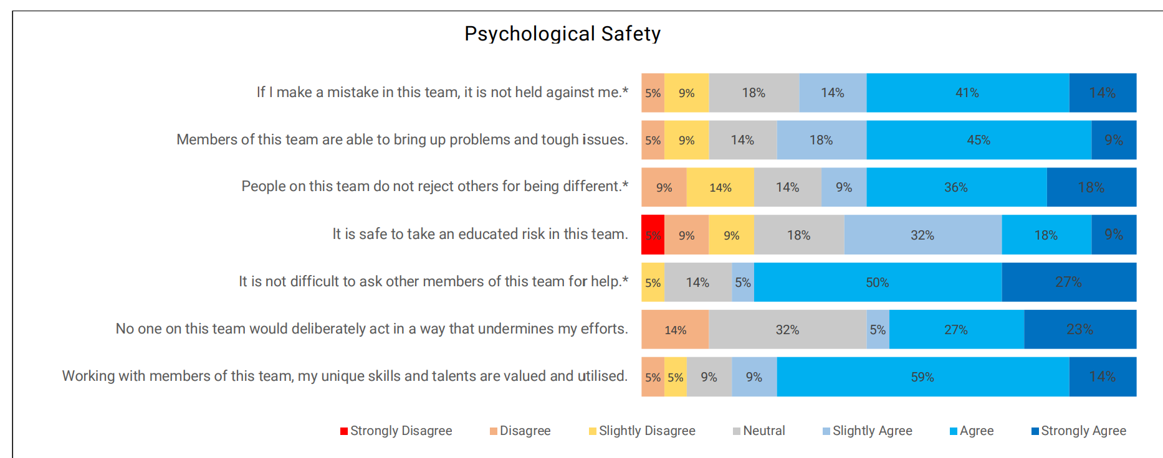
What it looks like
Psychological Safety
Example only

