Slide 1



COMPANY LOGO
The PSI Experience
Preparing Your Team
Psychological Safety Indicator powered by

Slide 2
PSI EXPERIENCE
OUR PURPOSE TODAY
01
04
What happens after the survey closes?
Introduce you to us
02
Introduce you to the
PSI indicator
05
Answer any questions about the project / process
03
Get you prepared to launch your PSI project

Slide 3

About Us
Add a little info about you
What are your values.

Slide 4

Psychological Safety & Inclusiveness
Inclusiveness is a sense that a persons diversity be it gender, cultural background, thoughts etc are accepted and encouraged by their team mates. A sense that it is safe to be me and what I offer.
Defined
Psychological Safety is the degree to which members of a team feel that it is safe enough to take interpersonal risks such as raising concerns, asking questions, offering ideas, giving feedback and accepting feedback.

Slide 5

Benefits
Significant lift in innovation + creative problem solving
When people feel psychologically safe and included…
Team productivity
Engagement and overall job satisfaction
Learning behaviours and growth of team members
Organisational loyalty and retention
Attraction of the best talent – ‘a talent magnet’

Slide 6

A ‘normal team’ has low psychological safety and instead
prefers superficial harmony.
But here’s the kicker…

Slide 7

GALLOP RESEARCH HAS CONSISTENTLY FOUND THAT PSYCHOLOGICAL SAFETY IS ‘MISSING’ IN THE AVERAGE TEAM
3/10
6/10
Average teams score about 3/10 on psychological safety.
Gallop states that organisations would reap truly incredible benefits if they could raise this
to 6/10.
They state a 27% reduction in turnover, a 40% reduction in safety incidents and a massive 12% increase in productivity.
Is a 6/10 acceptable for your team?

Slide 8
REFLECTION
Reflect on a recent experience when you had a concern, idea, improvement suggestion or important feedback yet bit your tongue?
No one else has known you’ve done this, but little do you know everyone else has done the same as you.
What impact does this ‘normal’ situation have on your work/life experience?

Slide 9
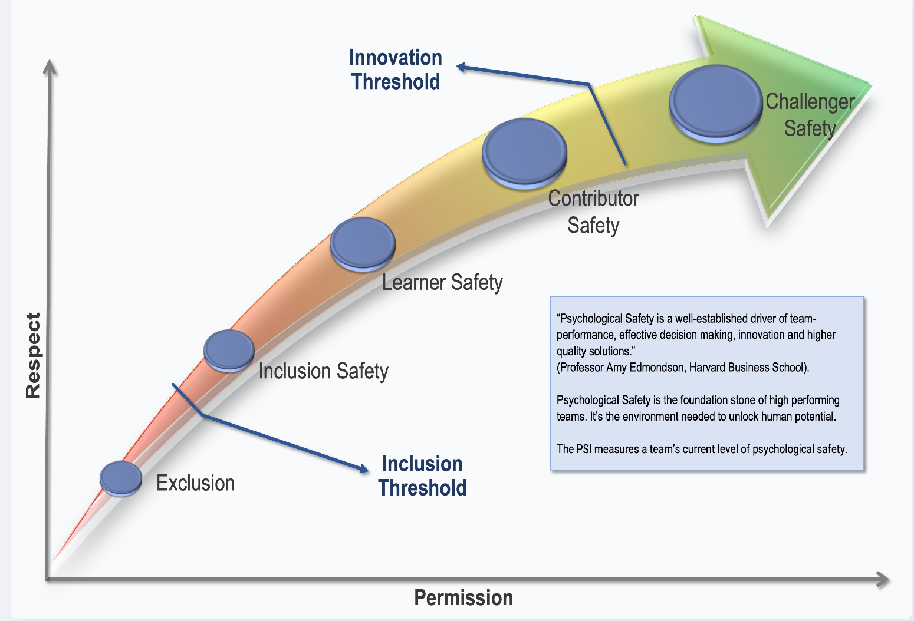
WHY PSI?
Elevate performance and innovation and reduce risk through safe, inclusive teams.
“
Psychological Safety is a well-established driver of team-performance, effective decision making, innovation and higher quality solutions.
Professor Amy Edmondson
Harvard Business School
“
Notes:
‘The belief that you can speak up without the risk of punishment or humiliation’
‘It’s the shared belief that the work team offers a safe environment for interpersonal risks and information sharing’.
Psychological safety is a condition in which you feel (1) included, (2) safe to learn, (3) safe to contribute, and (4) safe to challenge the status quo— all without fear of being embarrassed, marginalised, or punished in some way.
It is a function of both respect and permission.
‍Respect: The general level of regard and esteem we give each other. To respect someone is to value and appreciate them.
Permission: How we allow others to both influence us and participate in what we’re doing. Permission requires both autonomy and accountability.

Slide 10
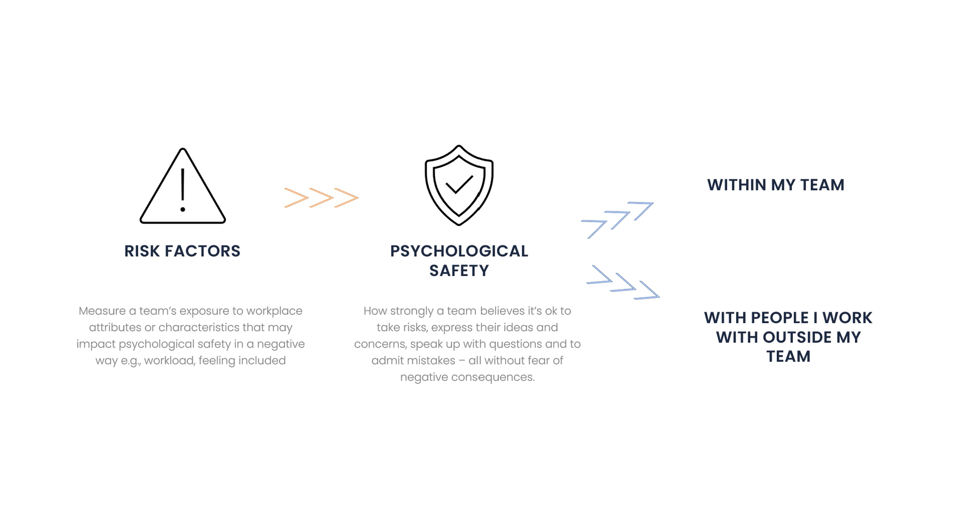
Psychological Safety & Inclusivity Indicator
Image of sash’s video on what it measures
What it measures
Hear from one of the founders of the PSI Indicator Program on what PSI measures.
PSI: Psychological Safety & Inclusivity Indicator - YouTube

Slide 11


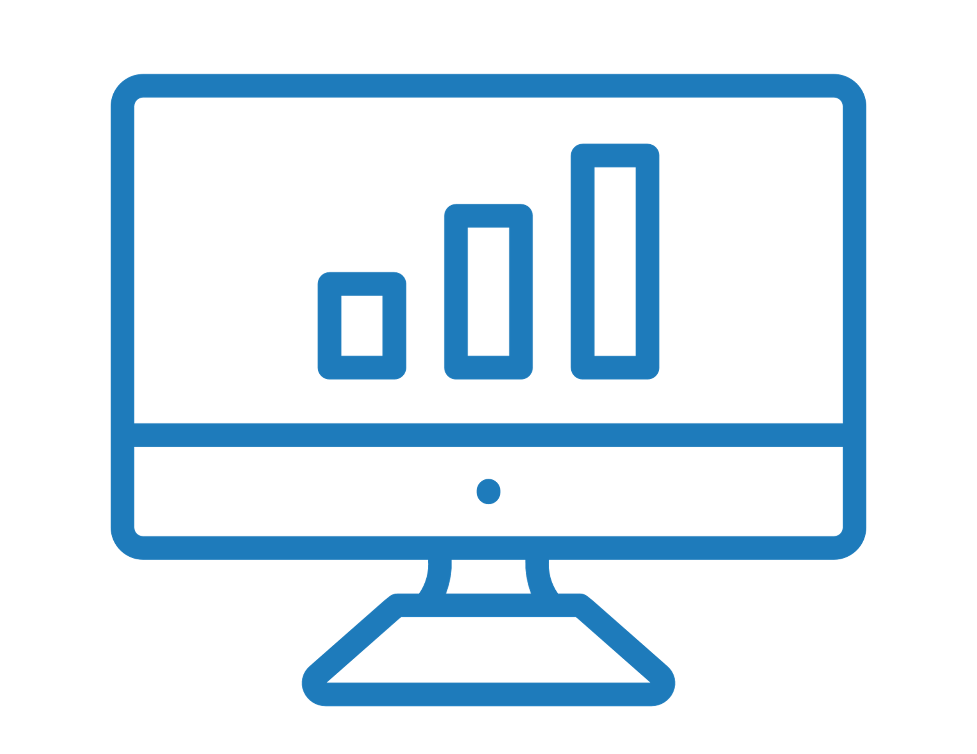

HOW IT WORKS
1. PSI LAUNCHES
2. SURVEY OPENS
3. REPORTS DELIVERED
4. Optimise
PSI will launch on XX. You will receive a link to the survey requesting you to give feedback.
The survey is open for 24 hours, closing on xx
Reports are generated by Data Drives Insight. All answers are confidential.
Your team will be provided with the results so you can action plan together.
The invitation email will be from assessments@datadrivesinsight.com
Assessments can be completed on any device and only takes around 4 minutes
Notes:
Chose this slide or the next depending on which option is selected

Slide 12
HOW IT WORKS
1. DOWNLOAD
2. COMPLETE
3. REVIEW
4. OPTIMISE
Download the DDI.com app through Google / Apple
Notification to complete the survey through your App, with 24 hours to complete
Reports are generated within 24 hours and found in the ‘My Dashboards’ tab of your app.
Your team will receive coaching notifications and activities to work on the two lowest areas indicated on the PSI [1 per week]
You will be reminded to complete the survey every month to assess improvements in PSI.

Slide 13
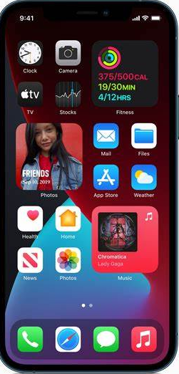
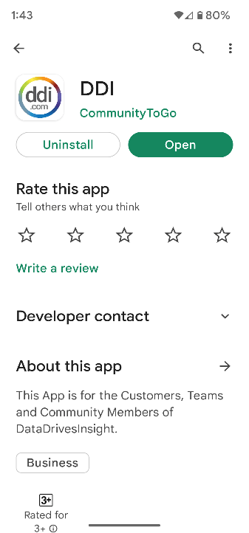
HOW TO DOWNLOAD THE APP
STEP 1
Download the FREE DDI app available for Apple and Android devices. Visit the iTunes App Store or Google Play to download or click below:
https://apps.apple.com/au/app/ddi/id6443887096
https://play.google.com/store/apps/details?id=com.communitytogo.ddi

Slide 14
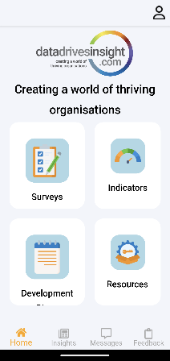
STEP 2
Enable notifications for the DDI App in your phone’s settings to ensure you receive notice when the PSI Survey is available to complete.
STEP 3
Accept invitation from Microsoft Invitations on behalf of Data Drives Insight Pty Ltd to create your user profile and respond to the survey. This is sent to your email.
Once you have accepted you can create a username with your organisation or personal email address.
Setting up your DDI Mobile APP

Slide 15

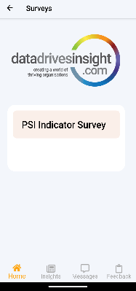
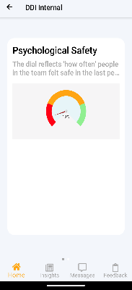
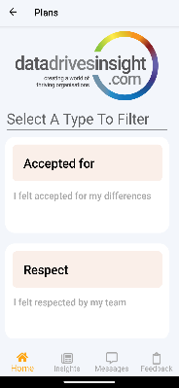
Connect with results in the customized interactive microlearning space
Survey Button: Respond to the PSI– PSI Indicator Survey
View & Understand
results

Slide 16
  Every survey can be completed using your PC, laptop, tablet or phone. All you need is access to the internet.
Completing the Survey
  It takes approx. 4 minutes to complete the survey. And is completely confidential and anonymous. Results will be displayed as team results; not individually.
  Be as honest as possible so the results are valuable to you and the team. This is designed for the teams development going forward.

Slide 17
ANY QUESTIONS?
Throughout the assessment process, ask us anything!

