Slide 1



COMPANY LOGO
The PSI Experience
Preparing Your Team
Psychological Safety Indicator powered by

Slide 2
PSI EXPERIENCE
OUR PURPOSE TODAY
01
04
What happens after the survey closes?
Introduce you to Veraison
02
Introduce you to the
PSI indicator
05
Answer any questions about the project / process
03
Get you prepared to launch your PSI project

Slide 3

About Us
Veraison is a Western Australian owned and operated premium corporate psychology provider that is passionate about assisting both individuals and organisations to reach their full potential
We value genuine partnerships, self-mastery, fun and sustainable results.

Slide 4

Psychological Safety & Inclusiveness
Inclusiveness is a sense that a persons diversity be it gender, cultural background, thoughts etc are accepted and encouraged by their team mates. A sense that it is safe to be me and what I offer.
Defined
Psychological Safety is the degree to which members of a team feel that it is safe enough to take interpersonal risks such as raising concerns, asking questions, offering ideas, giving feedback and accepting feedback.

Slide 5

Benefits
Significant lift in innovation + creative problem solving
When people feel psychologically safe and included…
Team productivity
Engagement and overall job satisfaction
Learning behaviours and growth of team members
Organisational loyalty and retention
Attraction of the best talent – ‘a talent magnet’

Slide 6

A ‘normal team’ has low psychological safety and instead
prefers superficial harmony.
But here’s the kicker…

Slide 7

GALLOP RESEARCH HAS CONSISTENTLY FOUND THAT PSYCHOLOGICAL SAFETY IS ‘MISSING’ IN THE AVERAGE TEAM
3/10
6/10
Average teams score about 3/10 on psychological safety.
Gallop states that organisations would reap truly incredible benefits if they could raise this
to 6/10.
They state a 27% reduction in turnover, a 40% reduction in safety incidents and a massive 12% increase in productivity.
Is a 6/10 acceptable for your team?

Slide 8
REFLECTION
Reflect on a recent experience when you had a concern, idea, improvement suggestion or important feedback yet bit your tongue?
No one else has known you’ve done this, but little do you know everyone else has done the same as you.
What impact does this ‘normal’ situation have on your work/life experience?

Slide 9
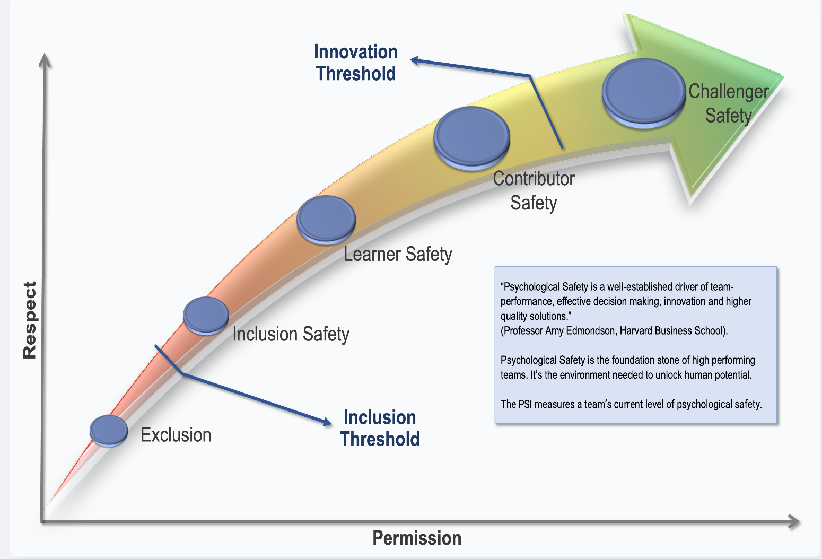
WHY PSI?
Elevate performance and innovation and reduce risk through safe, inclusive teams.
“
Psychological Safety is a well-established driver of team-performance, effective decision making, innovation and higher quality solutions.
Professor Amy Edmondson
Harvard Business School
“
Notes:
‘The belief that you can speak up without the risk of punishment or humiliation’
‘It’s the shared belief that the work team offers a safe environment for interpersonal risks and information sharing’.
Psychological safety is a condition in which you feel (1) included, (2) safe to learn, (3) safe to contribute, and (4) safe to challenge the status quo— all without fear of being embarrassed, marginalised, or punished in some way.

Slide 10
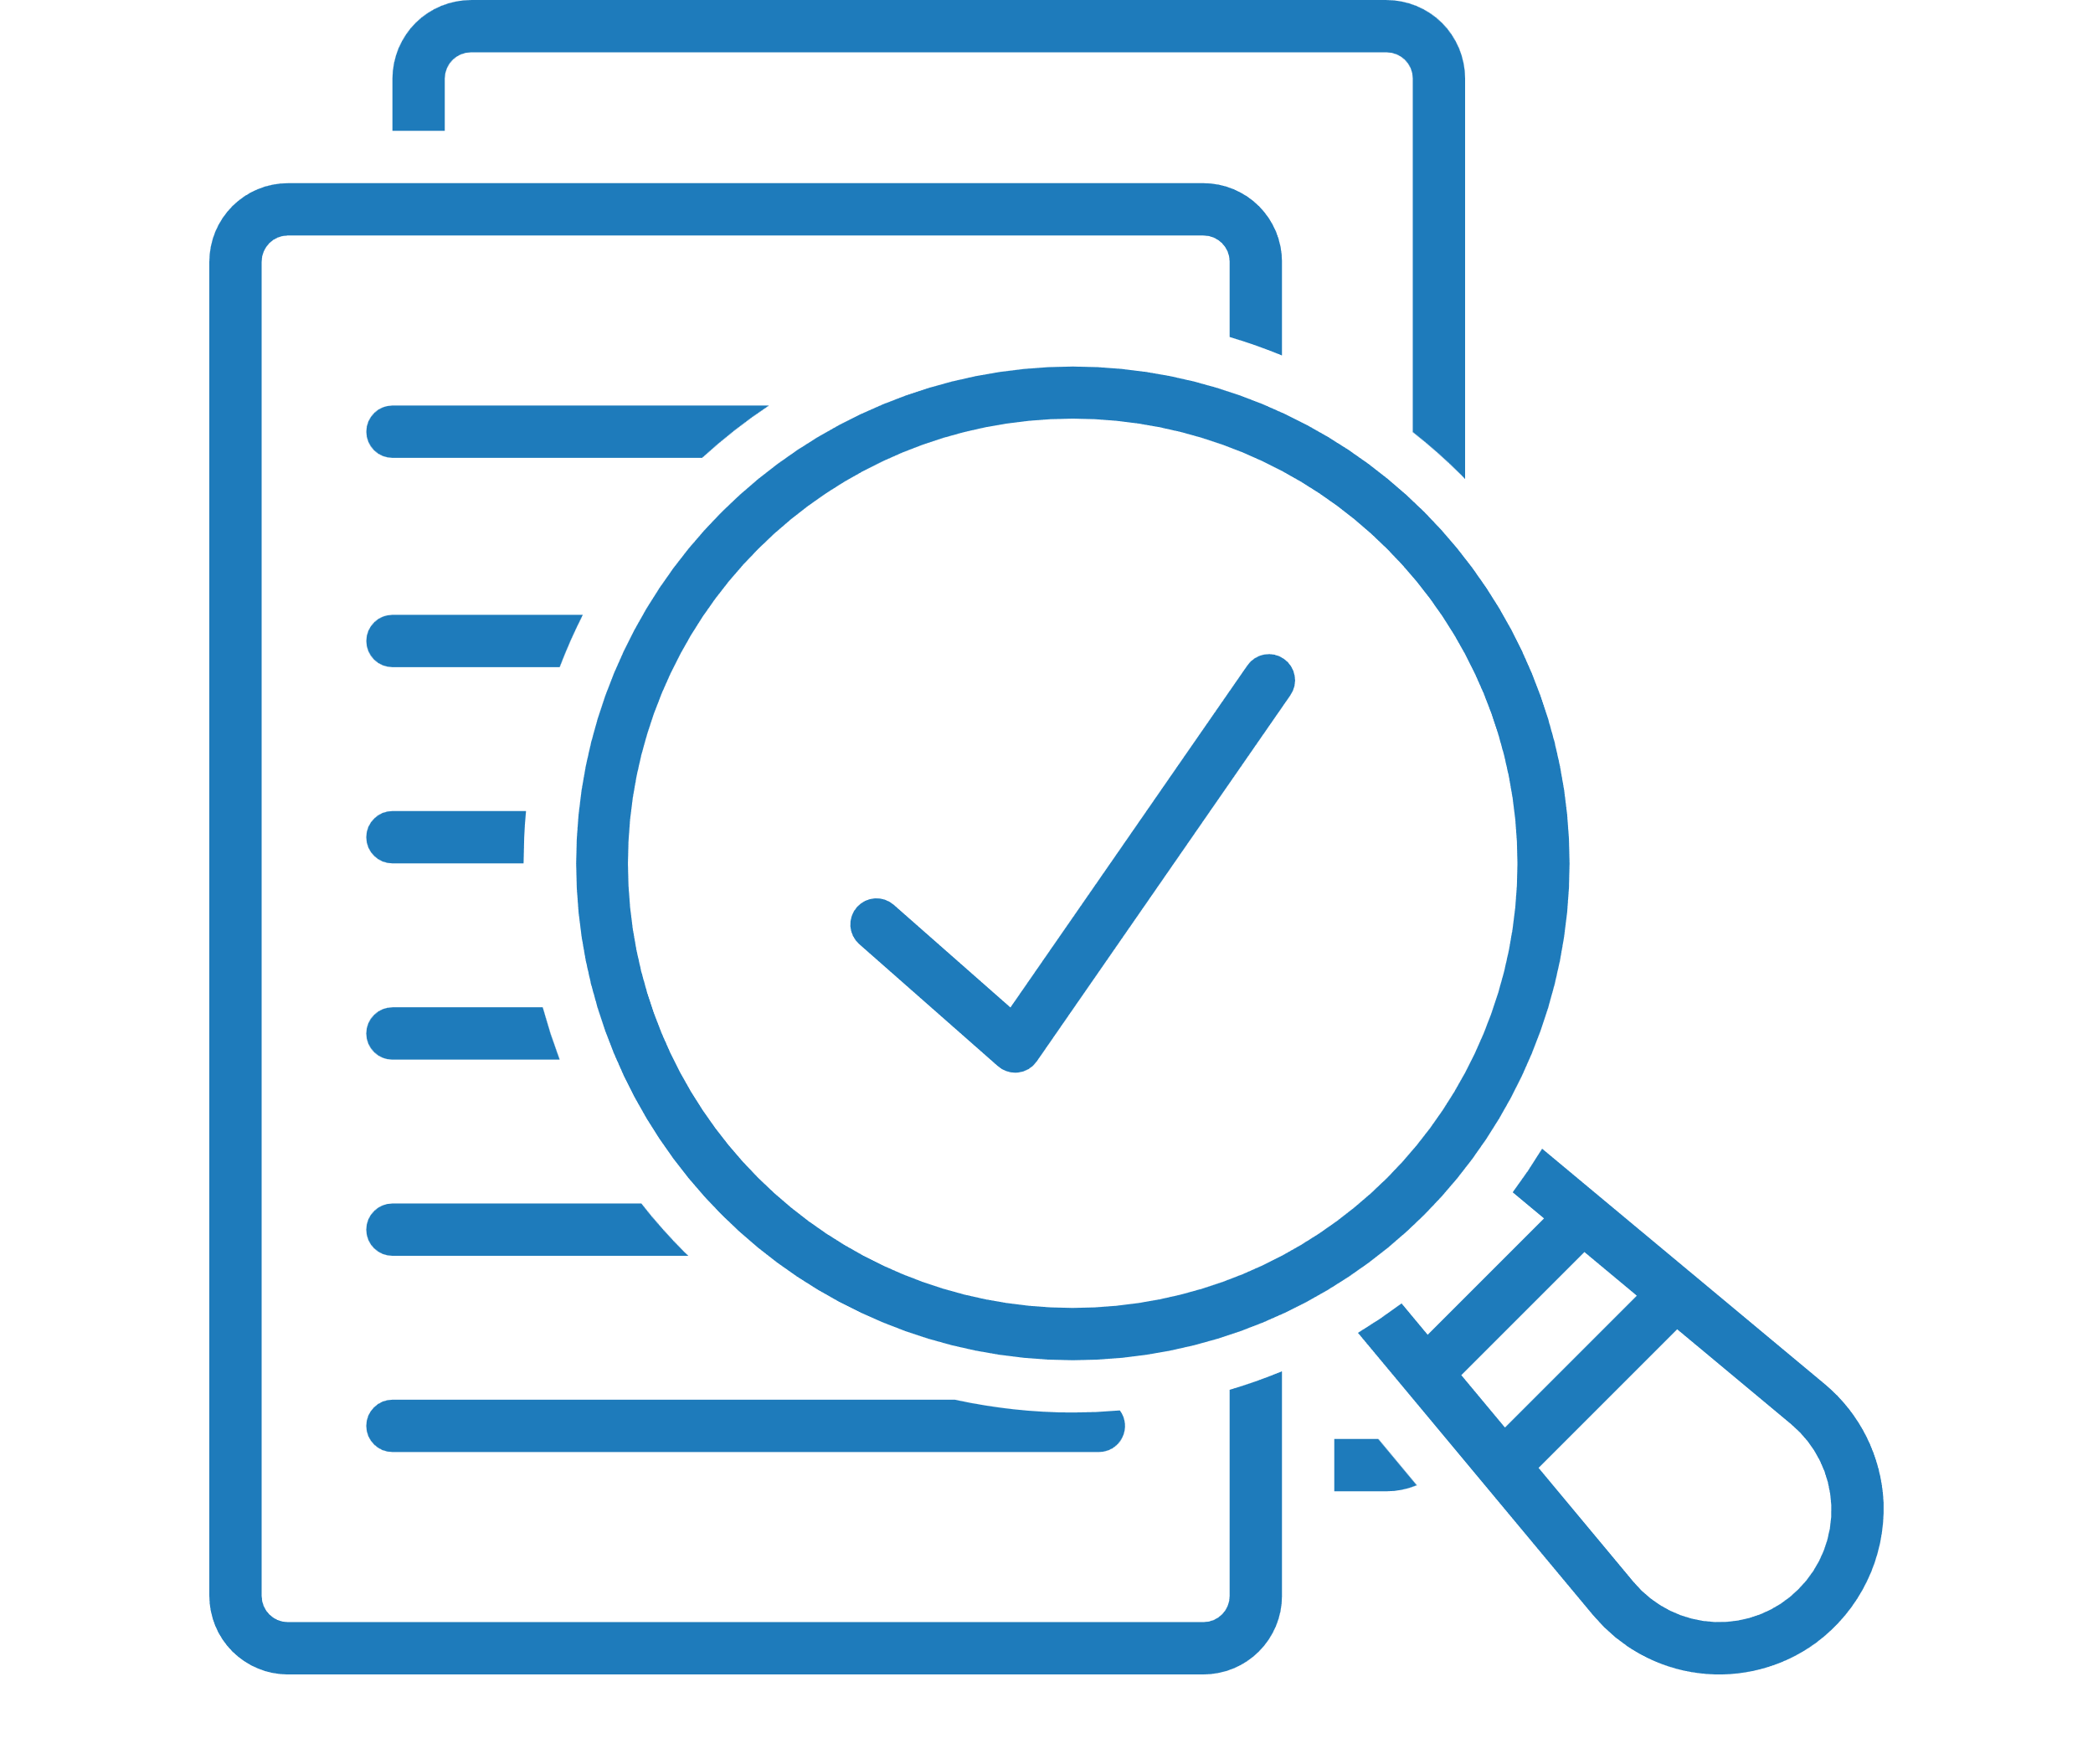

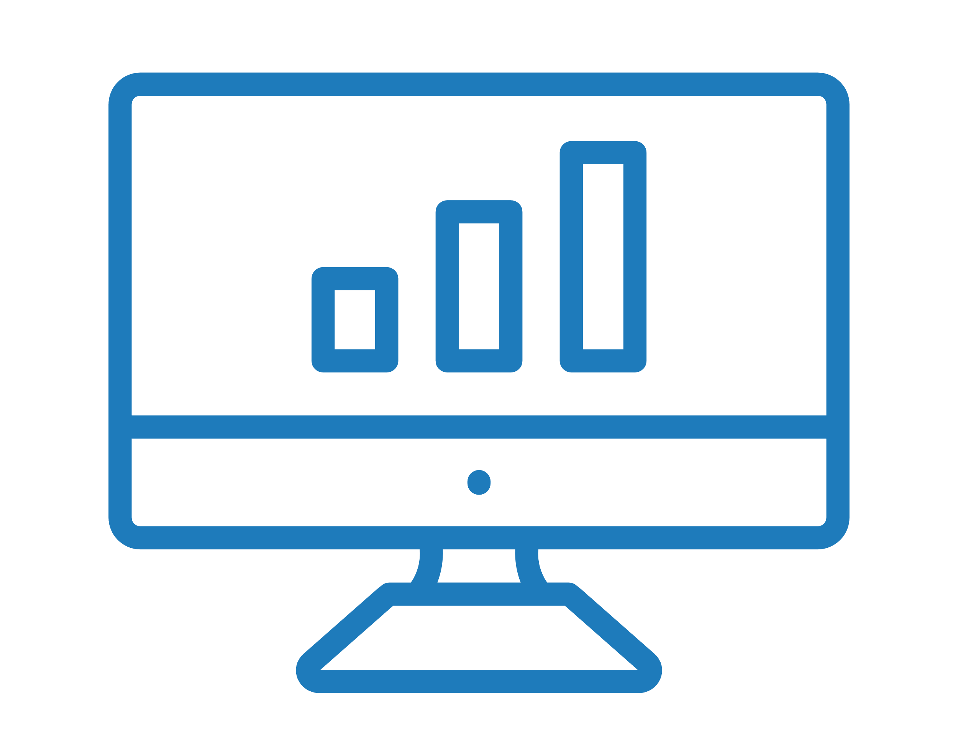

HOW IT WORKS
1. PSI LAUNCHES
2. SURVEY OPENS
3. REPORTS DELIVERED
4. PLANNING STARTS
PSI will launch on XX. You will receive a link to the survey via email requesting you to give feedback.
The survey is open for 24 hours, closing on xx
Reports are generated by Data Drives Insight. All answers are confidential.
Your team will be provided with the results so you can action plan together.
The invitation email will be from assessments@datadrivesinsight.com
Assessments can be completed on any device and only takes around 4 minutes

Slide 11
Follow the link in your email to complete the survey
  Every survey can be completed using your PC, laptop, tablet or phone. All you need is access to the internet.
Completing the Survey
  It takes approx. 4 minutes to complete the survey. And is completely confidential and anonymous. Results will be displayed as team results; not individually.
  Be as honest as possible so the results are valuable to you and the team. This is designed for the teams development going forward.

Slide 12
ANY QUESTIONS?
Throughout the assessment process, ask us anything!

Slide 13
ADDITIONAL FUNCTIONS

Slide 14
HOW IT WORKS
1. DOWNLOAD
2. COMPLETE
3. REVIEW
4. OPTIMISE
Download the DDI.com app through Google / Apple
Notification to complete the survey through your App, with 24 hours to complete
Reports are generated within 24 hours and found in the ‘My Dashboards’ tab of your app.
Your team will receive coaching notifications and activities to work on the two lowest areas indicated on the PSI [1 per week]
You will be reminded to complete the survey every month to assess improvements in PSI.

Slide 15
HOW TO DOWNLOAD THE APP
Content piece one
Content piece two
Content piece three
Content piece four
Content piece five

Slide 16
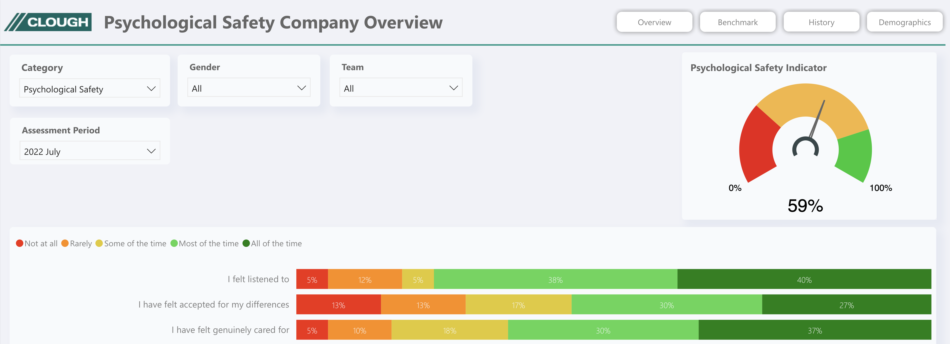

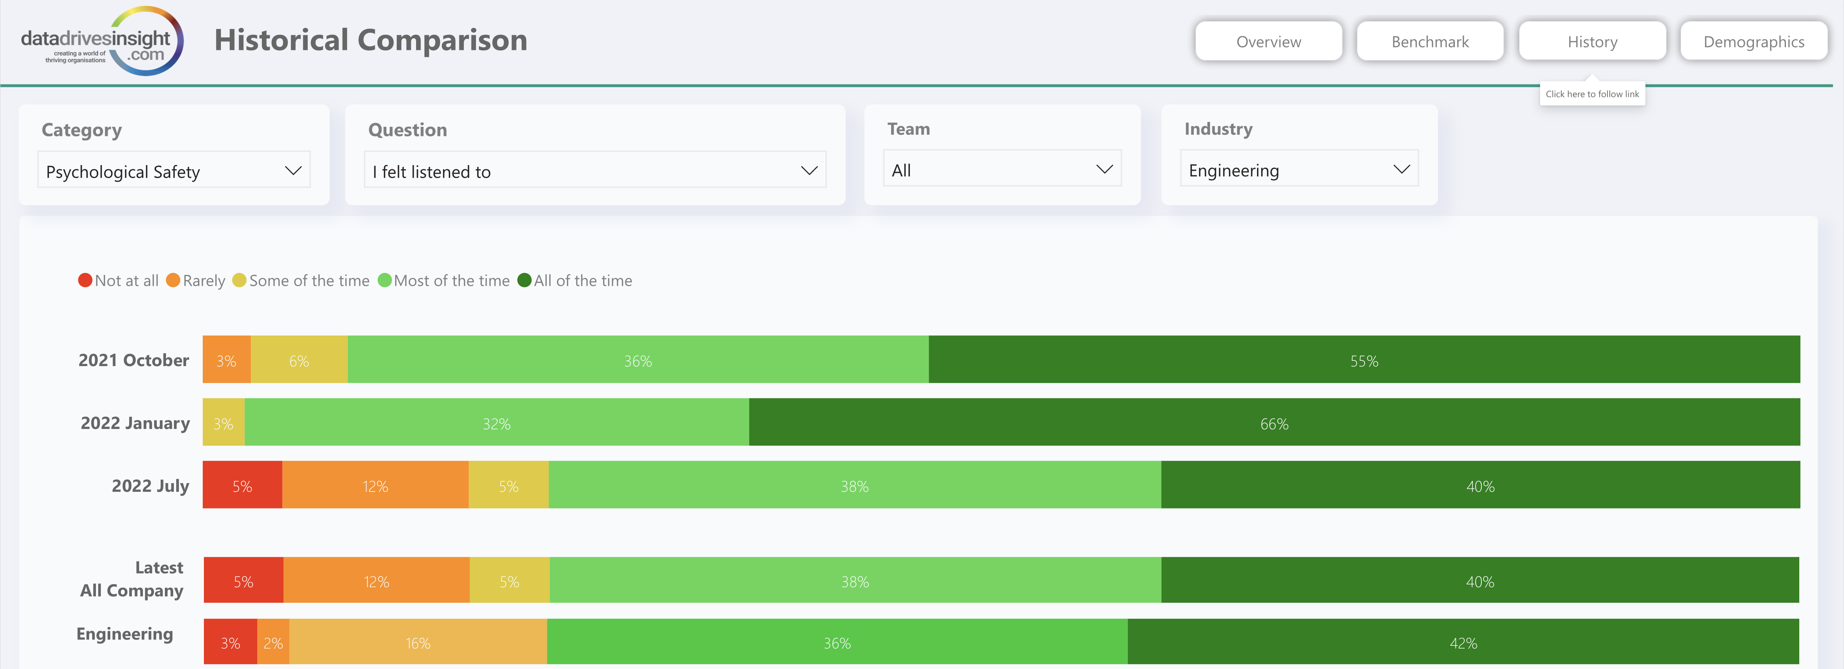

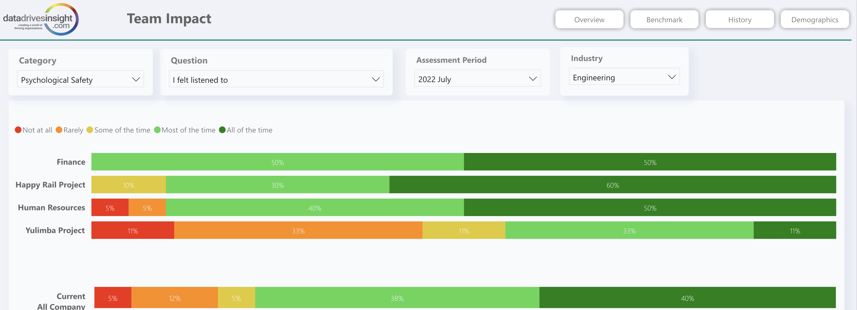
Bringing It
To Life
Company Overview
PSI can be implemented at a company-wide level, Executive level, or broken down into small teams
Benchmarking can be done from team-team, team-organisation or team-industry
Builds an evidence base that helps inform business and workplace strategy
Informs training and development budgets and allocation of spend between technical and people competencies
Benchmarking
Impact Mapping

