Slide 1


Transform your greatest asset.
Elevating productivity and
reducing risk through safe,
inclusive teams.
PSI
Psychological Safety Indicator
COMPANY LOGO
Notes:
The intention of this pack is to support:
Education of participants on Psychological Safety and Inclusion
Help create the environment for sharing and reflecting on the results
Help action planning and getting clear on next steps
Quick points
It is provided as a guide and it is ok for coaches to adjust as best fits their approach.
This pack was designed to be used with leadership groups but can also be adjusted/tweaked to support team/employee based debriefs.
It is a companion to the dashboard – you may chose to se the dashboard in its interactive/live state AND/OR take snipping/screen shots and include in here.
Different slides are included as ideas and additional slides are included at the end – please select or delete as best fits your need.

Slide 2

PSI EXPERIENCE
OUR PURPOSE TODAY
01
04
Make commitments and plans to create a shift
Let’s talk Psychological Safety & Inclusion
02
Share and reflect on your teams feedback
05
Answer any questions and provide support
03
Connect with what this means practically for your teams

Slide 3



UNDERSTANDING THE CHALLENGES
IMPACTING YOUR INDUSTRY
GLOBAL EMPLOYEE ENGAGEMENT
REGRETTABLE TURNOVER
DIVERSITY & INCLUSION
Only 15% of the global workforce is actively engaged costing $500B USD pa
One-third of new employees quit after 6 months
If treated as a compliance measure, the benefits are lost
Disengagement, regrettable turnover and lack of true diversity & inclusion costs the economy billions of dollars per annum – What are you doing about it?
Notes:
Edit/change the three key challenges for the client/industry you are speaking to

Slide 4

Psychological Safety & Inclusiveness
Inclusiveness is a sense that a persons diversity be it gender, cultural background, thoughts etc are accepted and encouraged by their team mates. A sense that it is safe to be me and what I offer.
Defined
Psychological Safety is the degree to which members of a team feel that it is safe enough to take interpersonal risks such as raising concerns, asking questions, offering ideas, giving feedback and accepting feedback.

Slide 5

PSYCHOLOGICAL SAFETY
In considering the dynamics of effective teams, Google’s researchers conducted a five-year study that found that what really mattered was less about who is on the team, and more about how the team worked together.
The lead researcher said that ‘psychological safety was far and away the most important of the five dynamics we found.’ It is the factor that underpins all others.
Building a diverse and inclusive workplace
Psychological safety can make or break the achievement of team performance in diverse teams
There is a direct correlation between psychological safety, predicted worker engagement and return on assets.
In short, process innovation can be a good way to boost performance, but a psychologically safe environment helps the investment pay off.

Slide 6

Benefits
Significant lift in innovation + creative problem solving
When people feel psychologically safe and included…
Team productivity
Engagement and overall job satisfaction
Learning behaviours and growth of team members
Organisational loyalty and retention
Attraction of the best talent – ‘a talent magnet’

Slide 7

A ‘normal team’ has low psychological safety and instead
prefers superficial harmony.
But here’s the kicker…
Notes:
Some notes from Amy Edmundson – needs to be worded better
People constantly manage interpersonal risk at work, consciously or not, inhibiting the open sharing of ideas, questions and concerns.
People (we) regularly chose to stay safe NOW (immediate benefit) rather than speak up now (immediate risk) and therefore the future benefit is lost.
Psychological Safety is NOT the normal state within teams. Instead, most teams settle for “Superficial Harmony”. This is because human beings are hard wired to “avoid interpersonal risk taking” that could lead to rejection, humiliation or conflict.
Professor Amy Edmondson cites the calculus calculator as one cause for this phenomenon, which in effect “discounts the future” because of a bias towards inaction. It’s primarily about managing “self-image”.
For example;

Slide 8

GALLOP RESEARCH HAS CONSISTENTLY FOUND THAT PSYCHOLOGICAL SAFETY IS ‘MISSING’ IN THE AVERAGE TEAM
3/10
6/10
Average teams score about 3/10 on psychological safety.
Gallop states that organisations would reap truly incredible benefits if they could raise this
to 6/10.
They state a 27% reduction in turnover, a 40% reduction in safety incidents and a massive 12% increase in productivity.
Is a 6/10 acceptable for your team?

Slide 9
REFLECTION
Reflect on a recent experience when you had a concern, idea, improvement suggestion or important feedback yet bit your tongue?
No one else has known you’ve done this, but little do you know everyone else has done the same as you.
What impact does this ‘normal’ situation have on your work/life experience?
Notes:
The intention of this slide is to help them connect with the results on a personal/lived experience way – take them from being about someone else to being about us/me.

Slide 10
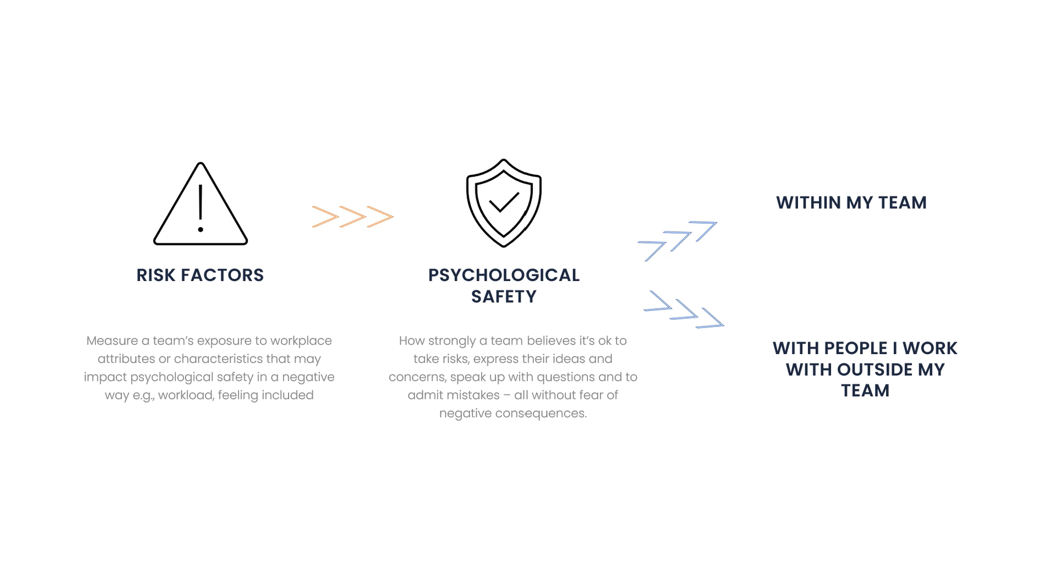
Psychological Safety & Inclusivity Indicator
Image of sash’s video on what it measures
What it measures
Hear from one of the founders of the PSI Indicator Program on what PSI measures.
PSI: Psychological Safety & Inclusivity Indicator - YouTube

Slide 11
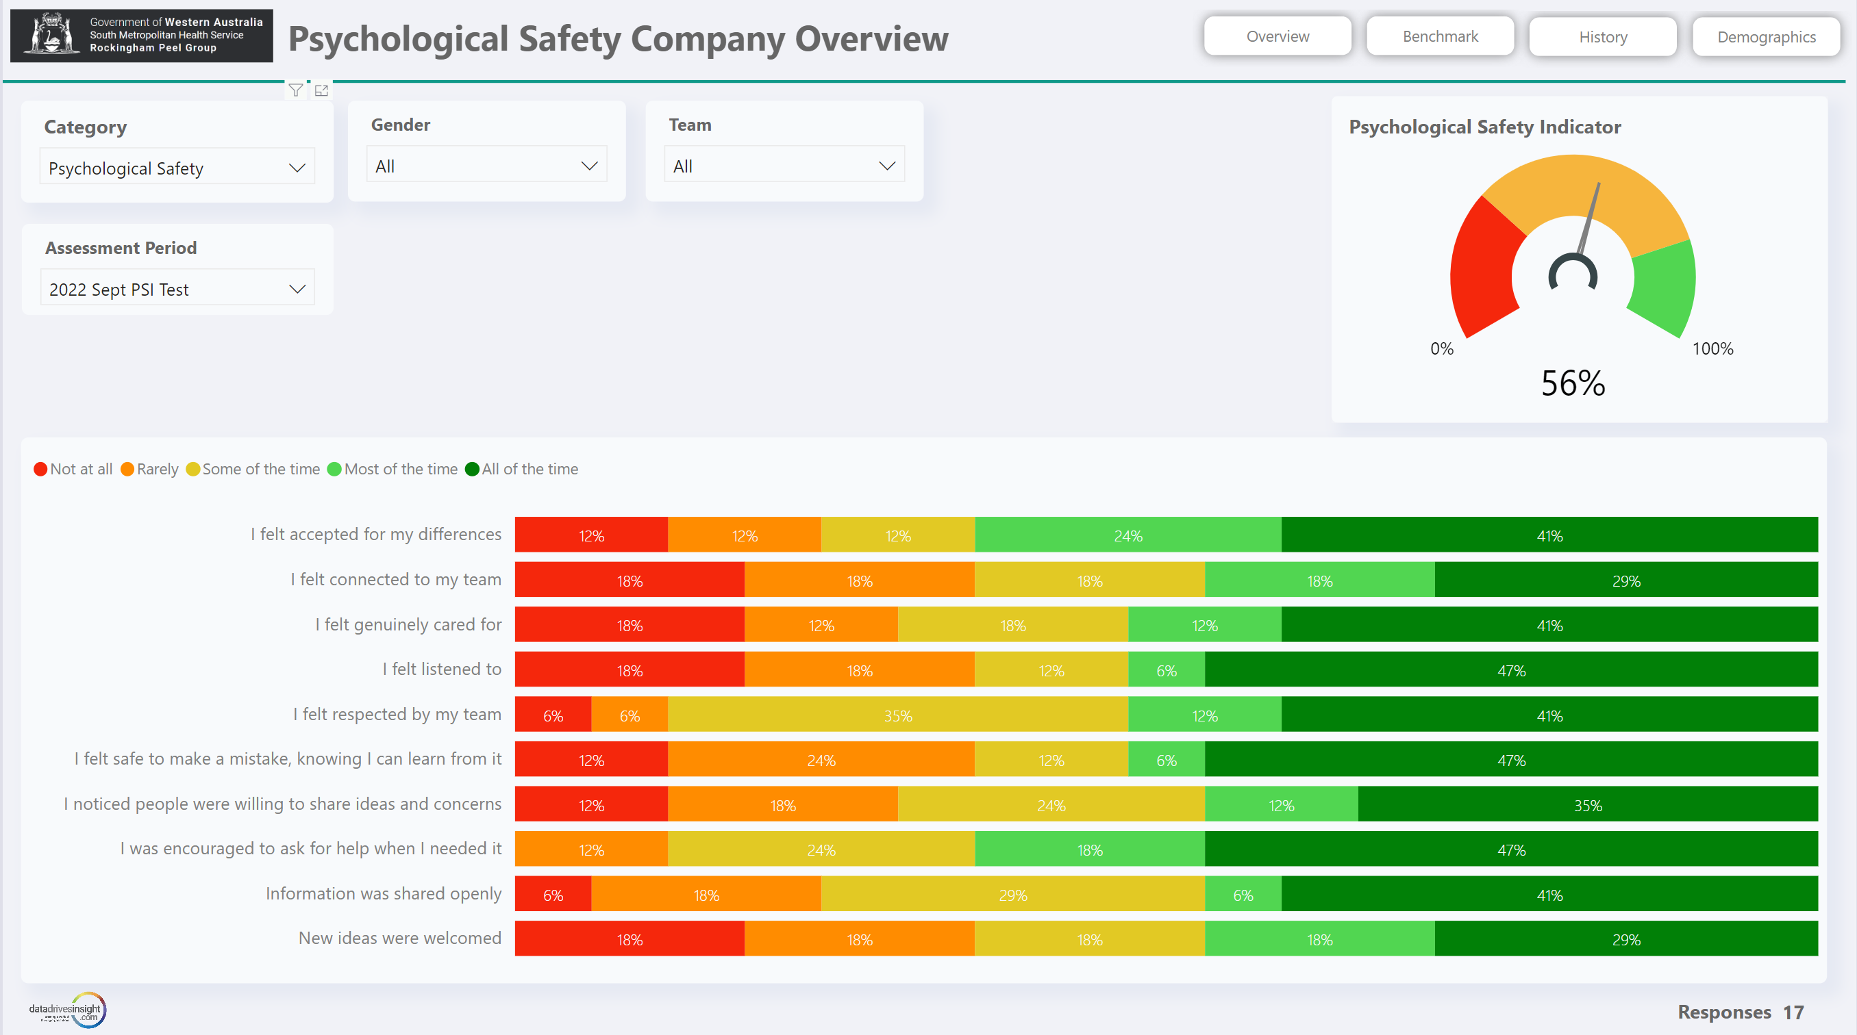
What is the feedback from the teams?
Dashboard
Add Company LOGO
Add screenshot of relevant dashboard
Psychological safety can have significant impacts on the wellbeing of your workforce and are some of the most expensive and time-consuming workplace injuries.
Notes:
You can include as many screenshots and slides as you feel necessary for your debrief with the audience.
Showing both the risk factors and the psych safety results is useful.

Slide 12
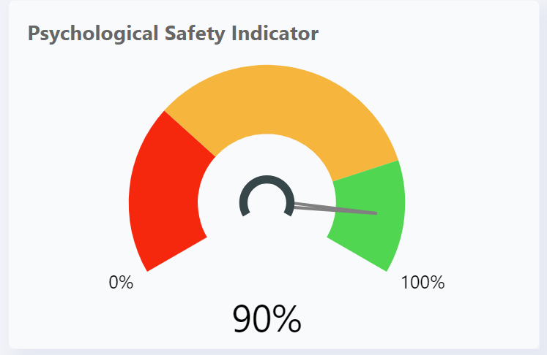
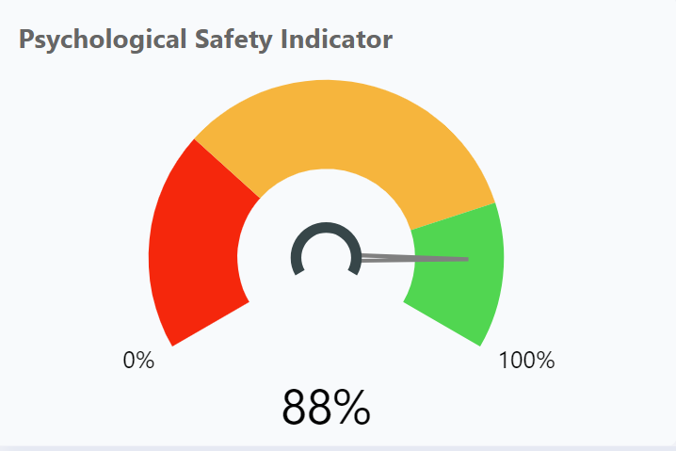
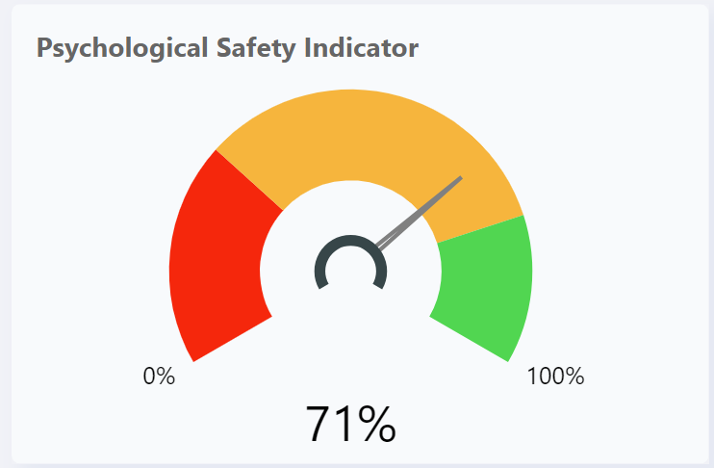

What is the feedback from the teams?
Dashboard – Psychological Safety
Add Company LOGO
When looking at the different teams
Add screenshot of relevant dashboard
Example Team A (n=5) | Example Team B (n=4) | Example Team C (n=8) | Example Team DA (n=8)
Top 2: Accepted for differences Encouraged to ask for help Low 2: Information openly shared Concerns taken seriously | Top 2: Encouraged to ask for help Listened to Low 2: Safe to make a mistake Safe to share ideas | Top 2: Information openly shared Ideas welcomed Low 2: Concerns taken seriously Encouraged to ask for help | Top 2: Accepted for differences Encouraged to ask for help Low 2: Information openly shared Concerns taken seriously
Notes:
This is one way to show multiple dials at once in a presentation

Slide 13
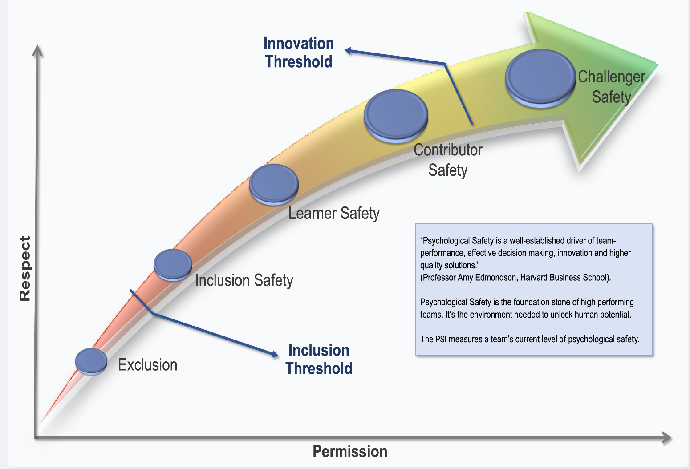
Levels of Psychological Safety
Elevate performance and innovation and reduce risk through safe, inclusive teams.
“
Psychological Safety is a well-established driver of team-performance, effective decision making, innovation and higher quality solutions.
Professor Amy Edmondson
Harvard Business School
“
Notes:
‘The belief that you can speak up without the risk of punishment or humiliation’
‘It’s the shared belief that the work team offers a safe environment for interpersonal risks and information sharing’.
Psychological safety is a condition in which you feel (1) included, (2) safe to learn, (3) safe to contribute, and (4) safe to challenge the status quo— all without fear of being embarrassed, marginalised, or punished in some way.
‍Psychological safety is a function of both respect and permission. One without the other creates a dangerous imbalance that hurts people in different ways. A serious deficiency in permission pushes a team into the gutter of paternalism, while a deficiency in respect can lead to exploitation.
‍Respect: The general level of regard and esteem we give each other. To respect someone is to value and appreciate them.
Permission: How we allow others to both influence us and participate in what we’re doing. Permission requires both autonomy and accountability.
Based on your results – where are you now…and what is the potential?
Psych safety….
It can and does shift quickly on the “downside” but requires more conscious and determined attention that is consistent over time to grow.
It’s the 9-1 rule. Out of 10 interactions, if 7 are handled in a manner consistent with creating a psychological safe environment, 2 are neutral and 1 is clearly not, the score board reads – 10.
This is because human beings are hard wired to over-represent fear-based experiences.
Local Level Leadership has a 70+% impact on a team’s level of psychological safety.

Slide 14



Key Themes – Psychological Safety
When looking at the feedback..
Edit to match the results for the team you are debriefing
Overall teams are feeling moderately safe and included (56%)
Team A team feedback was more positive
Team B Team have the most areas they wish to improve in
Untapped potential in those who responded ‘most of the time’ and ‘some of the time’
Felt accepted for my differences
Felt encouraged to ask for help when needed
Concern for those who responded “rarely’ or ‘not at all’
Listened to,
Connected,
New ideas welcomed
What stood out for you in the results?

Slide 15
Key Themes – Risk Factors
When looking at the feedback..
Edit to match the results for the team you are debriefing
Overall teams are feeling engaged (81%)
Team A feedback was more positive
Team B have the most areas they wish to improve in
Strengths in area where participants responded with ‘most of the time’ and ‘some of the time’
Trusted to do my job
Committed to teams plan
Understood what expected of me in my role
Felt fully included as a member of the team
Opportunity to grow where participants responded ‘rarely’ or ‘not at all’
  Felt secure about my position/role in team
  I was acknowledged or recognised for good
  I felt satisfied
  Encouraged to use skills and knowledge My workload was manageable
What stood out for you in the results?

Slide 16

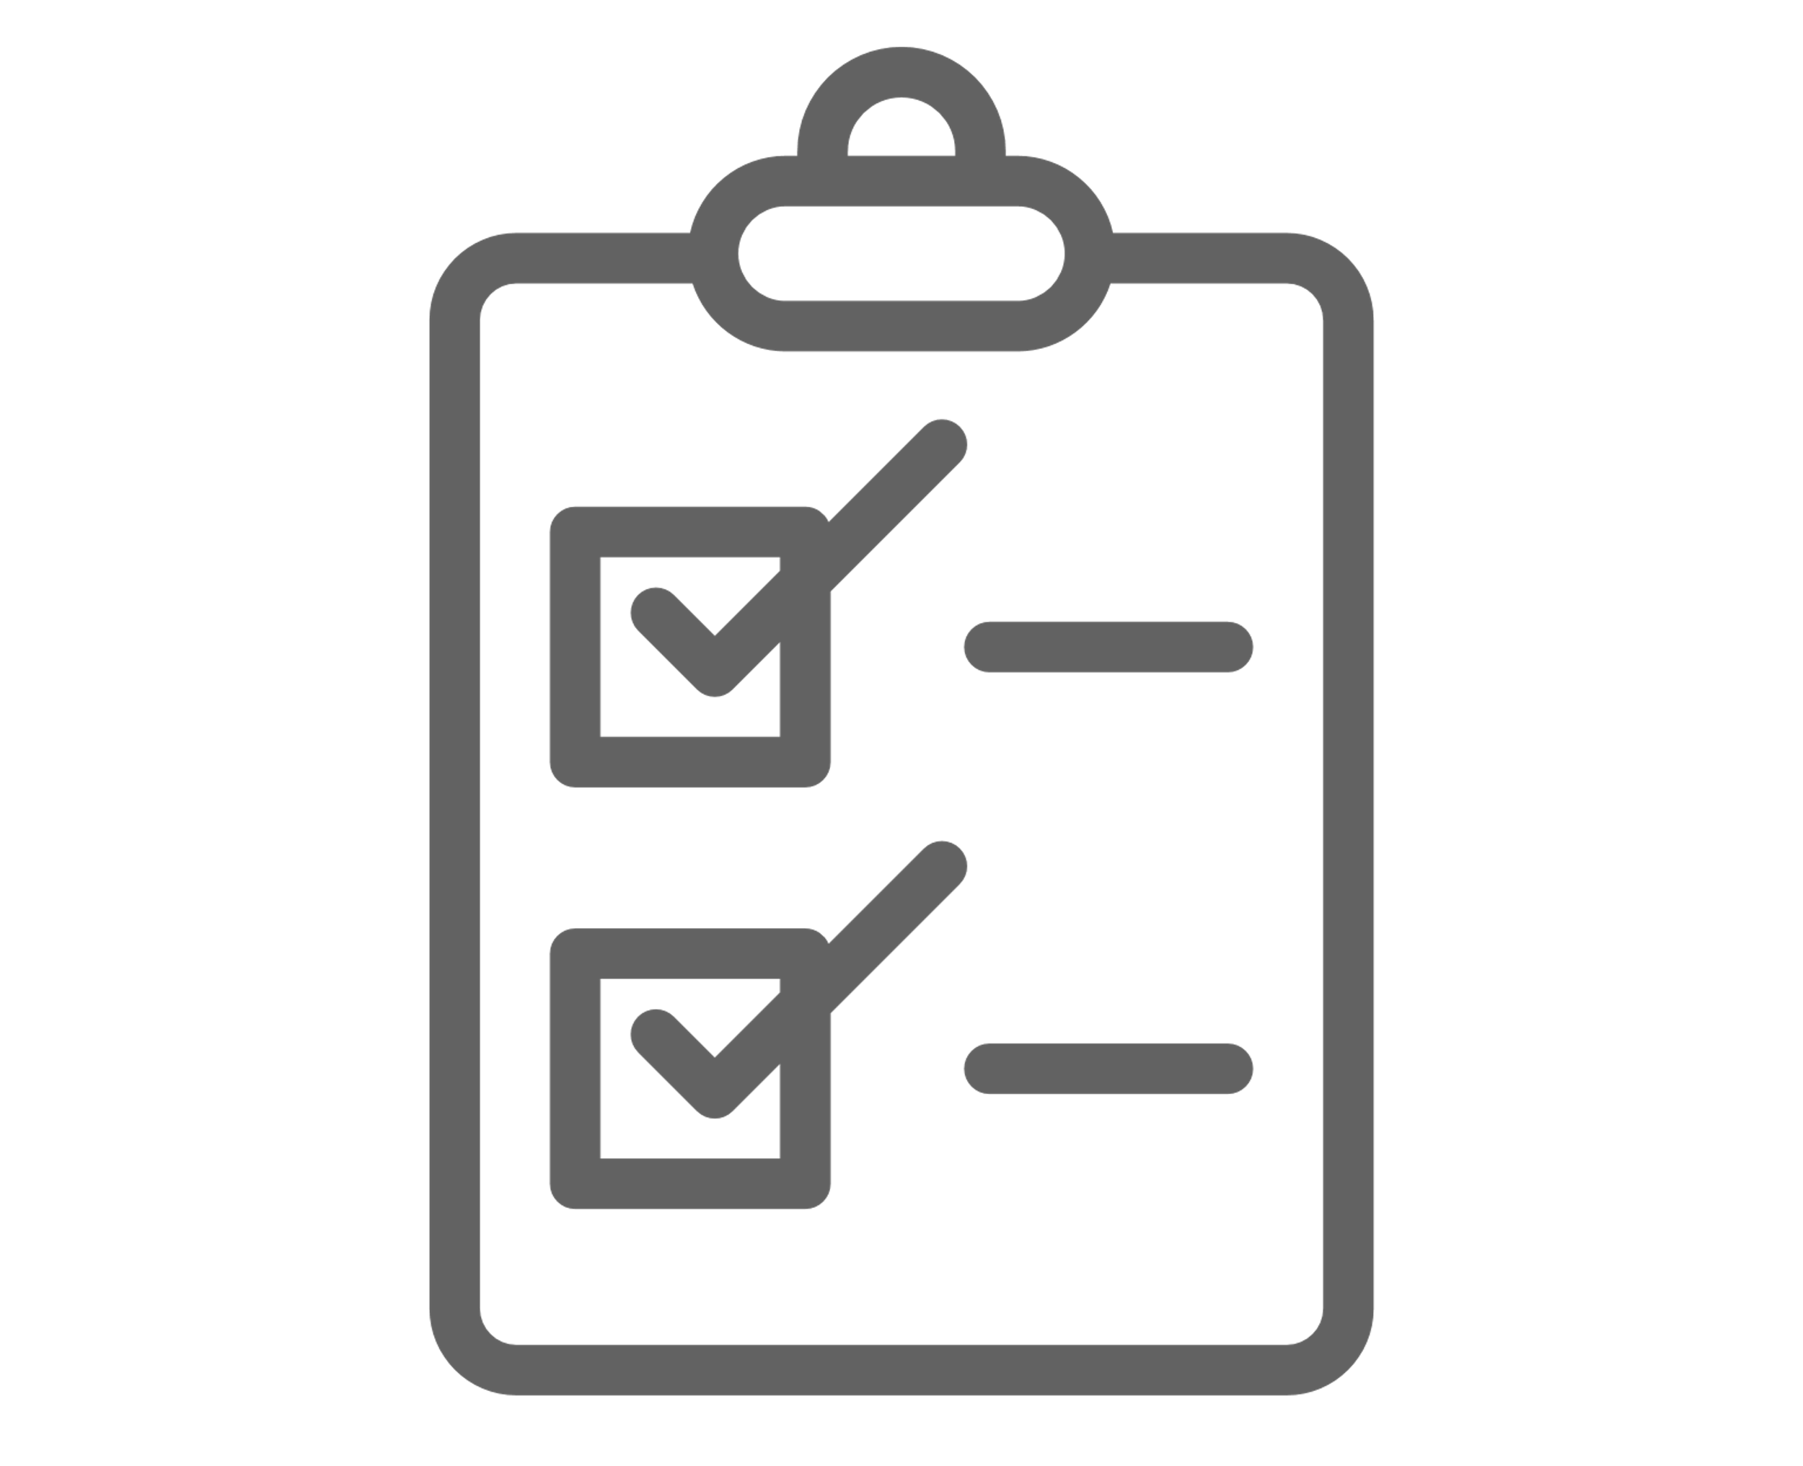

What are your thoughts about the feedback?
Reflection & Action
Reflection & Action
What stood out for you in the results?
What are you most curious about?
What examples can you think of?
collaborative action plan
What can we individually do to improve psychological safety & inclusivity?
What could the team do?
What could leaders do?
Commitment & Accountability
How will we support each other to do what we say we will do?
And – continue to learn and improve ?
What support might you need?

Slide 17

You are on your journey to turning
diversity into lived inclusivity!
Psychological Safety is a well-established driver of team-performance, effective decision making, innovation and higher quality solutions.
Professor Amy Edmondson, Harvard Business School.

