Slide 1
Key Frameworks for working with the DDI Tools: ISA360 & IASC
Information for Accredited Practitioners

Slide 2
Contents
Integral Model
View-Action-Result
Performance = Potential – Interference
Relationship Triangle
Transformation
Key Frameworks

Slide 3
Integral Model
Integral Model (Wilber) - Culture and leadership are levers for change​.
Personal Safety
Process Safety
Results
Incl safety performance
 | Invisible | Visible
Individual | Views and Beliefs | Behaviours & Actions
Group | Culture | Processes & Systems
Notes:
You may be familiar with Integral model by Wilber
That is, our beliefs/views at the indiv or group lvl, influence what we do/create, which impacts our results.
This is useful within a safety perspective as it relates directly with personal and process safety.
Through exp we see many orgs focus particularly on process/visible safety, however, we’re learning that it is the integration of these two that lead to safer outcomes
Thus, the Integral model shows how integrated these two factors are and how they impact safety outcomes.

Slide 4
View – Action - Result
Views and beliefs
Technical knowledge and management techniques
Your leadership effectiveness & impact
View
Action
Results
We use this model in individual and group debriefs, and provide reflective space in the Self Development Guide to enable participants to use the model themselves.

Slide 5
Performance = Potential - Interference
Tim Gallwey – Inner game of tennis

Slide 6
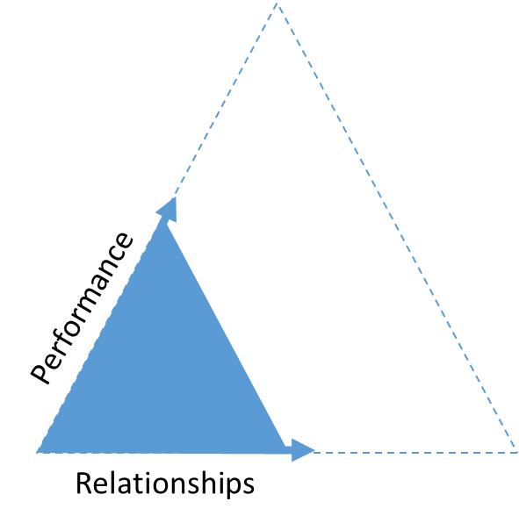
Relationship Triangle
This basic principle of; as the quality of relationships increase, so does the performance; is the power behind the DDI assessments and coaching experience.
The better we know someone, the better we work with them
It explains why a sporting team made up of talented individuals who haven’t played together before will always be beaten by a team that is less talented individually but have trained and played together for a long time.
It is also true in the workplace.
It is also true about any person, object, concept and experience; the better your relationship with it, the greater the performance.
Notes:
In the ISA 360 and IASC experience, our participants will deepen their relationship with self, team, organisation, safety, industry, etc, etc, etc.
The work you do with participants is intended to improve their relationships so they can have a profound impact on personal and professional performance and outcomes.

Slide 7
Transformation
Transformation
A transformational approach provides the opportunity for leaders to understand and then change their view of their current leadership, providing endless possibilities for more effective styles.
This in turn leads to the promotion of long-lasting effective leadership behaviours; true transformation.
Acceptance
Awareness
By designing programs targeted at the ‘view’ (or mindset) rather than the ‘behaviour,’ partnering organisations experience more long-term, meaningful and sustainable results.
Notes:
Jess
You may be familiar with Integral model by Wilber
That is, our beliefs/views at the indiv or group lvl, influence what we do/create, which impacts our results.
This is useful within a safety perspective as it relates directly with personal and process safety.
Through exp we see many orgs focus particularly on process/visible safety, however, we’re learning that it is the integration of these two that lead to safer outcomes
Thus, the Integral model shows how integrated these two factors are and how they impact safety outcomes.

Slide 8
Head Office
10B, 151 – 153 Herdsman Parade,
Wembley, Perth
Western Australia 6014
+61 8 9287 1041
info@datadrivesinsight.com
datadrivesinsight.com
Creating thriving organisations

