Slide 1
Psychological Safety Indicator Program
Changing the Paradigm

Slide 2
What is psychological safety?
“a belief that one will not be punished or humiliated for speaking up with ideas, questions, concerns, or mistakes, and that the team is safe for interpersonal risk taking”
- Amy Edmondson
Why does it matter?
There is a direct correlation between psychological safety, engagement and productivity
A Google research study found that Psychological safety is “the single most important factor for effective teams”
Yet, another Gallup study indicates employees currently feel 50% less cared for by their organisations than they did 3 years ago.
Notes:
So, what is psychological safety?
According to Amy Edmondson, American scholar and the pioneer of psych safety is “a belief that one will not be punished or humiliated for speaking up with ideas, questions, concerns, or mistakes, and that the team is safe for interpersonal risk taking”

Slide 3
But here’s the kicker…
A ‘normal team’ has low psychological safety and instead prefers artificial harmony.
In fact: most teams operate at a 3/10
By moving that ratio to 6/10, organisations could realise:
27% reduction in turnover
40% reduction in safety incidents
12% increase in productivity.
If Psychological Safety is the answer, why aren’t we all doing it better?

Slide 4
Changing Organisational Culture Traditional approach
1. Measure
4. Train
Characteristics
GRC-led
Annual Cycle
Hindsight & Point in Time
Individual focus
Aligned with OHS
Characteristics
Tactical and Reactionary
Top Down - Targets Managers
Significant investment
To set up
To participate
External Expertise
Compliance
Assurance
2. Report
3. Plan

Slide 5
Psychological Safety Indicator Program Changing the Paradigm
Focus on the Leader and Team
Designed for Enablement
Neuroscience-based Development Plans
View, Action, Results
Self-paced
Top Down and Bottom Up
Digital Transformation
Extensible
Scalable
1. Measure
5. Act and record
Source
Reward
Human Resources
Align
Learn & Develop
2. Connect with Results
4. Commit to change
3. Reflect on impact
Notes:
Measures the team’s exposure to workplace attributes or characteristics that may impact psychological safety in a negative way e.g., workload, feeling included

Slide 6
Evolution - Human Resources
Introduction of “Systems of Engagement”
EX 1.0
EX 2.0
EX 3.0
EX 4.0
Annual engagement survey
Pulse surveys with mobile access
Intelligent dashboards and action plans
Continuous response action platforms
Once per year. Focus on management. Benchmarked annually. Rigid questions asked year after year.
Focus on Benchmarking
Agile surveys as needed.
Pulse on regular basis.
Feedback on mobile or apps.
AI-based action plans
Immediate feedback.
Focus on Feedback
Many sources of data.
Dashboards recommend action, deliver nudges, suggestions, and learning or action plans for individuals.
Focus on Behaviour Change
Tied into internal systems with alerts, feedback, cases and integration with CX systems.
Now called EX, not Engagement.
Focus on Action
Survey Technology
Mobile, easy to use
Useful data and Learning
Instrumented actions
and alerts
Timeline
2005 - 2015
2015 - 2020
2021 - 2023
2023 -
Talent Systems of Record
(May go into or be HCM Platform)
(ATS, LMS, Compensation, Benefits, Survey, Rewards)
Source : JOSH BERSIN – Insights on Work, Talent, Learning, Leadership, and HR Technology (HR_TechMarket_2021_v7.pdf)

Slide 7
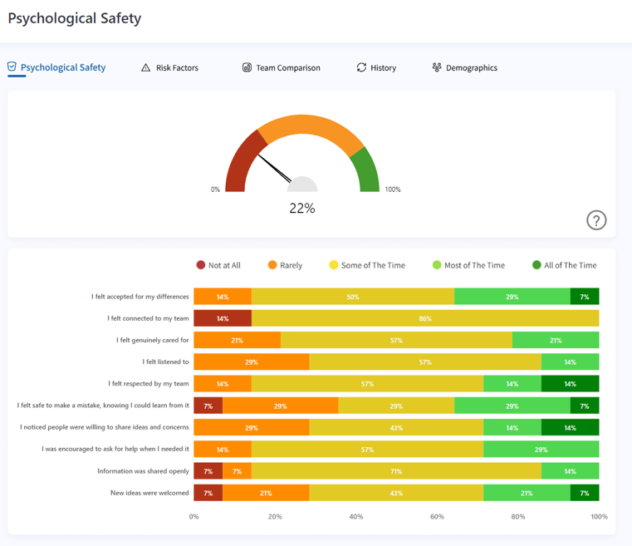
Case Study
Time 1 - Psych Safety
Overall score of 22%
Focus areas are increasing feelings of connection to the team and welcoming new ideas.

Slide 8
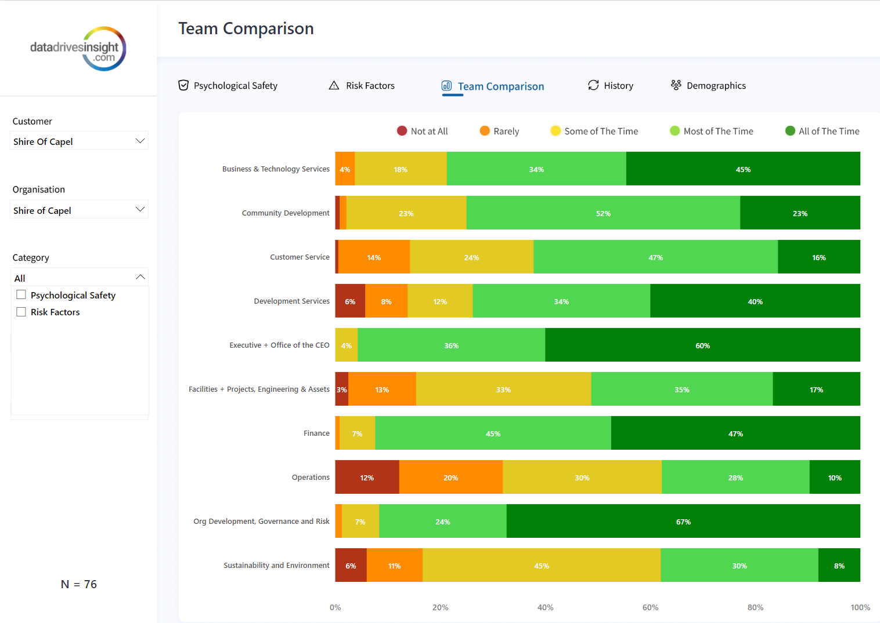
Comparisons across 10 teams
Time 2- Risk
Overall risk level decreased to 32%
Improvement in previous focus areas.
New focus areas

Slide 9
Demonstration
Measure - 4-minute “pulse check”
Connect - Intelligent Dashboard, App and Member Portal
Reflect on Impact, Commit to Change, Act and Record - Development Plans
Engage, Reward - Digital Nudge
Notes:
Measures the team’s exposure to workplace attributes or characteristics that may impact psychological safety in a negative way e.g., workload, feeling included

Slide 10
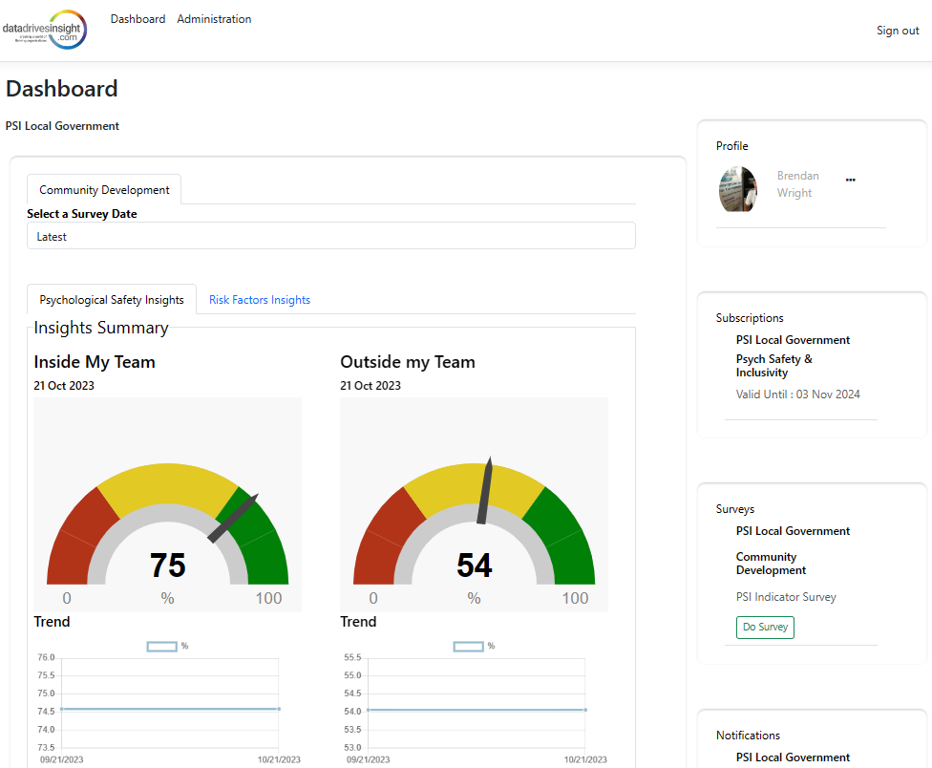
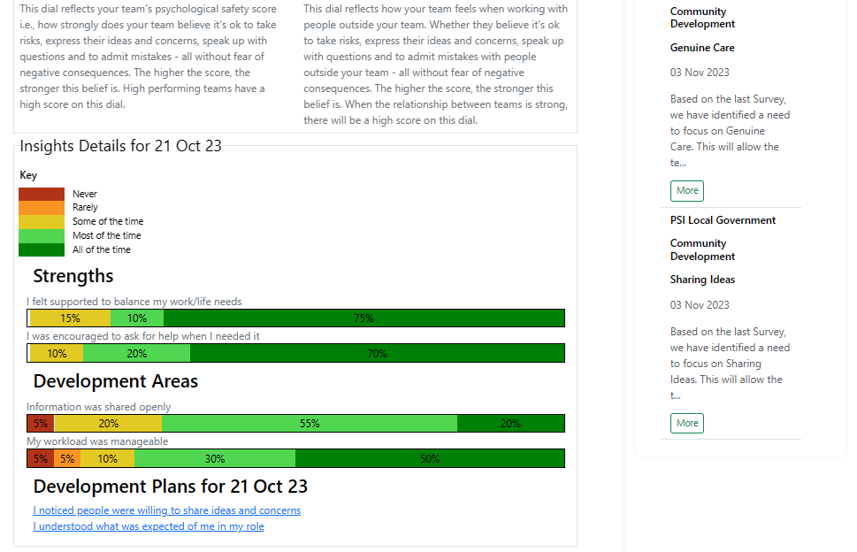
Digital Platform Enabling Transformation
1. Measure
5. Act and record
Source
Reward
Human Resources
2. Connect with Results
4. Commit to change
Align
Learn & Develop
3. Reflect on impact

Slide 11
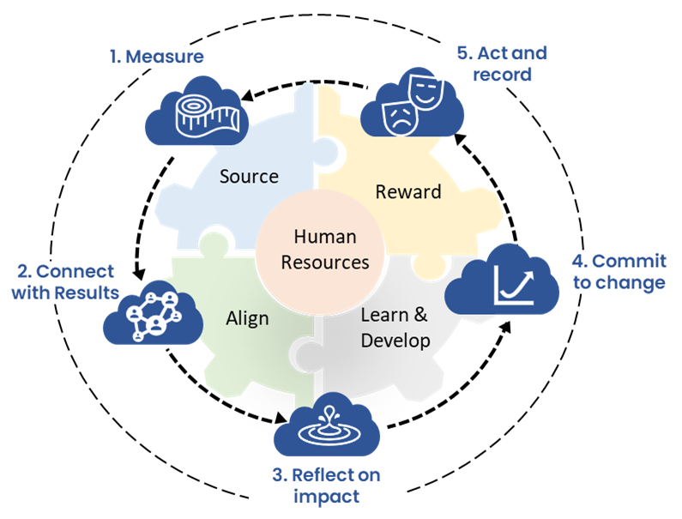
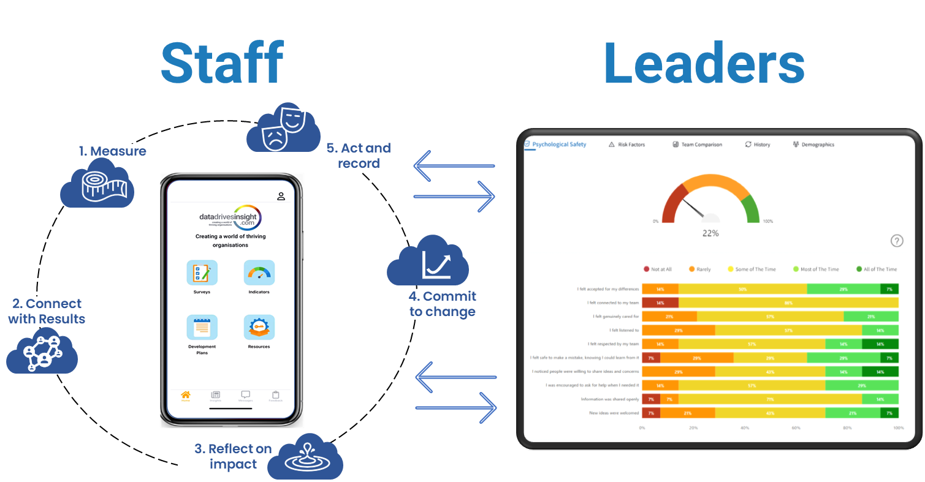

Slide 12
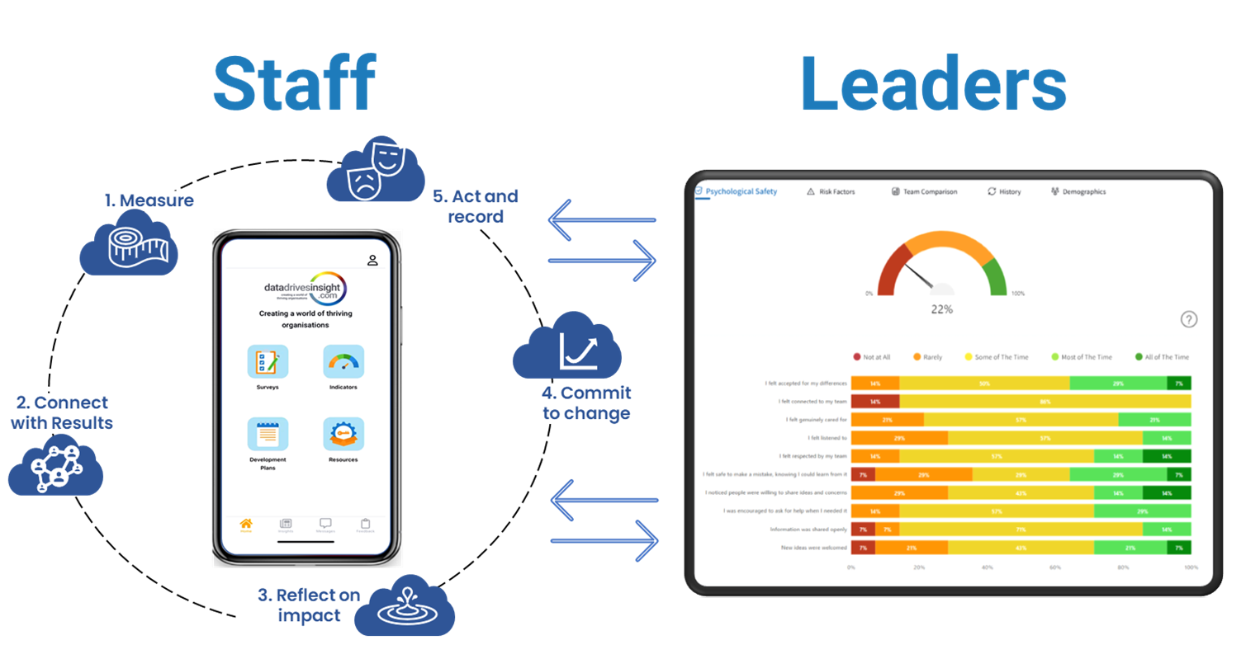

Slide 13
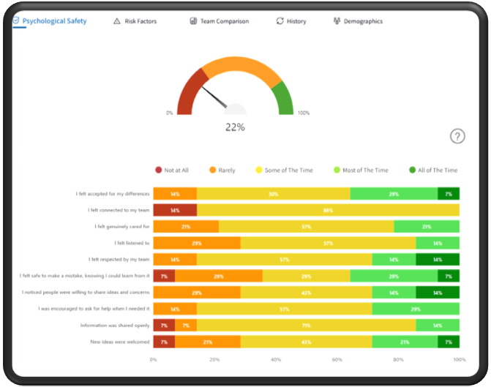
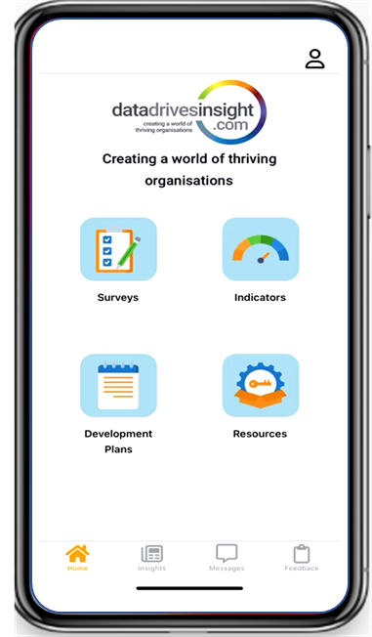
Staff
Leaders
1. Measure
5. Act and record
2. Connect with Results
4. Commit to change
3. Reflect on impact

Slide 14
Integrated Engagement
Diversity & Inclusivity
Workforce Planning
Source
Payroll
Inform Strategic and Operational Planning to enable Data Driven Decisions from Insights gathered
Strategic Plan
Bonus
Recognition
Satisfaction
Align
Roles
Configure Key Organisational Risk Factors
Development Areas act as Assurance for Governance and Compliance Programs
Corporate Social Responsibility
Recruitment
Source
Reward
Attract & Retain
Engagement
Learn and Develop
HRIS
Coach in Your Pocket
Guided by Digital Nudge
Attached to HR Professional Development Plans
Certifications are Micro-credentials within Training module
On Boarding
Align
Learn & Develop
Professional Development Plans
Risk Factors
Assessments
Reward
Culture
Clear path for financial and career
Connectivity for regular push and pull feedback and interaction
Training
Governance and
Compliance
Feedback
Assurance
Coaching
Competencies

Slide 15
Data Drives Insights
Platform Overview
Customer Environment
Project Management
Governance Risk and Compliance
Human Capital Management
Resource Planning
Mining Compliance
Safety
Operations
Risk Management
Assurance
Inclusivity and Diversity
OHS
Incident Management
etc
Workforce Planning and Management
Personal Development Plans
Training
Staff Feedback (360)
Knowledge base
Recruitment
Role / Skills matrix
Succession Planning
Member Portal App
Content
API Gateway
DDI Platform
Logic (Micro Services)
Privacy & Security Engine
Identity and Access Management
Authentication
Authorisation
Data Integrity
Engagement Engine
Personalisation
Recommendations
Nudges
Recognition
Content Engine
Surveys
Learning Modules
Development Plans
Content Library
Analytics Engine
Dashboard, Reports and Insights
Algorithms and AI
Advanced Analytics
Import / Export
Contextual Engine
Human Capital Management
Project Management
Governance Risk and Compliance
etc
Data and Process Engine
Workflow and Approvals
Task Management
Process Management
Data & Delivery Platform
Data and Analytics Engine
Channels
Subscriptions
Projects
Organisations
LMS
Structured Learning and Engagement
Content Library
Organisations
Packages
Products
Teams
Results (Big Data)
Development Plans
Pulse Questions
Teams
Entitlements
Participants
Responses
Members
Certification

Slide 16
Business Intelligence Platform
Context and Relevance
DDI
Program
Workforce Planning and Management
Operations
Strategy
Insights
Action
Facts
Personal Development Plans
I felt fully included as a member of the team
Employee Leave
Training
Human Resources
Psychological Safety
(Inside and Outside)
Staff Feedback (360)
etc
Psychological Safety and Inclusivity
Risk Factors
I was trusted to do my job
Knowledge base
Capability
I was encouraged to use my skills and knowledge
Role / Skill Matrix
CILCA / CISCA
Governance, Risk and Compliance
Culture
Assurance
- Inclusivity and Diversity
- OHS
- Incident Management
I felt the effort I put in was equal to the reward I took out
Impact
etc
Resource Planning
Safety
Projects
Operations
Risk Management

