Slide 1


Preparing for your IASC Experience

Slide 2
Our Purpose Today
Introduce you to <add licensee/accredited practitioner name>
Introduce you to the IASC
Get you prepared to launch your IASC project
What happens after the survey closes?
Answer any questions that you have about the project and the process

Slide 3
About us
add licensee/accredited practitioner info

Slide 4
What is IASC?
The Integral Assessment of Staff Capability and Culture is:
a valid and reliable team assessment
developed by Organisational Psychologists, HR professionals, Performance Coaches and industry experts in partnership with two Australian Universities
Based on the research of Ron Westrum, Amy Edmundson and Rick Strycker.
enables teams to identify their biggest gaps, risks and opportunities to achieve the optimal performance (including safety)
Collects feedback from different perspectives: team, leaders, other teams or customers.

Slide 5
What IASC360 Measures
Capability, Culture and Impact
Capability
Culture
Impact
Team Capability: Four Factors
What capability shift will get the greatest performance shift from the team?
Team Culture
Where are our high and low performing teams? What is the culture like?
Team Psychological Safety& Engagement
What psychological safety and engagement outcomes are linked to team culture and behaviours.

Slide 6
Capability
Purpose
Caring
Connecting
Curious
Our research based on the perspectives of 512 individuals working in highly safety critical environments has identified four safety capability areas that enable high performing (Generative) teams
Our analysis has shown that each of the four capability areas have a positive impact on the way staff feel and behave at work.
We have shown that an improvement in the four capability areas WILL lead to an improvement in workforce behaviour and outcomes.

Slide 7
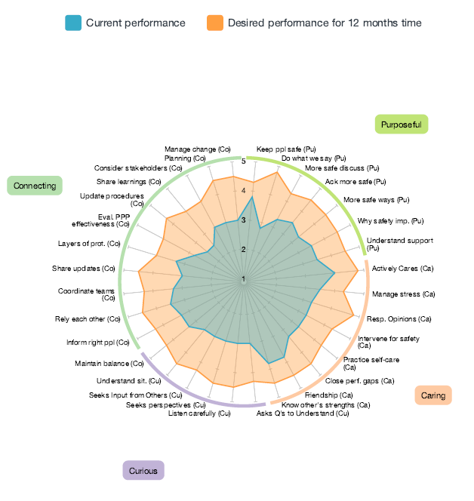
Add sample spidergraph
Note on the 360 element – on capability and impact or just impact??
What the results looks like
Team Capability Against the four capability areas
Quickly see team strengths and areas for improvement
Focus transformation programs and resources in areas that will have the biggest impact

Slide 8
Culture Typology
Detrimental | Bureaucratic | Generative
Power Oriented Characterized by low cooperation, blame, hiding incidents. Information is often withheld for personal gain. It is not safe to speak up, especially if doing so might be embarrassing. Messengers are shot, responsibilities are shirked. When things go wrong, a scapegoat is found and punished. There is no real learning from failure. | Rule Oriented Focused on positions, hierarchy, span of control. Responsibilities are compartmentalized by departments that seek to preserve their own existence and power. Information must flow through standard channels or procedures, in order to preserve status quo. Messengers are neglected, responsibilities are narrowed. When things go wrong, there is a process to produce retribution. Learning is institutional. | Purpose Oriented The hallmarks are good information flow, high cooperation and trust, bridging across teams, and conscious inquiry. Psychological safety creates openness, curiosity, care, and systemic learning. There is awareness of the importance of getting the right information to the right people, in the right form at the right time . When things go wrong, people look for a systemic cause and for systemic solutions, a recognition of the interrelated parts of the organization. Messengers are trained.

Slide 9
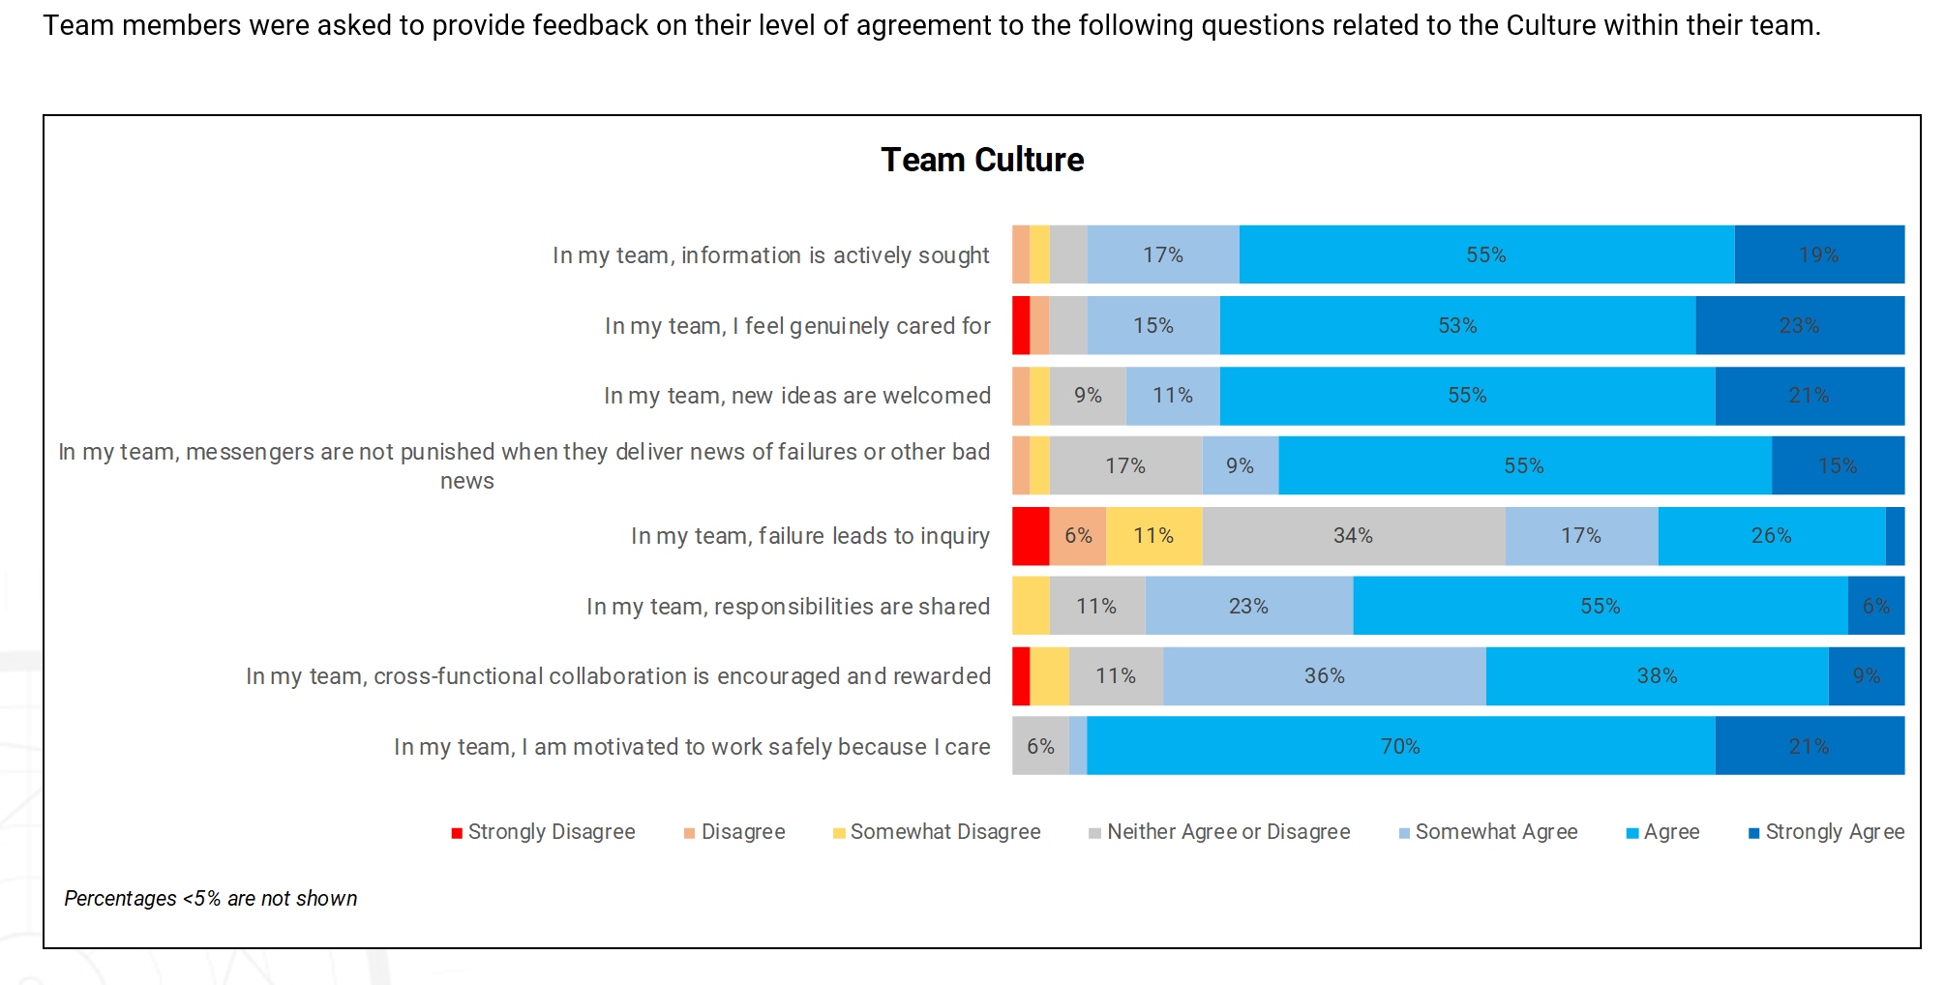
Add visual if we can or an explanation of three trypologies
What the results looks like
Team Culture - Quantitative

Slide 10
Add visual if we can or an explanation of three trypologies
What the results looks like
Team Culture Qualitative
Understand the dominant current culture in your organisation.
Why are we at risk of injury?
What is working to create a safer culture
What’s missing and what needs improvement
Westrum Typologies

Slide 11
What IASC360 Measures
Impact - Engagement
Engagement
Career Development
Intention to Stay
Commitment to Organisational Goals
Organisational Commitment
Psychological Contract
Satisfaction
Mission and Vision

Slide 12
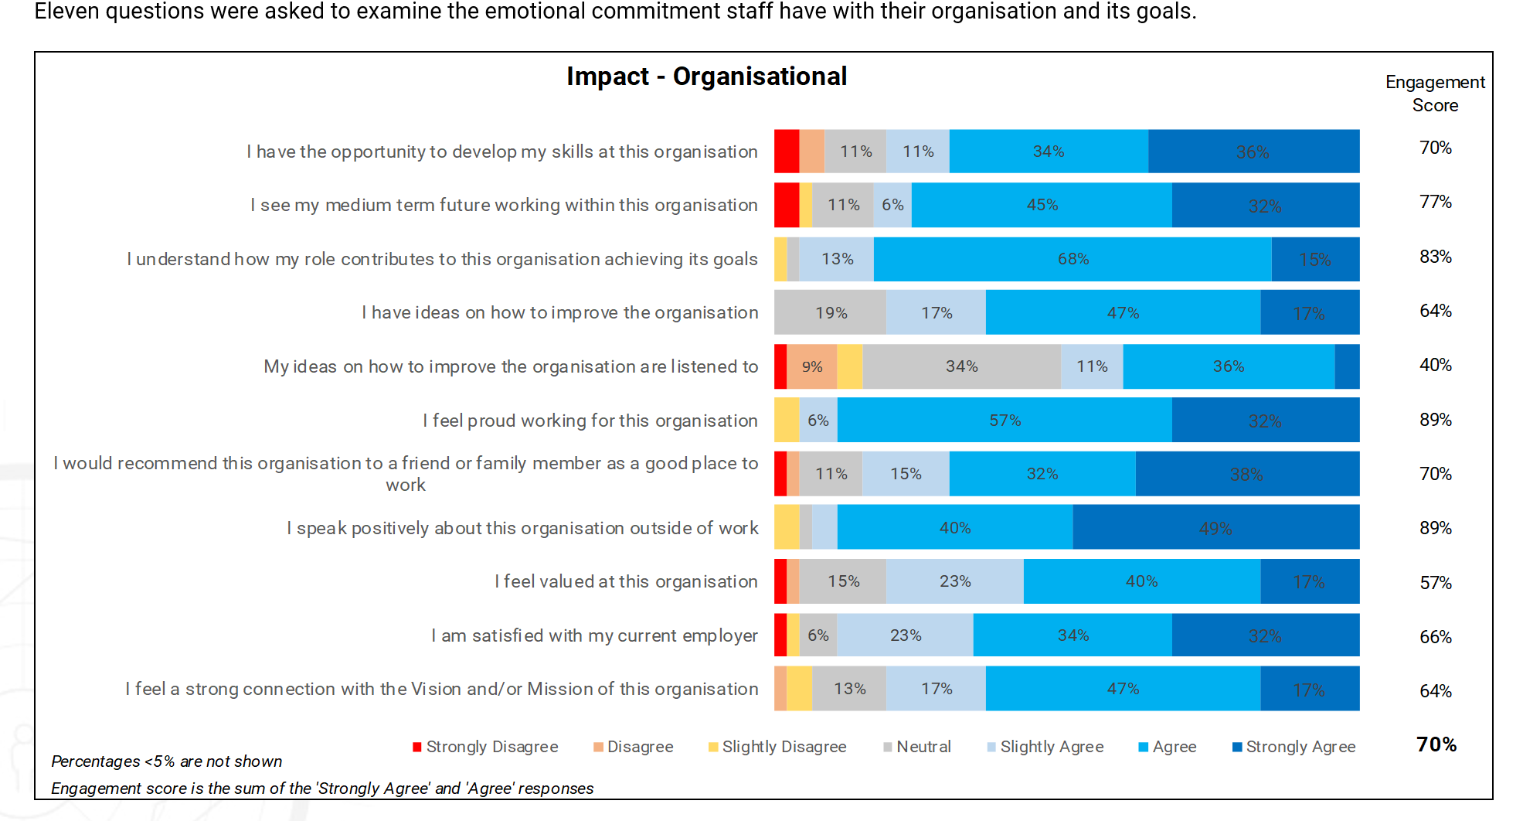
What IASC360 Measures
Impact - Engagement

Slide 13
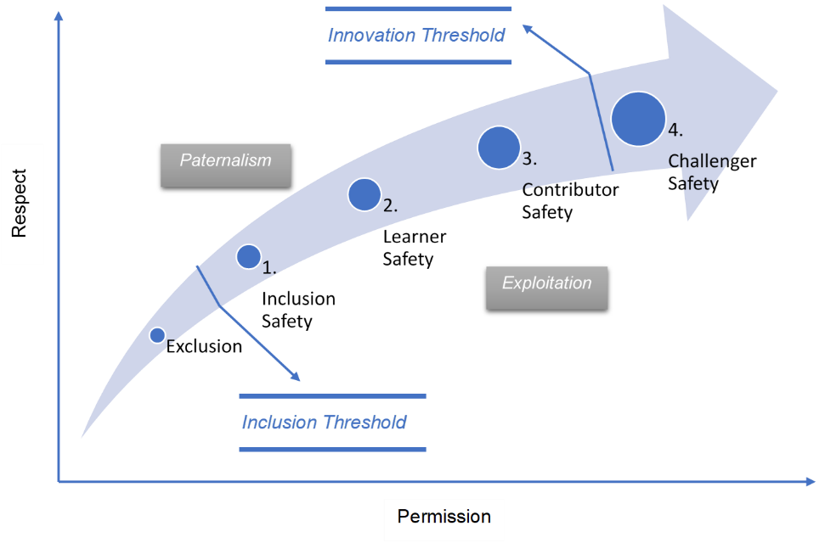
Psychological Safety
Psychological safety is a condition in which you feel (1) included, (2) safe to learn, (3) safe to contribute, and (4) safe to challenge the status quo— all without fear of being embarrassed, marginalised, or punished in some way.
Psychological safety is a key characteristic of a Generative Culture and so we have embedded these features into the four factors.
It is also:
  an outcome of the development of the four factors and
  a good measure of a team’s working environment
so we include it in our assessment of culture to indicate how well leaders and teams are progressing in their journey toward high performance.

Slide 14
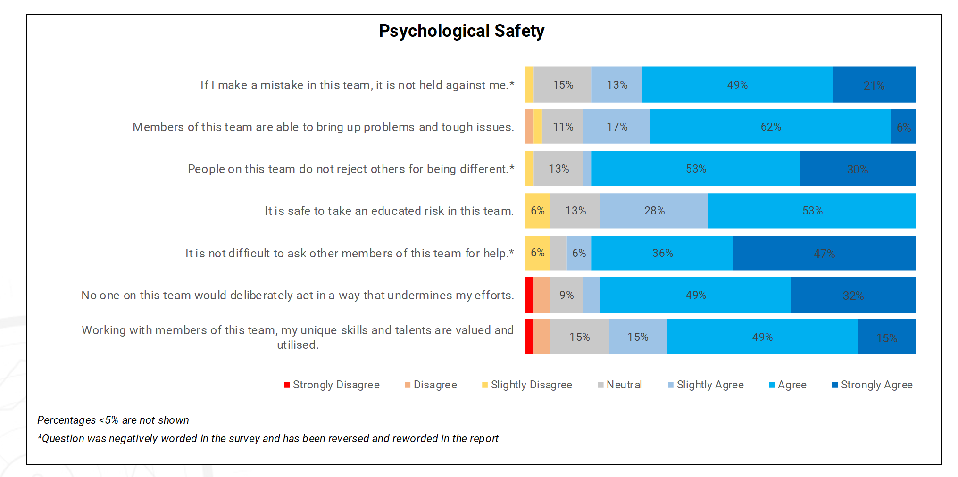
Add the step daigram from edmunson…??
Sample impact graph
What the results looks like
Impact – Psychological Safety

Slide 15
Insights About Culture
Our Research has Found That Organisations That..
..engage in transformation activities have a significant improvement in performance outcomes.
79% decrease in TRIFR
43% decrease in SIFR
60% reduction in vehicle collisions
Productivity went up 10% while maintaining 86% timely maintenance schedule
Notes:
Taken from the case study organisation data

Slide 16





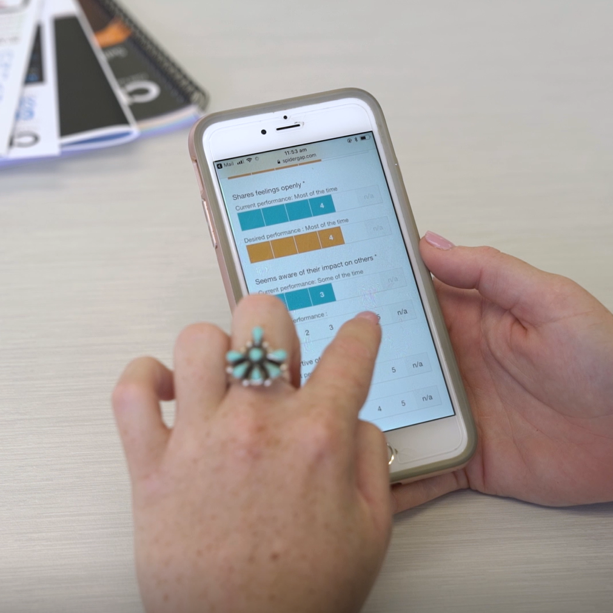
How it Works?
The IASC will Launch on DATE
You will receive a link to the survey via email requesting you to give feedback.
Reports are generated Data Drives Insight
(all answers are confidential)
We will debrief the leadership team, and then all teams and create an action plan together.
The survey is open for 2 weeks.
Close date
The email will be from ISAadmin@datadrivesinsight.com
Note: Assessments can be completed on any device and only takes around 10mins to complete!

Slide 17
Completing the Survey
  Follow the link in your email to complete the survey.
  Every survey can be completed using your PC, laptop, tablet or phone. All you need is access to the internet!
  It takes approx. 10 minutes to complete the survey. And is completely confidential. All data is collated and themed.
  Be as honest as possible so the results are valuable to you and the team. This is designed for the teams development going forward.

Slide 18
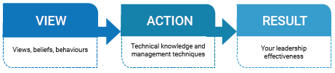
Team Debrief
  Add any notes you want to share about the debrief approach/process/timeline

Slide 19
Any Questions?
Throughout the assessment process, ask us anything!

