Slide 1



Preparing for your PSI360 Assessment Experience

Slide 2
Our Purpose Today
Introduce you to LICENCEE
Introduce you to the PSI360
Get you prepared to launch your project
What happens after the survey closes?
Answer any questions that you have about the project and the process

Slide 3
About us -
add licensee/accredited practitioner info

Slide 4
What is PSI360?
The Psychological Safety and Inclusivity Indicator is:
  A valid and reliable leadership capability and impact assessment
  Developed by Organisational Psychologists, HR professionals, Performance Coaches and industry experts.
  Is about understanding how leader’s capabilities are impacting the level of psychological safety and inclusivity those around them experience and how they can improve it.
  It identifies where leaders can focus on to improve their impact in how phycological safe & inclusive teams feel.
  Suitable for leaders at all levels.
  Collects feedback from different perspectives: self, manager, peers, reports.

Slide 5
What makes a great leader?
Purpose
Caring
Connecting
Curious
Our research based on the perspectives of 512 individuals working in highly safety critical environments has identified four leadership capability areas required to be truly ‘integral’.
Our analysis has shown that each of the four leadership capability areas have a positive impact on the way staff feel and behave at work.
We have shown that an improvement in the four capability areas WILL lead to an improvement in workforce behaviour and outcomes.

Slide 6





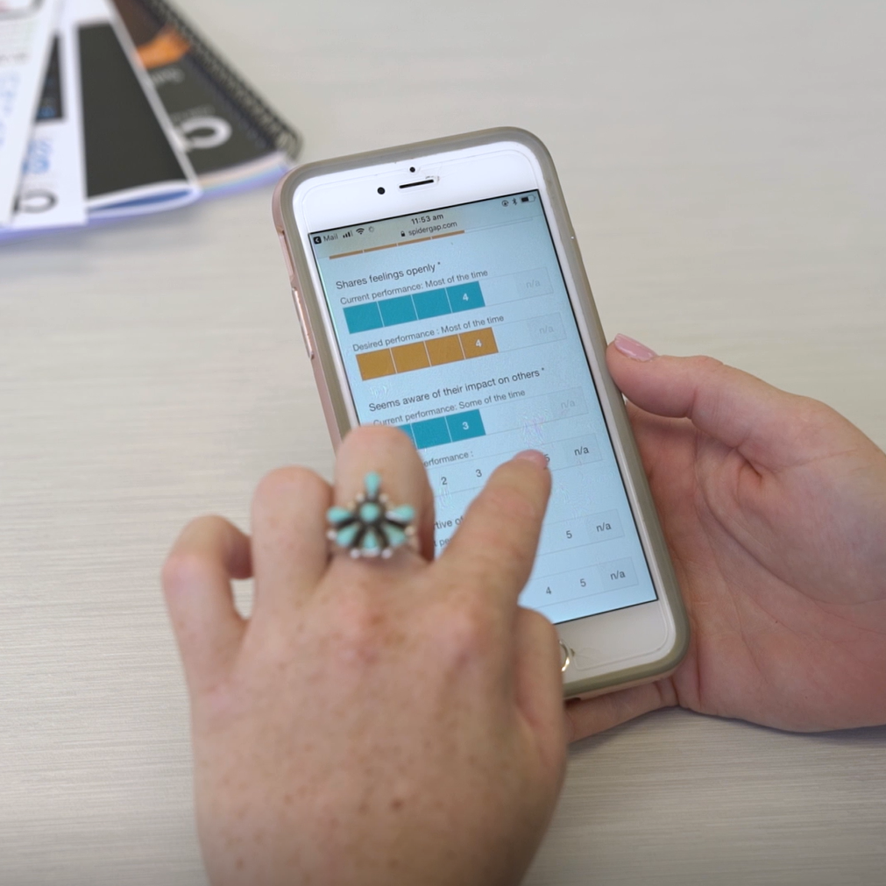
How it Works?
The two emails will be from assessments@datadrivesinsight.com
The PSI360 will Launch today
You will receive a link to the survey via email requesting you to nominate your raters. Do this ASAP.
On the launch date, you will also receive a link to complete your own assessment.
Reports are generated by third party; Data Drives Insight
You are debriefed your results with an accredited coach, where you will receive your report and create an action plan together.
Organisation receives the Composite Report & group debrief/s
Note: Assessments can be completed on any device and only takes around 10mins to complete!

Slide 7
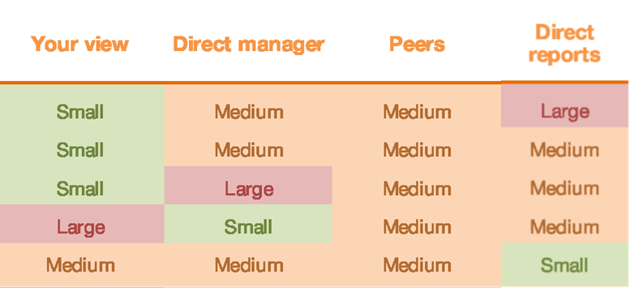
Who You Need to Nominate
Nominate between 10-15 colleagues to provide you feedback, in each of the following categories:
Direct manager (minimum 1)
  Colleagues/Peers (minimum 5)
  Employees below you/direct reports (minimum 5)
  Colleagues you work closely with /or additional people from the above categories (minimum 5)
Note: You must nominate at least 3 colleagues in each category to respond (apart from Direct Report) to receive a breakout group for that category in your report. If you have less than 3 responses in a category, your data will be grouped with another category.
Important: Feedback provided is confidential and the data is grouped together to show how respondents of each break out group rate your performance in each area. Your Direct Manager however, will be always separated.

Slide 8

Who You Need to Nominate
‘Key’ Criteria for Selecting Respondents
  Work colleagues who know you well i.e. interact with them frequently.
  People you trust and respect, and that you believe will give you honest and reliable feedback
  ‘Challenge network’ – think of the colleagues who will hold you accountable, who want you to develop and improve in your career, and who are not afraid to provide honest feedback.

Slide 9
Nominating Your Raters
Before the Survey Launch
Think about who you are nominating. Have a conversation with your raters and let them know how important this is for your leadership development, and that you are relying on them to provide honest feedback.
When the Survey is Launched
Nominate your raters early to allow them enough time to complete the survey for you (within the first 3 days of the survey opening).
  Enter the names and email addresses of the people you have nominated into the online form.
  The PSI360 administration team will then send them a survey invitation via email and provide all the support they need to complete the survey.
  Remember… the rater’s feedback is completely confidential, honesty is key!
Note: Some of you may be each other’s raters, so keep an eye out for those emails
too. You will receive reminders along the way.

Slide 10
Completing the Survey
  Follow the link in your email to complete the survey.
  Every survey can be completed using your PC, laptop, tablet or phone. All you need is access to the internet!
  It takes approx. 10 minutes to complete the survey.
  Be as honest as possible so the results are valuable to you. This is designed for your own development. Your individual results will only be shared with you.

Slide 11
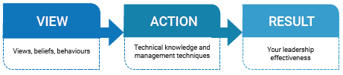
Your Debrief
  You will meet with a coach, where we will go through your results looking at the most significant gaps by understanding the current and desired performance.
  We will partner with you to understand the key areas for improvement.
  Explore the transformational model to develop your leadership skills.
  Provide ongoing support.

Slide 12
Self Development Guide
You will all receive an online comprehensive Self Development Guide that enables you to access models, resources, activities and videos/TED talks to continue your leadership development.
Provides opportunities for you to transform your capability and continue learning beyond the assessment and debrief.
Includes personal action planning for ongoing support.

Slide 13


How it Works?
Receive 2 emails
1. With login details
2. With direct link to your specific guide
Follow the instructions
Capture your actions/commitments from your debrief into the Personal Development Plan
Dive into the Guide wherever you need to!
Email will be from PSIselfdevelopmentguide@t.kajabimail.com
  Check junk or spam if you don’t get it
  You may need to whitelist the email domain – chat to your IT helpdesk
  Call 1300 121 030 or email info@datadrivesinisght.com if you need help

Slide 14
Any Questions?
Throughout the assessment process, ask us anything!

