Slide 1
Preparing for your HILCA360 Experience

Slide 2
Our Purpose Today
Introduce you to the HILCA360
Introduce you to Organisation
Get you prepared to launch your HILCA360 project
What happens after the survey closes?
Answer any questions that you have about the project and the process

Slide 3
What is HILCA360?
The Health Industry Leadership Assessment is:
a leadership assessment tool correlated to the Australian Health LEADS Capability Framework and the quality standards
developed by Organisational Psychologists, HR professionals, Performance Coaches and industry experts in partnership with two Australian Universities
specifically designed for Health Industry
enables individuals to identify their biggest gaps, risks and opportunities across 5 capability areas
Suitable for all levels of leaders

Slide 4
What is HILCA360?
It shines a spotlight on the most significant opportunities for the individual leadership capability by understanding the current and desired performance.
It is purely designed for your self-development. Only you receive a copy of your report.
The results will be debriefed to you in a confidential and supportive session with one of our Performance Coaches.
You will be provided with a Self-Development Guide that includes models, resources, activities and videos/TED talks to transform your leadership and overall effectiveness.

Slide 5
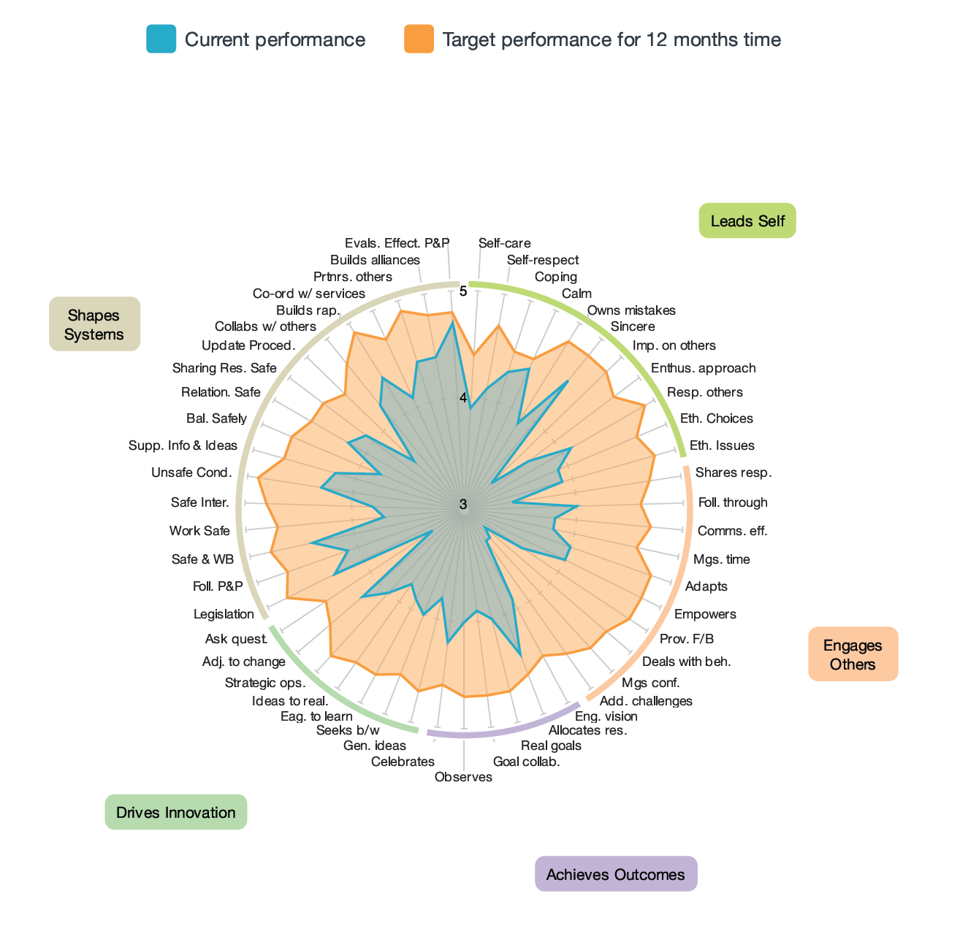
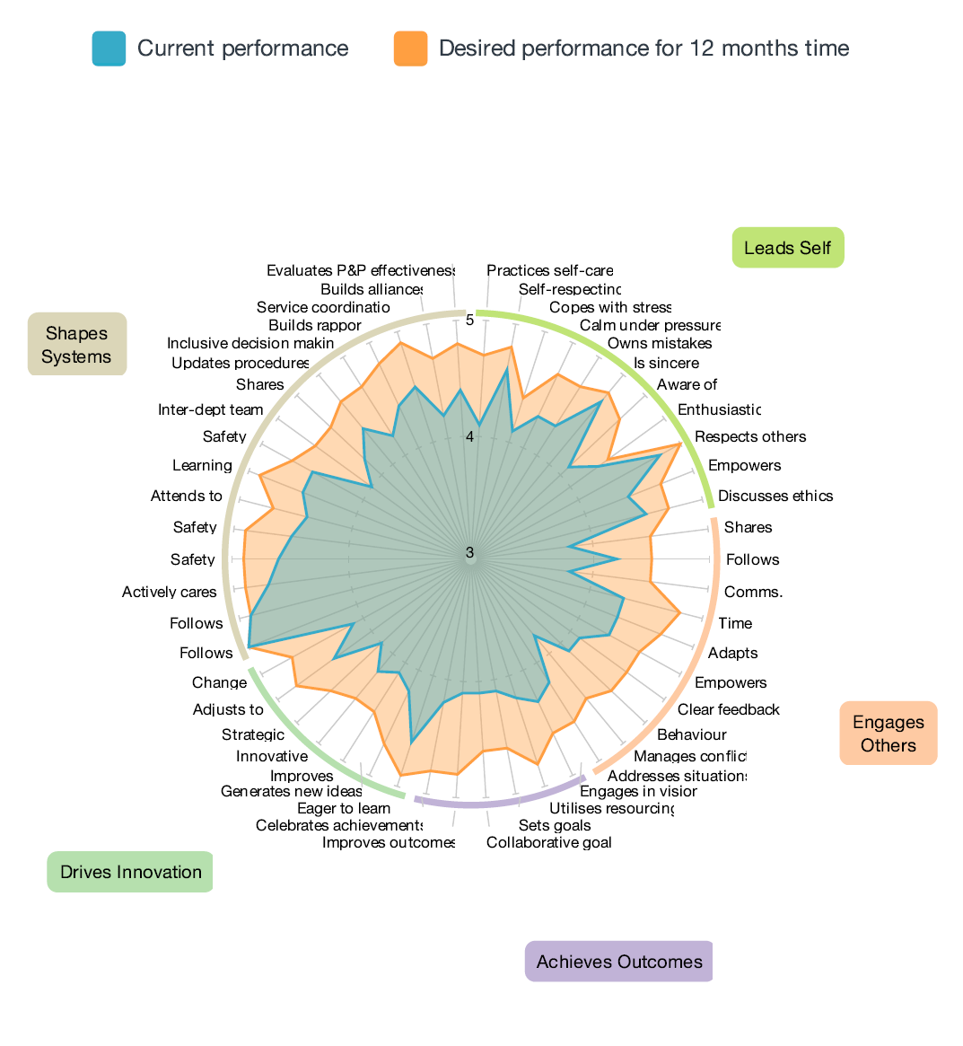
What is in it for Individuals?
The opportunity to transform
Time 1
Time 2

Slide 6
What is in it for Individuals?
Testimonial:
I was super excited to see the results that a key health industry leader (Manager Level) achieved inside the last 12 months. She had been quite disappointed in her first round results and her “unintended impact” on her large team, but was able to turn this disappointment into motivation to grow and develop. I coached her over the 12 month period and she regularly checked in with me about “real time” challenges she was dealing with relating to staffing issues (pressure, shortages, covid, conflict etc). She did “the work”.

Slide 7
The two emails will be from: datadrivesinsight”. E.g. “CILCA Admin”
How it Works?
Assessment 360 to Launch on DATE
You will receive a link to the survey via email requesting you to nominate your 11 raters. Do this ASAP.
On the launch date, you will also receive a link to complete your own assessment.
Reports are generated by third party; Data Drives Insight
You are debriefed your results with a Veraison coach, where you will receive your report and a Self-Development Guide
Organisation receives the Composite Report & group debrief/s
Note: Assessments can be completed on any device and only takes around 10-15mins to complete!

Slide 8
Who You Need to Nominate
Nominate between 10-20 colleagues to provide you feedback, in each of the following categories:
Direct manager (minimum 1)
Colleagues/Peers (minimum 5)
Employees below you/direct reports (minimum 5)
Colleagues you work closely with /or additional people from the above categories (minimum 5)
Note: You must nominate at least 3 colleagues in each category to respond (apart from Direct Report) to receive a breakout group for that category in your report. If you have less than 3 responses in a category, your data will be grouped with another category.
Important: Feedback provided is confidential and the data is grouped together to show how respondents of each break out group rate your performance in each area. Your Direct Manager however, will be always separated.

Slide 9
Who You Need to Nominate
‘Key’ Criteria for Selecting Respondents
Work colleagues who know you well i.e. interact with them frequently.
People you trust and respect, and that you believe will give you honest and reliable feedback
‘Challenge network’ – think of the colleagues who will hold you accountable, who want you to develop and improve in your career, and who are not afraid to provide honest feedback.

Slide 10
Nominating Your Raters
Before the Survey Launch – Think about who you are nominating. Have a conversation with your raters and let them know how important this is for your leadership development, and that you are relying on them to provide honest feedback.
When the Survey is Launched - Nominate your raters early to allow them enough time to complete the survey for you (within the first 3 days of the survey opening).
Enter the names and email addresses of the people you have nominated into the online form.
The HILCA360 administration team will then send them a survey invitation via email and provide all the support they need to complete the survey.
Remember… the rater’s feedback is completely confidential, honesty is key!
Note: Some of you may be each other’s raters, so keep an eye out for those emails
too. You will receive reminders along the way.

Slide 11
Completing the Survey
Follow the link in your email to complete the survey.
Every survey can be completed using your PC, laptop, tablet or phone. All you need is access to the internet!
It takes approx. 10-15 minutes to complete the survey.
Be as honest as possible so the results are valuable to you. This is designed for your own development. Your individual results will only be shared with you.

Slide 12
Your Debrief
You will meet with a coach, where we will go through your results looking at the most significant gaps by understanding the current and desired performance.
We will partner with you to understand the key areas for improvement.
Explore the transformational model to develop your leadership skills.
Provide ongoing support.

Slide 13
Self Development Guide
You will all receive an online comprehensive Self Development Guide that enables you to access models, resources, activities and videos/TED talks to continue your leadership development.
Provides opportunities for you to transform your capability and continue learning beyond the assessment and debrief.
Includes personal action planning for ongoing support.

Slide 14
How it Works?
Receive 2 emails
1. With login details
2. With direct link to your specific guide
Follow the instructions
Capture your actions/commitments from your debrief into the Personal Development Plan
Dive into the Guide where ever you need to!
Email will be from hilcaselfdevelopmentguide@t.kajabimail.com
Check junk or spam if you don’t get it
You may need to whitelist the email domain – chat to your IT helpdesk
Call 1300 121 030 or email info@datadrivesinisght.com if you need help

Slide 15
Any Questions?
Throughout the assessment process, ask us anything!

Slide 16
Head Office
15A, 151 Herdsman Parade,
Wembley, Perth
Western Australia 6014
+61 8 9287 1041
info@datadrivesinsight.com
datadrivesinsight.com
Creating thriving organisations

