Slide 1
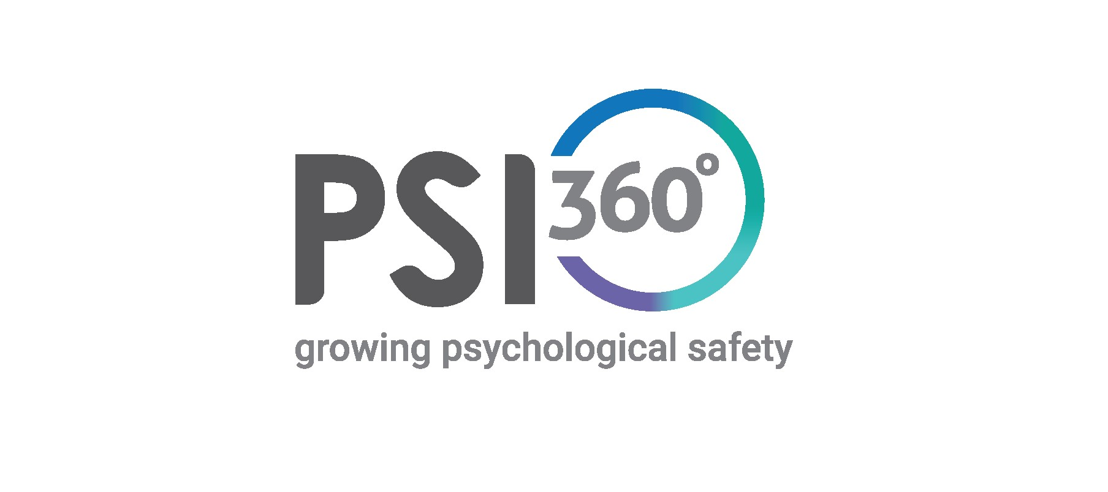
Grow Safe and Inclusive Leaders

Slide 2
About PSI360
The four domains explained
What it measures and how its represented
Insights

Slide 3
Four Domains- Explained
Purposeful
Purposefulness provides practical guidance and orientation to a person, team or organisation, indicating the direction of change. When people know why they are doing a project or task, they can self-correct when they get off course. Purpose is enacted through shared commitments.
People make commitments to safety explicit and visible, engaging each other in the possibility of, and practices that support everyone going home safe every day. When integrity is broken, it is restored by returning to commitment, rebuilding trust. Leaders engage others to be purposeful, committed, and continuously learning how to improve safe performance.
Caring
Care is regard for the intrinsic value of people, actively providing what is needed to support health, safety and wellbeing. Care is personal, connecting with others based on understanding of how it is and what is needed from their perspective. Regard for others creates an environment where people respect each other and build trust and willingness to say what is true.
Caring springs from care for oneself, ensuring one has the capacities and energy to provide real help. It balances a focus on building strengths with a compassionate drive to address gaps in performance and realise potential.

Slide 4
Four Domains- Explained
Curious
Curiosity creates openness to learning how things actually happen in order to improve safe performance. It includes the capacity to suspend what you know, and actively seek out what you don’t know.
Openness means that people are slow to make judgments or to blame people when things go wrong. Inquiry is kept open as long as possible in order to fully understand what happened and to generate lasting change.
People listen to as many diverse perspectives as possible in the time allowed in order to create a more complete picture.
Connecting
Allows us to see how things are related, people seek to understand how roles, teams and functions must integrate to optimize the performance of the whole system.
Connecting is increased when people work together to create models of how the system works and then continually updated as new information is revealed. There is a concerted effort to understand how people close to the work understand the work, updating systems to match how work is actually done.
There is work on the right things at the right time with the right people. There is use of highly intentional and focussed approaches that leads to operational discipline and maximises the use of all resources to achieve the purpose.

Slide 5
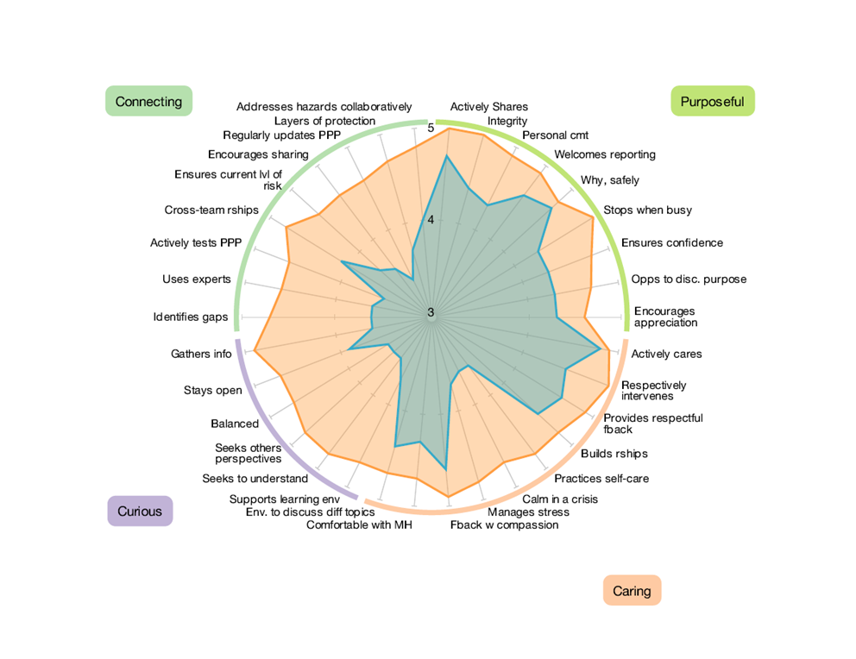
Add four factor stuff
Add example spidergraph
What PSI360 Measures
1. Leadership Capability Against Four Domains
Measures both current and desired performance
Helps focus development and growth to what will have the greatest impact
Example

Slide 6
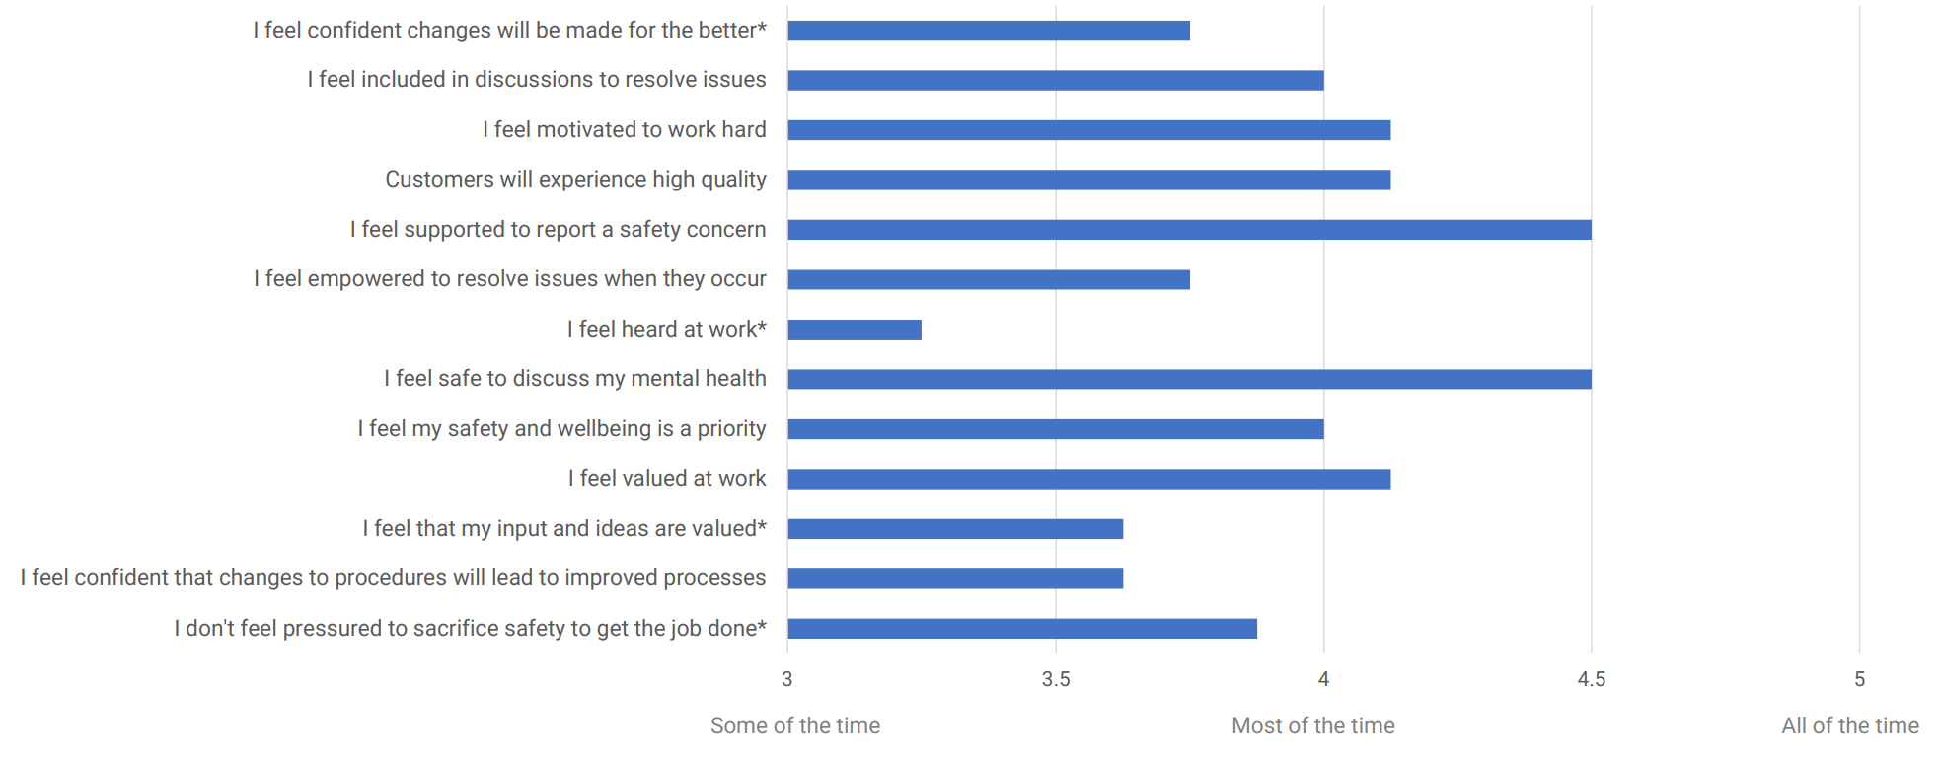
Add impact graph sample
What PSI360 Measures
2. Leadership Impact
In my interactions with my leader….
Measures elements of engagement AND psychological safety experienced by raters as a result of their interactions with the leader
Helps focus development and growth to what will have the greatest impact

Slide 7
Add impact graph sample
What PSI360 Measures
2. Psychological Safety
In my interactions with my leader….

Slide 8
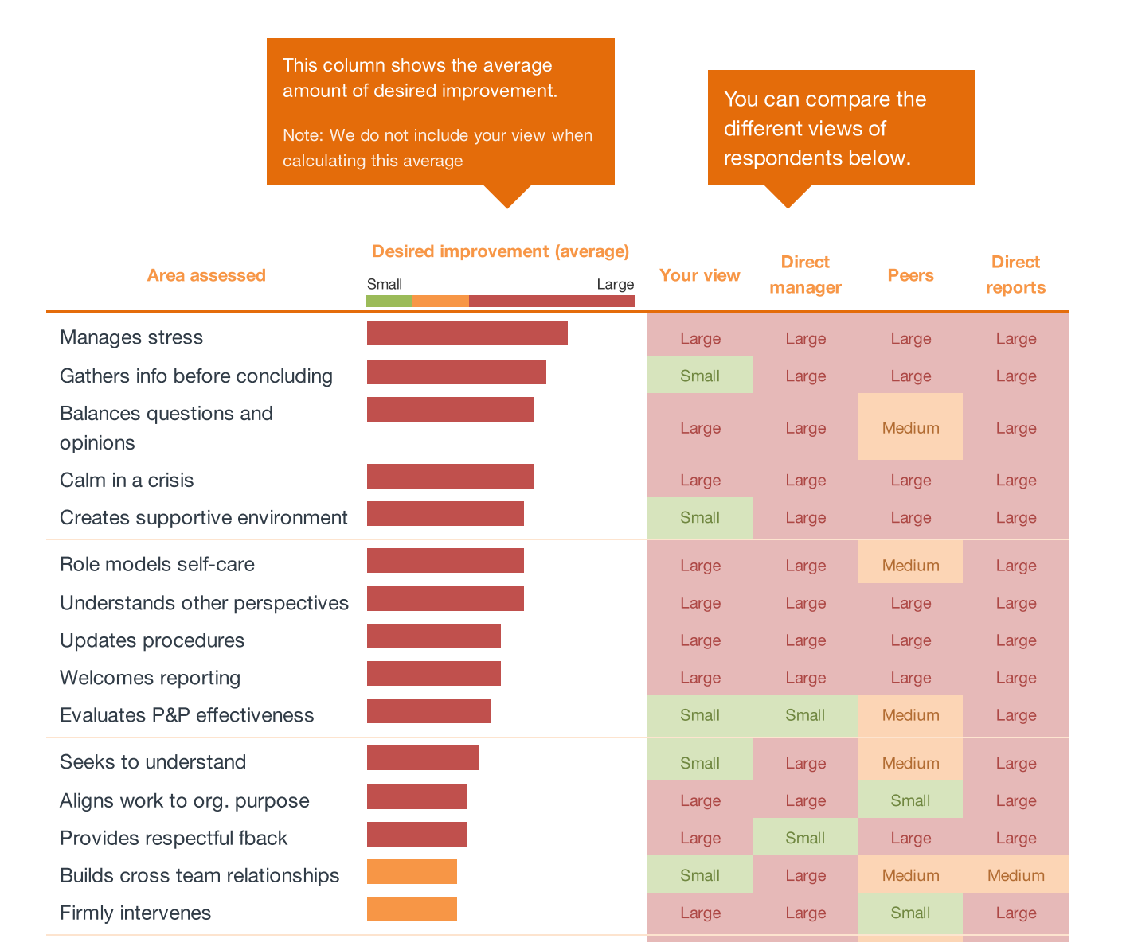
Add different views sample
What ISA360 Measures
Reveals Blind spots
Helps focus on areas that will have the biggest impact right now
Notes:
We also found that most leaders weren’t aware of these gaps until their colleagues, manager and staff gave them genuine, honest and valid feedback

Slide 9
Insights About Leaders
Our Research has Found that Leaders…
Have strengths in Purposeful and Caring
Lack the ability to effectively demonstrate Curiosity and Connecting, ultimately limiting their leadership potential
Those who perform substantially better in PSI360 result in a more engaged workforce
41% felt more valued?
59% more listened to?
58% less avoidant of safety issues?
63% more confident that changes would result in improved processes?
57% more likely to share their ideas and concerns?

Slide 10
Insights About Leaders
Our Research has Found Leaders Who Engage in Transformation Activities After Their PSI360….
Had a significant improvement in leadership impact
What would it mean to you if…..
17% more staff, felt safe to stop the job if unsafe?
34% more staff, had confidence in safety processes?
15% more staff, felt empowered?

Slide 11
Head Office
10B, 151 – 153 Herdsman Parade,
Wembley, Perth
Western Australia 6014
+61 8 9287 1041
info@datadrivesinsight.com
datadrivesinsight.com
Creating thriving organisations

