Slide 1
Lifting Team Performance Psychological Safety & Inclusivity Program - Accreditation
Elevating productivity and reducing risk through safe, inclusive teams.

Slide 2
Information Session
Today
What to expect in the program
Accessing the portal and portal tour
Meet others in the program
Q&A

Slide 3
What to expect
6 x Online modules to complete between virtual sessions (5hrs)
2 x Virtual Sessions to expand learning and build confidence (4.5hrs)
Deliver Pilots to shift from the classroom to real world
Support throughout

Slide 4
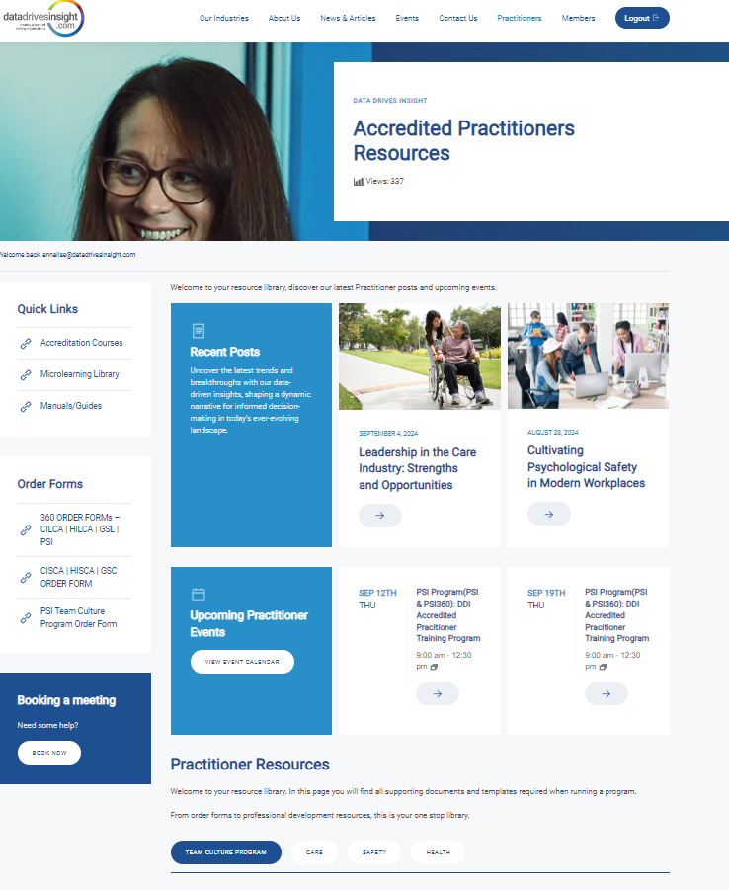
Practitioner Resource Centre
Help deliver projects
Help sell the solutions
Development resources for you and your clients
Stay connected to the community
Research Updates and latest news
Success stories
Practitioners Resources - Data Drives Insight
Notes:
Facilitator to log onto the portal and show how to access the course, what other resources are there, how to ask questions during the program (forum)

Slide 5
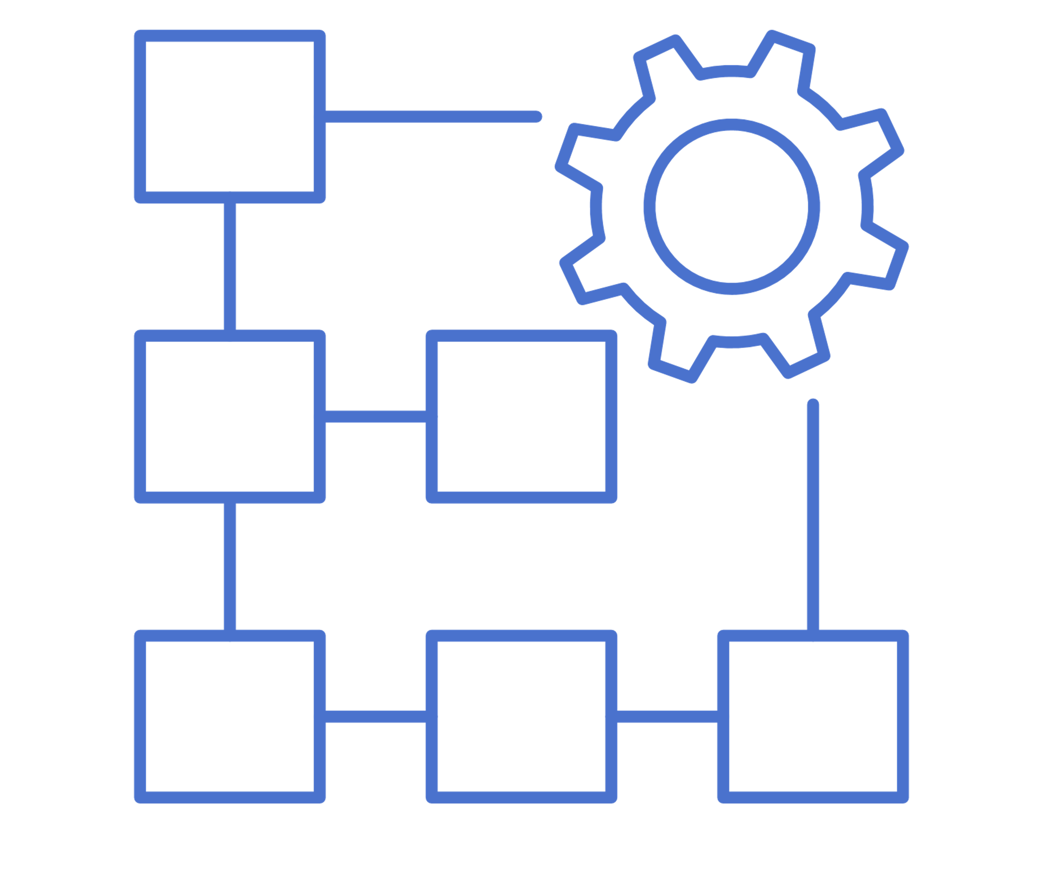
UNDERSTANDING THE CHALLENGES IMPACTING YOUR CLIENTS
WORK HEALTH & SAFETY
TURNOVER
PRODUCTIVITY
Regulatory changes around expectations of employers and industry standards
High turnover is costly. It’s challenging to attract and retain talent
Projects running over budget and behind schedule.
How do you want to help? What do you need from the program?
Psychological safety can have significant impacts on the wellbeing o your workforce and are some of the most expensive and time-consuming workplace injuries.

Slide 6
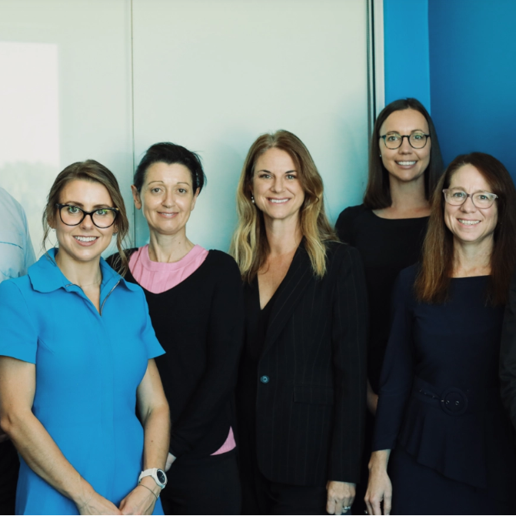
Your support crew
Annalise Wright: annalise@datadrivesinsight.com
Donna Buchanan: donna@datadrivesinsight.com
Brendan Wright: Brendan@datadrivesinsight.com

Slide 7
Virtual Session 1: PSI for Teams
Q&A – what do you want to explore more based on what you learnt?
Deep dive into psych safety and why it’s important for team performance
Key frameworks for working with teams and leaders
Use a live demo dashboard to prepare for a debrief (work in breakout groups)
Trouble shoot debrief challenges
App/portal walk through – this is how the participants experience the program
Explore the Micro-Learning Library – how you can use it in your work

Slide 8
Improved Team Performance
=
Improved Organisational Performance
Over the past few decades there’s been a huge emphasis on Organisational Culture and Performance.
Research shows that organisational culture is built at a team level.

Slide 9
Team Performance is the driver of Organisational Performance
For an organisation, high performing teams can bring the following benefits:
Increased productivity
Reduction in safety incidents
Reduction in employee turnover
Motivated employees who innovate
Quality improvements
Increased engagement

Slide 10
Team Performance is
improved through Psychological Safety
So, what is Psychological Safety?
“A belief that one will not be punished or humiliated for speaking up with ideas, questions, concerns, or mistakes, and that the team is safe for interpersonal risk taking”
- Amy Edmondson
Psychological safety is crucial for the performance of teams.
“We learned that there are five key dynamics that set successful teams apart from other teams at Google. . . . Psychological safety was far and away the most important.”
—Julia Rozovsky, people analytics manager at Google, Aristotle Project

Slide 11
Psychological Safety and Team Performance?
Gallup Research:
“My opinion counts at work” 3/10 Strongly Agree
Shifting from a 3/10 to a 6/10.
Benefits:
27% reduction in turnover
40% reduction in safety incidents
12% increase in productivity.
Amy, C. Edmondson. “The Fearless Organisation”. HBS. 2019. Wiley.
Gallop “State of the American Workplace Report 2017”
Google Aristotle Project
5 yr Study.
180 Teams.
I question: What were the ingredients of the highest performing teams?
5 Dynamics:
Impact, Dependability, Structure & Clarity, Meaning and Psychological Safety
“Psych Safety was by far the most important factor – it UNDERPINNED the other 4”
Rozovsky, J. “The five keys to a successful Google team.” Nov 17, 2015.
Notes:
Add references and brief details of the studies.

Slide 12
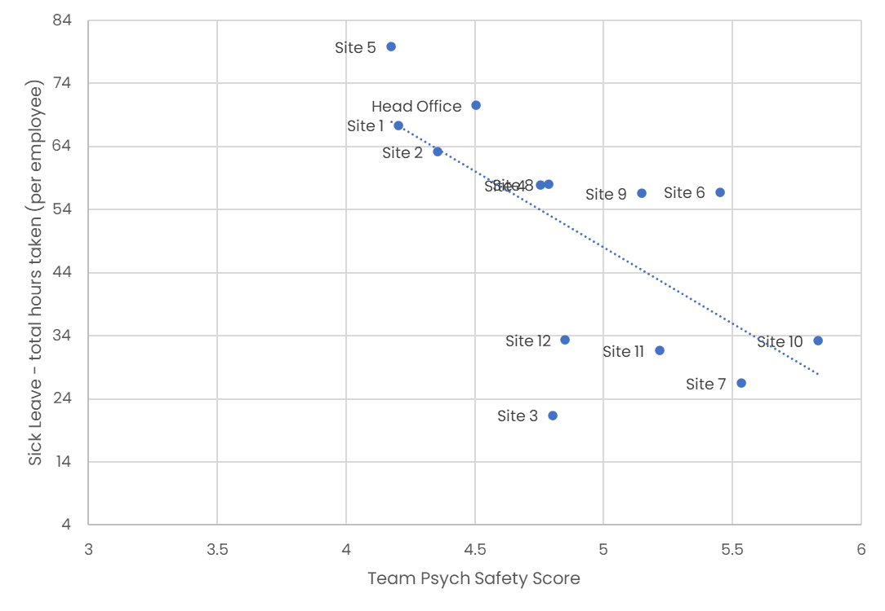
Costs and Safety Risks of Low Performing Teams
Case Study: Residential, Community & Retirement Living Organisation (Perth & Regional WA, 800 FTE). Sick leave and agency fees were costing this organisation significantly
'Site 5' had low Psych Safety resulting in:
High levels of sick leave, costing $593,600 p/a in sick leave and agency fees.
The second highest safety incident p/employee ratio across the organisation.
By improving this team's psych safety score by 30%, to the same level as some of the higher performing sites (Site 7 & 10), this team has the potential to:
Save $371,000 in agency fees per year.
Reduce safety incidents by 40%
Notes:
Low psychological safety is costing us in other ways, outside of turnover, every day. Let’s look at an example organization from our data set. They have 13 teams working in different locations across Australia. The data is telling us that teams with low psych safety had significantly higher sick leave, than those with high psych safety. In other words, people would prefer to take sick leave, than deal with issues or speak up. And we all know that high sick leave is a pre-cursor to resignation! They have got to a point where they cant face work I would rather risk the wrath of letting the team mates down than the distress of working. Guess what though……this organization got to do something about it….because they made the invisible visible!!! Which meant the teams put measures in place to get in and start listening etc. EL is going to show you how this happends in a moment.
These costs go beyond sick leave, when we consider the location with the lowest psych safety score, they are averaging 82 hours of sick leave per employee annually – most employees are only entitled to 76 hours a year. Think of the contractors or relief staff required to cover these hours. I can see the accountants in the room shifting uncomfortably.
We need to improve psychological safety.

Slide 13
Teams with high psychological safety often experience:
A deeply engaged, productive and passionate workforce
Staff who take initiative and collaborate effectively
Effective decision making and higher quality solutions
Innovation, creativity and focus on excellence
Attract and retain better talent

Slide 14
But here’s the kicker…
A ‘normal team’ has low psychological safety and instead
prefers artificial harmony.
Let that sink in for a moment

Slide 15
Reflect on the last 24 hours where you thought something about someone else’s behaviour, performance etc but didn’t tell them.
Why didn’t you?
Do you now see the size of this challenge?
ACTIVITY

Slide 16
Teams with low psychological safety often experience:
Low tolerance for mistakes
No/Low sharing or diversity of opinions
Criticism and blame
No/Low innovation or creativity
Distrust
Low/slow productivity
Notes:
The unintended impact of this artificial harmony is…

Slide 17
More about…
Psychological Risks
Psychosocial Risks
Psychological Safety
The New “standard” set by ISO
What specifically the PSI Pulse Measures

Slide 19
Psychological Safety & Inclusivity Indicator
High Performance
Culture of Learning
Innovation
Psychological Safety
Asking for help
Problem Solving
Continuous Improvement
Conflict Resolution
Neutral
What it measures
Wellbeing
Clarity
Psychosocial Risk
Isolation
Security
Workload
Fear
Concern

Slide 20
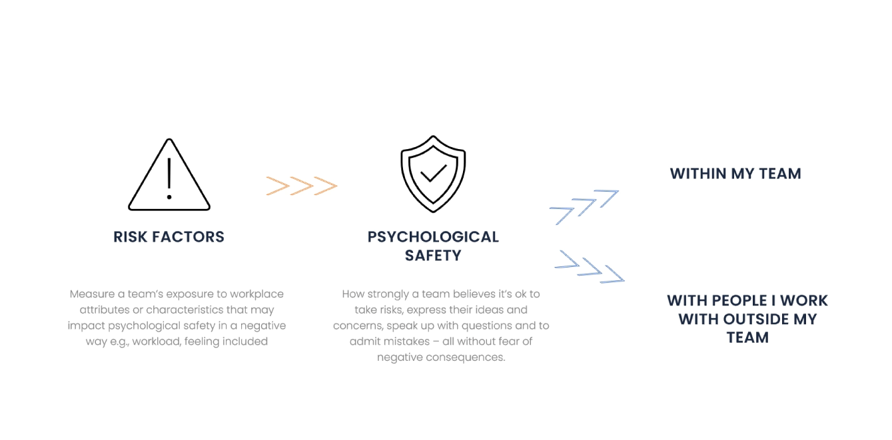
What the PSI Measures

Slide 21
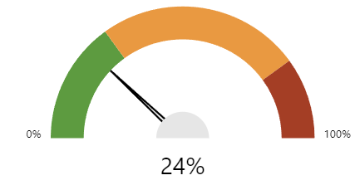
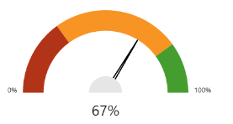
Risk Factors | Psychological Safety
In my team…. | In my team… and Outside my team…
Frequency Scale: 1= not at all 2 = rarely 3 = some of the time 4= most of the time 5= all of the time | Frequency Scale: 1= not at all 2 = rarely 3 = some of the time 4= most of the time 5= all of the time
Lower the score the better I.e.. Risk factors are experienced less often | Higher the score the better The psychological safety elements are experienced more often
I felt fully included as a member of the team I was trusted to do my job I was encouraged to use my skills and knowledge I felt the effort I put in was equal to the reward I took out I understood what was expected of me in my role I was acknowledged or recognised for good work My workload was manageable I was enabled to make decisions about my own work schedule or priorities I felt satisfied I felt secure about my role/position in the team I was committed to our teams current plan I felt supported to balance my work/life needs | Inside I felt safe to make a mistake, knowing I could learn from it I felt accepted for my differences I was encouraged to ask for help when I needed it I noticed people were willing to share ideas and concerns New ideas were welcomed I felt genuinely cared for I felt listened to I felt connected to my team I felt respected by my team Information was shared openly Outside I felt safe to make a mistake, knowing I could learn from it I felt accepted for my differences I was encouraged to ask for help when I needed it I noticed people were willing to share ideas and concerns New ideas were welcomed I felt genuinely cared for I felt listened to Information was shared openly
What the PSI Measures
Also see the Validity & Reliability paper

Slide 22
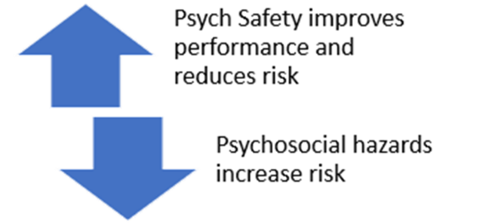
Mapping PSI to ISO 45003 Psychosocial Hazards
Psychosocial risk and psychosocial hazards are important, however the PSI extends BEYOND measuring just these things. It includes psychological safety, which contributes to performance, innovation etc., not just risk management.
Think Assurance, rather than Compliance.
Common psychosocial hazards at work | PSI Program Item
Job demands | 7. My workload was manageable 12. I felt supported to balance my work/life needs
Low job control | 2. I was trusted to do my job 8. I was enabled to make decisions about my own work schedule or priorities
Poor support | 15. I was encouraged to ask for help when I needed it 18. I felt genuinely cared for 13. I felt safe to make a mistake, knowing I could learn from it
Lack of role clarity | 5. I understood what was expected of me in my role
Poor organisational change management | 22. Information was shared openly 16. I noticed people were willing to share ideas and concerns 10. I felt secure about my role/position in the team
inadequate reward and recognition | 4. I felt the effort I put in was equal to the reward I took out 6. I was acknowledged or recognised for good work
poor organisational justice | 14. I felt accepted for my differences 21. I felt respected by my team 1. I felt fully included as a member of the team
traumatic events or material | All PSI questions
remote or isolated work | 20. I felt connected to my team 18. I felt genuinely cared for
Common psychosocial hazards at work | PSI Program Item
poor physical environment | Not directly in tool, however, psych safety would be a precursor to whether someone felt safe to speak up about poor physical environment e.g., conditions that affect concentration (e.g. high noise levels, uncomfortable temperatures or poor lighting)
violence and aggression | All PSI questions
bullying | 14. I felt accepted for my differences 15. I was encouraged to ask for help when I needed it 16. I noticed people were willing to share ideas and concerns 18. I felt genuinely cared for 19. I felt listened to 21. I felt respected by my team
harassment, including sexual harassment, and | 14. I felt accepted for my differences 15. I was encouraged to ask for help when I needed it 16. I noticed people were willing to share ideas and concerns 18. I felt genuinely cared for 19. I felt listened to 21. I felt respected by my team
conflict or poor workplace relationships and interactions | All psych safety questions

Slide 23
Turning diversity into lived inclusivity
Psychological Safety is a well-established driver of team-performance, effective decision making, innovation and higher quality solutions.
Professor Amy Edmondson, Harvard Business School.

Slide 24
"Diversity without inclusion is a story of missed opportunities, of employees so used to being overlooked that they no longer share ideas and insights.
Harvard Business Review article "Diversity Doesn't Stick Without Inclusion"
High Diversity/ Low Psych Safety
There is richness of views and ideas, however, team members withhold them from the group because they don’t feel “safe” to express them.
High
Diversity
High Psych Safety / Low Diversity
Team members feel “safe” to fully express themselves, however, there’s simply not sufficient diversity of thought to create high performance. “Group Think”
Low
Low
High
Psychological Safety
Notes:
Speaker notes:
Let’s consider the relationship between Psychological Safety and Diversity.
The matrix here shows that when we have High Diversity, but low psychological safety team members experience working in silos, issues are either not raised or raised with others (gossip), ideas are not shared, people are excluded from decision making – essentially people are present but not fully contributing, if they do, they are shut down or ignored.
When we have Low Diversity and high Psych Safety the team may achieve goals, but miss out on the full potential performance as they do not have access to rich, diverse, alternative perspectives (more here??)
Case Study: Research by Datadrivesinsight.com
Organisation X celebrated their diversity:
80% Female 31% CALD
Met diversity targets
Program to attract people living with disability
BUT, they did not have inclusivity
Female staff felt less included
Female staff felt less listened too
CALD staff felt ‘hard to ask for help’
CALD had fewer opportunities to develop skills

Slide 25
High Diversity/ Low Psych Safety
There is richness of views and ideas, however, team members withhold them from the group because they don’t feel “safe” to express them.
High
Inclusivity
Diversity
High Psych Safety / Low Diversity
Team members feel “safe” to fully express themselves, however, there’s simply not sufficient diversity of thought to create high performance. “Group Think”
Low
Low
High
Psychological Safety
Notes:
Speaker notes:
The gold standard, and where innovation lies, is in High Diversity and High Psychological Safety – the high performance Zone
Here teams will raise ideas and issues in a timely and constructive way
They will value each other for what they bring and the potential of what they can be/bring
This means individual, team and organisational learning is possible – which brings about innovation.
These teams are highly desirable – attraction and retention is easy.
This is the high performance zone, and the focus is on teams for a reason…

Slide 26
How we can help through the PSI
Backed by globally renowned psychological research, PSI provides an empirical understanding of psychological health, team effectiveness, motivation, wellbeing, engagement, inclusivity, and productivity in your teams.
4-minute online survey
Identifies risk factors
Builds an evidence base that helps inform business and workplace strategy
Makes the invisible Visible
Puts the power for change in everyone’s hands
Uses neuroscience to effect lasting change
Notes:
Measures the team’s exposure to workplace attributes or characteristics that may impact psychological safety in a negative way e.g., workload, feeling included

Slide 27
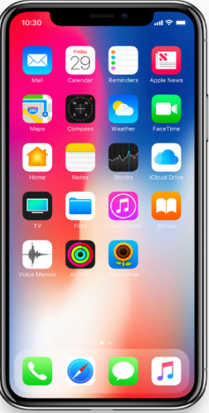
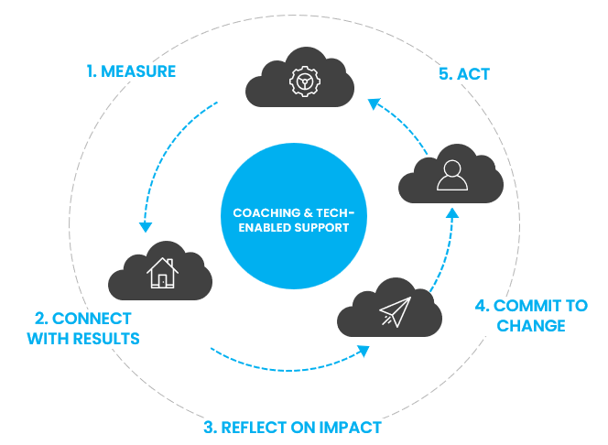
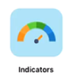
PSI Bringing it to life
Notes:
Psychological Safety
This dial reflects your team’s psychological safety score i.e., how strongly does your team believe it’s ok to take risks, express their ideas and concerns, speak up with questions and to admit mistakes – all without fear of negative consequences. The higher the score, the stronger this belief is. High performing teams have a high score on this dial.
Risk Factors
This dial represents your team’s risk level i.e., exposure to workplace attributes or characteristics that may impact psychological safety in a negative way e.g., workload, feeling included. The lower the score, the lower the risk to psychological safety. High performing teams have a low risk.

Slide 28
Essential Frameworks for working with leaders and teams

Slide 29
Integral – Systems approach to change
Invisible
Visible
Results
Performance
Outcomes
Impacts
Individual views
& beliefs
Individual behaviours & actions
Organisational culture
Organisational systems, policies, processes
Page 13 and 26 of Manual
Ken Wilber Integral Model

Slide 30
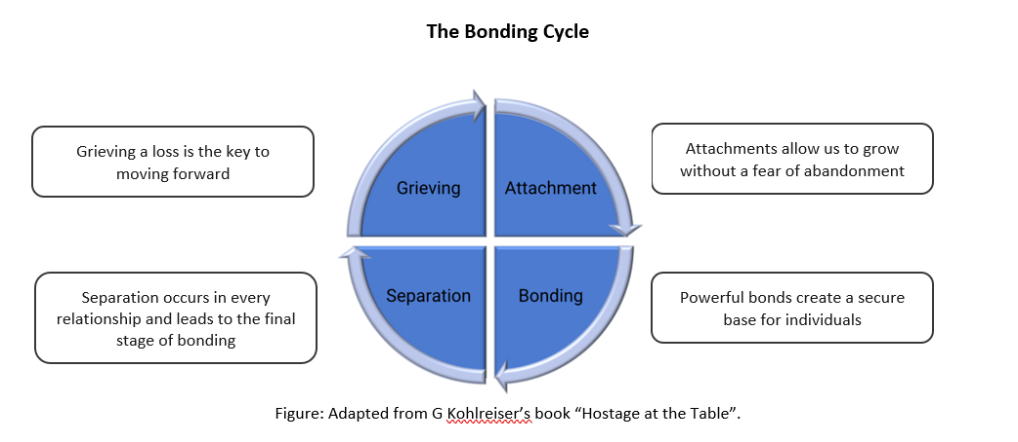
Secure base leadership
Leaders who help others connect to people and goals, create ‘secure bases’ from which they can perform, take risks, grow and develop.
Dynamic leaders focus on maximising their teams' performance towards common goals rather than trying to control them. To achieve this, leaders are encouraged to prioritise building bonds with their employees around a common goal that motivates employees to take risks, seek change, and effectively manage conflict. This is what is embodied in a generative culture (Westrum, 2004).
Page 11 of Manual
John Bowlby, Attachment Theory

Slide 31
Generative Culture
Culture occurs at team level
Different Teams in an organization can have different cultures
Generative cultures are the goal!
Detrimental | Bureaucratic | Generative
Power Oriented Characterised by low cooperation, blame, hiding incidents. Information is often withheld for personal gain. It is not safe to speak up, especially if doing so might be embarrassing. Messengers are shot, responsibilities are shirked. When things go wrong, a scapegoat is found and punished. There is no real learning from failure. | Rule Oriented Focused on positions, hierarchy, span of control. Responsibilities are compartmentalised by departments that seek to preserve their own existence and power. Information must flow through standard channels or procedures, in order to preserve status quo. Messengers are neglected, responsibilities are narrowed. When things go wrong, there is a process to produce retribution. Learning is institutional. | Purpose Oriented The hallmarks are good information flow, high cooperation and trust, bridging across teams, and conscious inquiry. Psychological safety creates openness, curiosity, care, and systemic learning. There is awareness of the importance of getting the right information to the right people, in the right form at the right time. When things go wrong, people look for a systemic cause and for systemic solutions, a recognition of the interrelated parts of the organisation. Messengers are trained.
Page 26 of Manual
A Typology of Organisational Cultures, Quality and Safety in Health Care · January 2005 Ron Westrum

Slide 32
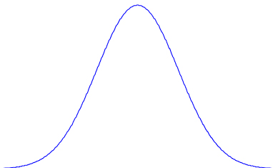
Communication Styles
H
Relationship Success
M
L
L
M
H
Level of Conflict
Another relevant model is Patrick Lencioni, Conflict Continuum
Notes:
These have entry and exit animations

Slide 33
Transformation Model
View
Action
Result
If I ask for help people might think I’m not capable
Outcome suffers
Quality suffers
May or not be seen as competent.
Stay quiet and try and figure it out on my own
“Asking for help gives us better results.
People LIKE helping and sharing their knowledge and skills.”
Collaboration
Innovation
Achieve better outcomes
Team members get a chance to shine
Learn from others
Speak up, ask for help/ input from others.

Slide 34
How it works
The PSI Process for participants
The role of the practitioner

Slide 35
The PSI Program Steps
Week 1
Week 2
Week 3
Select
Teams
Information Session
Complete PSI Pulse
Results Generated
Debrief Team with Results
Coach in your pocket
Repeat / Cycle
Which teams
How many teams
Email addresses
15-minute virtual session or recording of a session.
Email (template)
4min Pulse on any device.
Indicator open for 2-5days
Immediate result for each team.
Top strengths
Top development areas – “hot spots’.
Shifts over time.
45-minute virtual session to discuss results with each team.
Participants access after debrief
Provide templates and drafts of emails and slides
Facilitate the info session
Monitor and support positive response rate.
Identify opportunities, trends.
Make recommendations
Identify opportunities, trends.
Make recommendations
Coach and support
Engage, Nudge, Coach and support
Additional activities to support growth and development
Collate info with client and place order

Slide 36
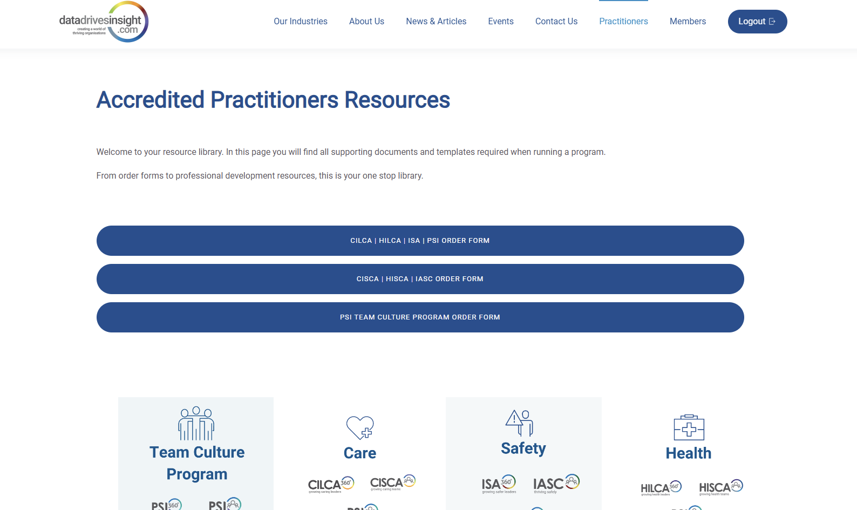
Resources for Practitioners
All the resources you need in the member portal, practitioners page
Members - Data Drives Insight

Slide 37
Debriefing
Purpose is to enable the team to:
Connect with the results
Reflect on the impact (self and others)
Commit to a change
And
Complete Personal Development Plan
Utilise the Online Resources
Notes:
Utlise a sample report to help the AP’s connect with the report and explore how they might debrief it.
Also reference the AP manual that has guidance on how to prepare for a debrief, the basic structure of a debrief etc.

Slide 38
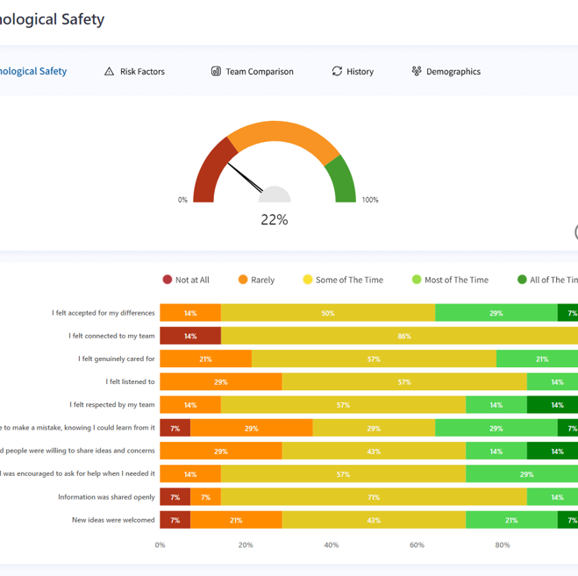
Case Study 1: Module 3
What did you learn from the case study in Module 3?
What were your key takeaways?
What further questions do you have?
Can you customise the dashboard or survey?
Notes:
All PSI customers can now add up to 3 additional demographic filter questions at the END (not in replacement of) our current standard demo q’s.
E.g., LG Pro wanted to add a ‘regional vs. metro,’ filter.
We will no longer allow for further customisation (like we did with PUC) unless they are willing to pay a premium.

Slide 39
Let’s look at a few more examples from teams……….
Where are your eyes drawn to? – ask this a few times to see different reactions
What are the strengths of the team? – this is just as important as the developmental areas so make sure to point out.
How do these results sit with you? (surprised, makes sense, disappointing, upsetting etc) – normalise reactions.
Is it something you are all wanting to work on and change?
Which area if the team focused on it over the next month would make a big difference?
What impact would it have to the team if this area improved?
What could the team begin to do differently to work on this area
Page 46 of Manual

Slide 40
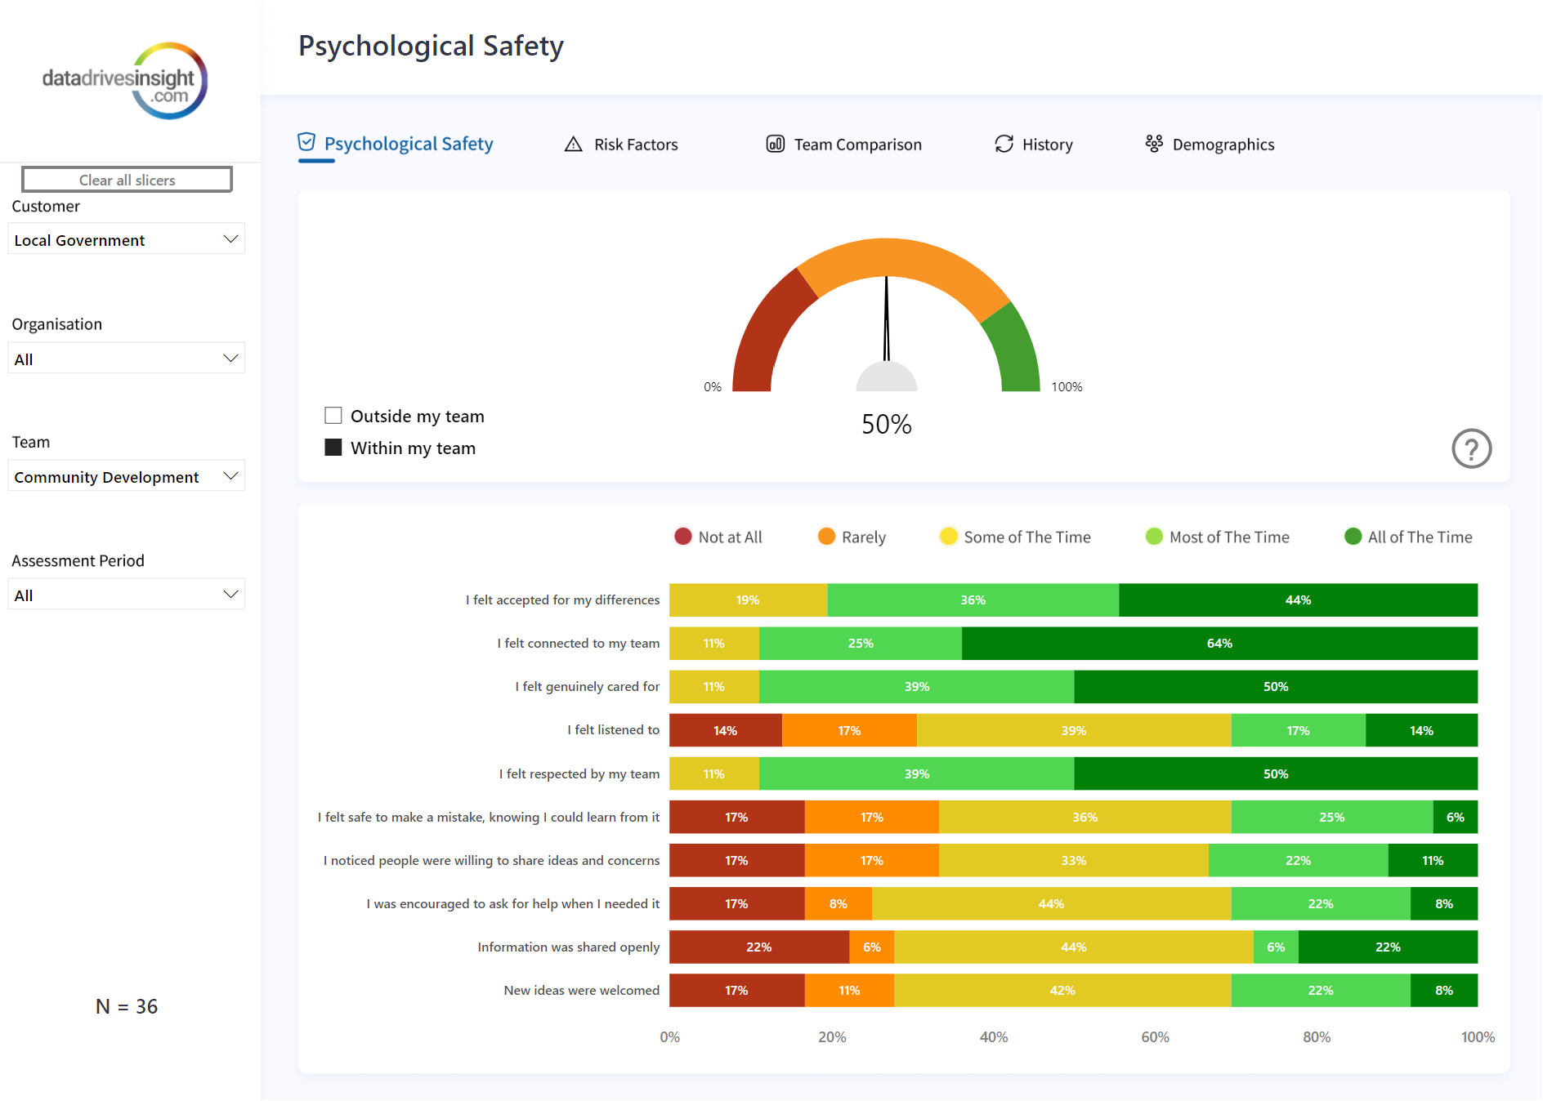
Case Study 2: LG Dashboard
Local Government Demo Dashboard
3 teams
3 pulses
In groups
look at the results
Use the guidance on pages 42-47
Prepare to debrief your team
Microsoft Fabric (powerbi.com)

Slide 41
Common Questions and comments
Questions/comments | Responses
If the average is 3/10 and we are a 5/10 then we aren’t too bad then? | If you forget about the average for a minute how does it sit with you that half of your team don’t feel accepted for their differences? What’s the impact on the team and outcomes of this?
How is this formula coded? | That I can’t tell you as that’s the secret sauce! What I can tell you is that it's been rigorously tested and is valid and reliable
Does the 20% mean 2 people given we are a group of 10? So that means 2 people rarely feel ….. | Yes that would be correct; its normal to want to figure out who in the team said what, but remember the ‘some of the time rating’ is also not ideal.
I don’t agree with these results. I think we discuss lots of new ideas and I always feel heard when speak | We can all experience the same situation differently. Whilst you feel heard when you speak; perhaps have a think about what you may be doing or may not be doing that could send the message to others that they aren’t feeling heard or that it may not be safe to share.
I’m a leader of the team and I meet with my team all of the time and separately. I feel I do listen to people often so why is the results so low? | Remember this isn’t a leadership assessment – this is how each member of the team contributes to the environment.

Slide 42
Virtual Session 2: PSI360 for Leaders & Business Development
Today
PSI360 Sample report exploration and debrief preparations & approach
Explore the SDG
BD - Elevator pitch
BD – Relevance & Contest Discussion using the ray diagram
BD – Objections – what and how to respond
Next Steps – doing your pilot.

Slide 43
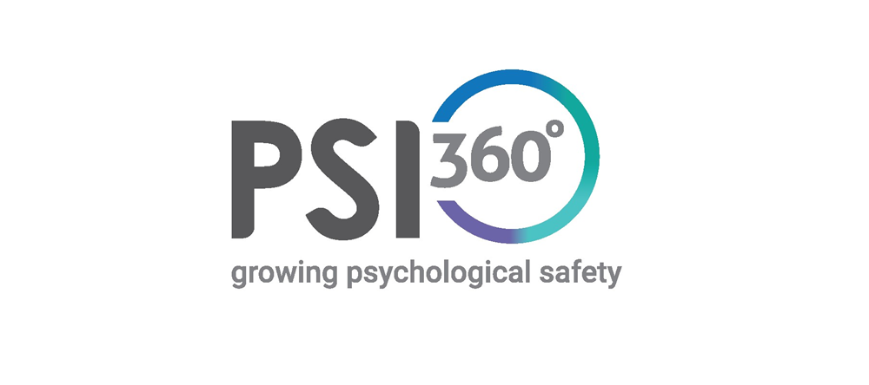
Leadership Focus

Slide 44
About PSI360
The four domains explained
What it measures and how its represented
Insights

Slide 45
Role of leaders as secure base
Reflections on the content in Module 1 around secure bases and the four capabilities?
What are they?
Why are secure bases relevant to psychological safety and inclusivity?
Notes:
Page 10 in the manual
Module 1 in moodle
Two types of secure bases: leaders and goals
In organisations, dynamic leaders focus on maximising their teams' performance towards common goals rather than trying to control them. To achieve this, leaders are encouraged to prioritise building bonds with their employees around a common goal that motivates employees to take risks, seek change, and effectively manage conflict. This is what is embodied in a generative culture (Westrum, 2004).

Slide 46
What does PSI360 experience do?
View
Action
Result
Makes the invisible, visible
Capability
Impact
Creates a space for reflection and increased awareness of current view.
Opportunity to shift views for different outcomes.
Feedback on how often the leader demonstrates key behaviours
How others experience you as a result of what you do
What I do and how often
Intended and unintended
Gives feedback from manager, peers and reports on actions and impacts

Slide 47
Four Domains- Explained
Purposeful
Purposefulness provides practical guidance and orientation to a person, team or organisation, indicating the direction of change. When people know why they are doing a project or task, they can self-correct when they get off course. Purpose is enacted through shared commitments.
People make commitments to safety explicit and visible, engaging each other in the possibility of, and practices that support everyone going home safe every day. When integrity is broken, it is restored by returning to commitment, rebuilding trust. Leaders engage others to be purposeful, committed, and continuously learning how to improve safe performance.
The items:
Actively shares their commitment to the vision of the organisation
Does what they say they will do
Demonstrates a high level of personal commitment to safety and wellbeing
Encourages people to raise issues or concerns
Enrols others to understand the organisational goals
Creates opportunities to discuss how our work supports the purpose of the company
Encourages the team to appreciate each other when they achieve goals
Also see the Validity & Reliability paper

Slide 48
Four Domains- Explained
Caring
Care is regard for the intrinsic value of people, actively providing what is needed to support health, safety and wellbeing. Care is personal, connecting with others based on understanding of how it is and what is needed from their perspective. Regard for others creates an environment where people respect each other and build trust and willingness to say what is true.
Caring springs from care for oneself, ensuring one has the capacities and energy to provide real help. It balances a focus on building strengths with a compassionate drive to address gaps in performance and realise potential.
The items:
Actively cares about all of their team
Firmly intervenes when they become aware of inappropriate behaviour
Provides feedback to others in a respectful manner
Spends time to get to know others personally
Effectively role models self-care
Provides a sense of calm even in a crisis
Manages stress well
Shows compassion for the person when giving feedback on performance
Encourages team members to raise mental health concerns
Creates an environment where team members can discuss difficult topics

Slide 49
Four Domains- Explained
Curious
Curiosity creates openness to learning how things actually happen in order to improve safe performance. It includes the capacity to suspend what you know, and actively seek out what you don’t know.
Openness means that people are slow to make judgments or to blame people when things go wrong. Inquiry is kept open as long as possible in order to fully understand what happened and to generate lasting change.
People listen to as many diverse perspectives as possible in the time allowed in order to create a more complete picture.
The items:
Supports actively seeking information and ideas to create a learning environment
Seeks to understand all perspectives when something goes wrong
Makes sure others' perspectives are fully understood
Keeps a balance between asking questions and giving opinions
Stays open to new information on how to improve performance
Gathers information and ideas before making conclusions

Slide 50
Four Domains- Explained
Connecting
Allows us to see how things are related, people seek to understand how roles, teams and functions must integrate to optimise the performance of the whole system.
Connecting is increased when people work together to create models of how the system works and then continually updated as new information is revealed. There is a concerted effort to understand how people close to the work understand the work, updating systems to match how work is actually done.
There is work on the right things at the right time with the right people. There is use of highly intentional and focused approaches that leads to operational discipline and maximises the use of all resources to achieve the purpose.
The items:
Identifies gaps in performance and works to resolve them
Encourages the team to use experts outside the immediate team, if necessary, to achieve goals
Supports actively testing processes and procedures to determine their effectiveness
Actively builds good working relationships with other teams
Encourages others to consider risks so that they are understood and managed
Encourages sharing resources with other teams to achieve the organisations purpose
Ensures procedures reflect best practice
Encourages working together to resolve issues
Manages team conflict effectively
Addresses challenging situations effectively

Slide 51
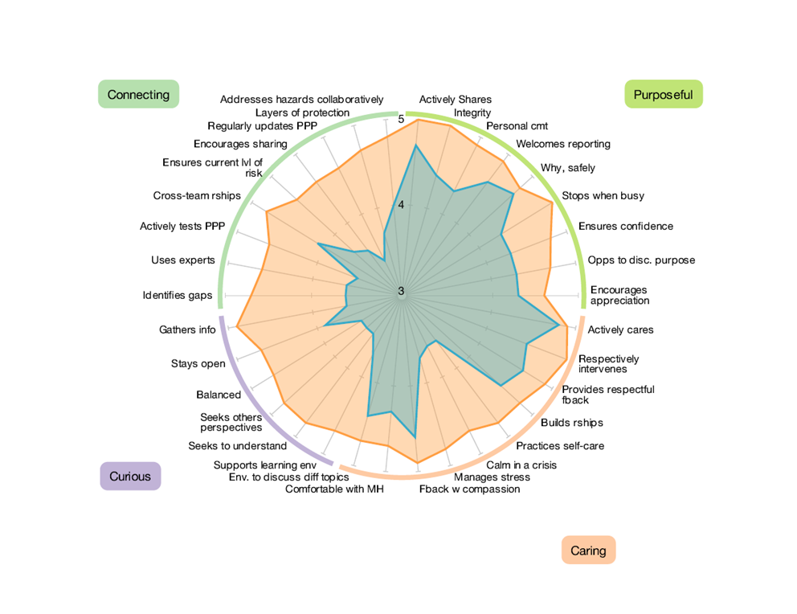
Add four factor stuff
Add example spidergraph
What PSI360 Measures
1. Leadership Capability
Measures both current and desired performance
Helps focus development and growth to what will have the greatest impact
Example

Slide 52
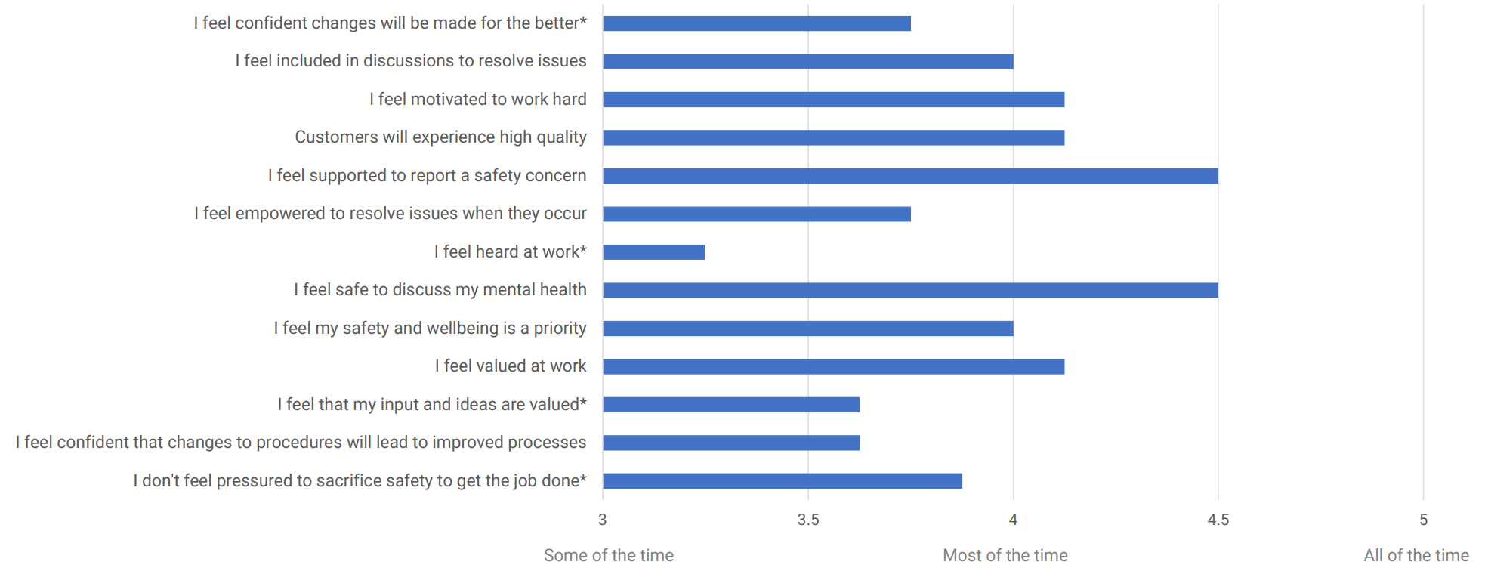
Add impact graph sample
What PSI360 Measures
2. Leadership Impact
In my interactions with my leader….

Slide 53
Add impact graph sample
What PSI360 Measures
3. Psychological Safety
In my interactions with my leader….

Slide 54
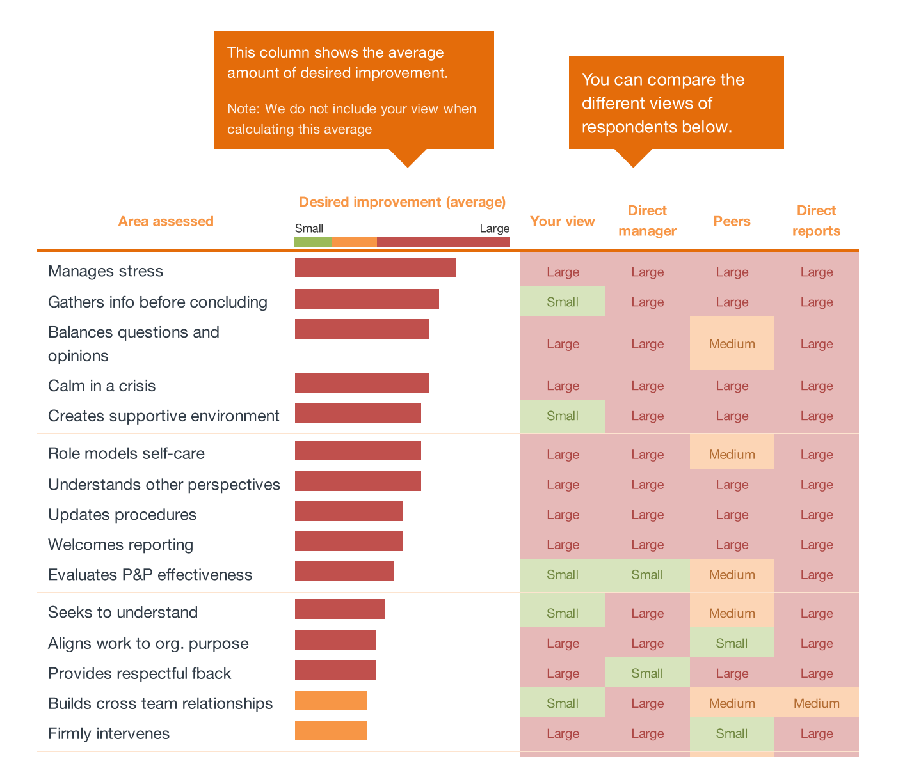
Add different views sample
What PSI360 Measures
Different perspectives
Reveals blind spots
Helps focus on areas that will have the biggest impact right now
Notes:
We also found that most leaders weren’t aware of these gaps until their colleagues, manager and staff gave them genuine, honest and valid feedback

Slide 55
Insights About Leaders
Case Study
60 leaders
2-year program
Critical Infrastructure Business
Research has Found that Leaders…
Have strengths in Purposeful and Caring
Lack the ability to effectively demonstrate Curiosity and Connecting, ultimately limiting their leadership potential
Those who perform substantially better in PSI360 result in a more engaged workforce
41% felt more valued?
59% more listened to?
58% less avoidant of safety issues?
63% more confident that changes would result in improved processes?
57% more likely to share their ideas and concerns?

Slide 56
Insights About Leaders
Case Study
60 leaders
2-year program
Critical Infrastructure Business
Our Research has found Leaders Who Engage in Transformation Activities After Their PSI360….
Had a significant improvement in leadership impact
What would it mean to you if…..
17% more staff, felt safe to stop the job if unsafe?
34% more staff, had confidence in safety processes?
15% more staff, felt empowered?

Slide 57
What’s included in the experience
Personal report
Confidential debrief
Access to self-directed online learning

Slide 58
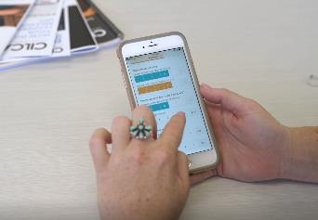
The PSI360 process
Receive an email inviting you to complete the survey. The survey will be open for 2 weeks to gather feedback from your raters.
Receive Email
Survey Open
Report & Schedule
Debrief and Development
Complete the survey
Nominate Raters
2 weeks to complete the survey.
All the feedback is collated and a report provided.
Debrief Sessions & Action planning.
Self Development Guide
Survey can be completed on any device and takes about 10mins

Slide 59
The Preparation Process
Work with your clients to set the project up for success.
Planning
Design
Communicate
Order
Agree who is going to participant, the timing of the project and how you will communicate
Draft communications
e.g. emails, presentations, posters.
Send communications to participants
Submit your order form with participant list attached.

Slide 60
Resources for Practitioners
All the resources you need in the member portal, practitioners page

Slide 61
Debriefing
Purpose is to enable the leader to:
Connect with the results
Reflect on the impact (self and others)
Commit to a change
And
Complete Personal Development Plan
Utilise the Online Resources
Notes:
Utlise a sample report to help the AP’s connect with the report and explore how they might debrief it.
Also reference the AP manual that has guidance on how to prepare for a debrief, the basic structure of a debrief etc.

Slide 62
Business Development
Understand Customer Context
Understand the solution
Optimal relevance & buy-in

Slide 63
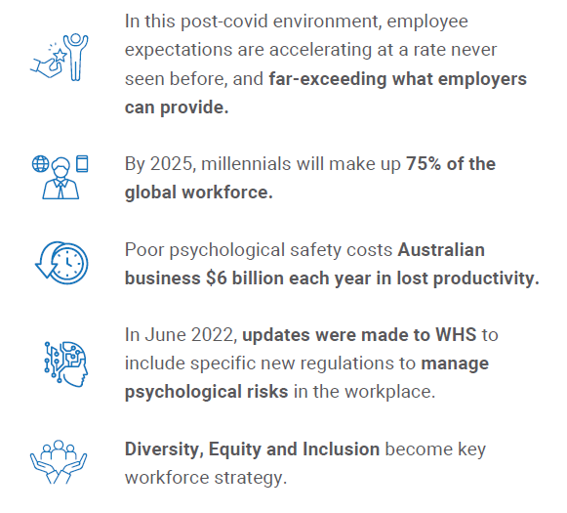
Psychological Safety The need – the world has changed
What is psychological safety?
“a belief that one will not be punished or humiliated for speaking up with ideas, questions, concerns, or mistakes, and that the team is safe for interpersonal risk taking”
- Amy Edmondson
Direct correlation between psychological safety, engagement and productivity
A Google research study found that Psychological safety is “the single most important factor for effective teams”
Yet, another Gallup study indicates employees currently feel 50% less cared for by their organisations than they did 3 years ago.
Notes:
So, what is psychological safety?
According to Amy Edmondson, American scholar and the pioneer of psych safety is “a belief that one will not be punished or humiliated for speaking up with ideas, questions, concerns, or mistakes, and that the team is safe for interpersonal risk taking”

Slide 64
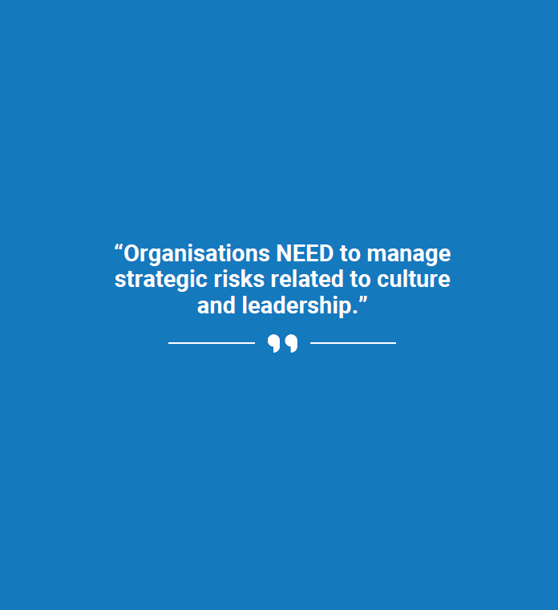
Psychological Safety The Business Case – writes itself
A psychologically safe environment identifies hazards, allowing the risks to be managed in a preventative and proactive way
A ‘normal team’ has low psychological safety and instead prefers artificial harmony.
But here’s the kicker … In fact: most teams operate at a 3/10
By moving that ratio to 6/10, organisations could realise:
27% reduction in turnover
40% reduction in safety incidents
12% increase in productivity.
And let’s not forget the legal implications of being non-compliant

Slide 65
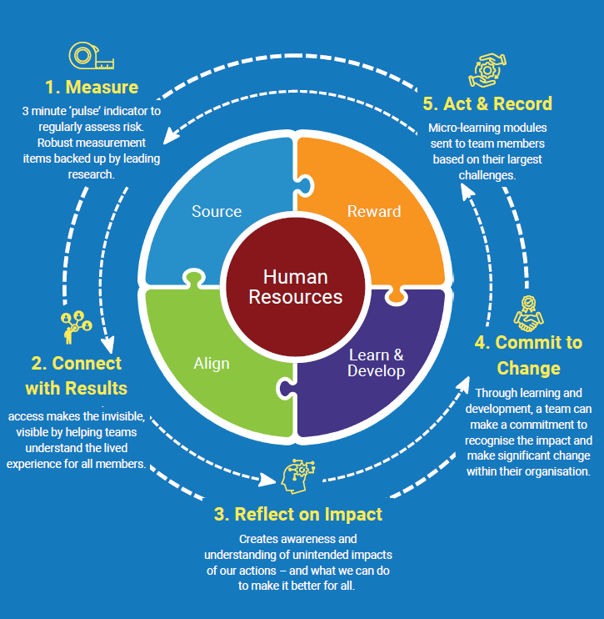
Psychological Safety and Inclusivity Program Changing the Paradigm
Focus on the Team and Team Leader
Designed for Enablement
Neuroscience-based Development Plans
View, Action, Results
Self-paced
Top Down and Bottom Up
Digital Transformation
Extensible
Scalable
Notes:
Measures the team’s exposure to workplace attributes or characteristics that may impact psychological safety in a negative way e.g., workload, feeling included

Slide 66
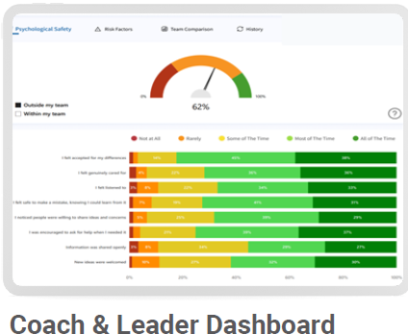
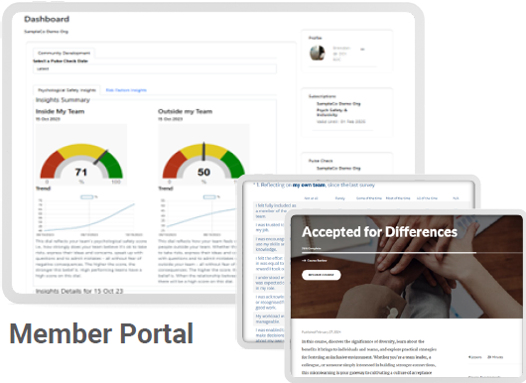
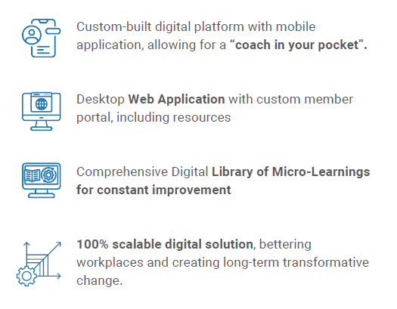
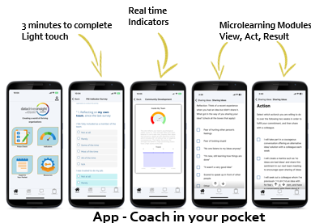
Digital Platform Enabling Transformation

Slide 67
Evolution - Human Resources
Introduction of “Systems of Engagement”
EX 1.0
EX 2.0
EX 3.0
EX 4.0
Annual engagement survey
Pulse surveys with mobile access
Intelligent dashboards and action plans
Continuous response action platforms
Once per year. Focus on management. Benchmarked annually. Rigid questions asked year after year.
Focus on Benchmarking
Agile surveys as needed.
Pulse on regular basis.
Feedback on mobile or apps.
AI-based action plans
Immediate feedback.
Focus on Feedback
Many sources of data.
Dashboards recommend action, deliver nudges, suggestions, and learning or action plans for individuals.
Focus on Behaviour Change
Tied into internal systems with alerts, feedback, cases and integration with CX systems.
Now called EX, not Engagement.
Focus on Action
Survey Technology
Mobile, easy to use
Useful data and Learning
Instrumented actions
and alerts
Timeline
2005 - 2015
2015 - 2020
2021 - 2023
2023 -
Talent Systems of Record
(May go into or be HCM Platform)
(ATS, LMS, Compensation, Benefits, Survey, Rewards)
Source : JOSH BERSIN – Insights on Work, Talent, Learning, Leadership, and HR Technology (HR_TechMarket_2021_v7.pdf)

Slide 68
Psychological Safety and Inclusivity Program Aligned, Engaged and Rewarded
Diversity & Inclusivity
Workforce Planning
Source
Payroll
Inform Strategic and Operational Planning to enable Data Driven Decisions from Insights gathered
Strategic Plan
Bonus
Recognition
Satisfaction
Align
Roles
Configure Key Organisational Risk Factors
Development Areas act as Assurance for Governance and Compliance Programs
Corporate Social Responsibility
Recruitment
Source
Reward
Attract & Retain
Engagement
Learn and Develop
HRIS
Coach in Your Pocket
Guided by Digital Nudge
Attached to HR Professional Development Plans
Certifications are Micro-credentials within Training module
On Boarding
Align
Learn & Develop
Professional Development Plans
Risk Factors
Assessments
Reward
Culture
Clear path for financial and career
Connectivity for regular push and pull feedback and interaction
Training
Governance and
Compliance
Feedback
Assurance
Coaching
Competencies

Slide 69
Demonstration
Measure - 4-minute “pulse check”
Connect - Intelligent Dashboard, App and Member Portal
Reflect on Impact, Commit to Change, Act and Record - Development Plans
Engage, Nudge and Reward
Notes:
Measures the team’s exposure to workplace attributes or characteristics that may impact psychological safety in a negative way e.g., workload, feeling included

Slide 70
The PSI Program Steps
Week 1
Week 2
Week 3
Select
Teams
Information Session
Complete PSI Pulse
Results Generated
Debrief Team with Results
Coach in your pocket
Repeat / Cycle
Which teams
How many teams
Email addresses
15-minute virtual session or recording of a session.
Email (template)
4min Pulse on any device.
Indicator open for 2-5days
Immediate result for each team.
Top strengths
Top development areas – “hot spots’.
Shifts over time.
45-minute virtual session to discuss results with each team.
Participants access after debrief
Provide templates and drafts of emails and slides
Facilitate the info session
Monitor and support positive response rate.
Identify opportunities, trends.
Make recommendations
Identify opportunities, trends.
Make recommendations
Coach and support
Engage, Nudge, Coach and support
Additional activities to support growth and development
Collate info with client and place order

Slide 71
CONVERSATION GUIDE
Connecting With The Client’s Needs
What are you trying to achieve?
What are your challenges?
How has the organisation measured to date?
ESG | Environmental, Social, Governance
OSH Performance
Risk Management
Innovation
Psychological safety
Compliance
Diversity/Inclusivity
Employer of choice
Customer satisfaction
Market Leading/ahead of the curve
Operational Excellence
HSE incidents
Team cohesion
Trust
Job satisfaction
Engagement
Inter-team collaboration
Productivity
Errors/mistakes
Attracting talent/Retaining talent
Projects behind schedule/over budget
Poor behaviours
Lack of innovation (No ideas coming forward)
Avoiding responsibility
Information not being shared
Levels of psychological safety and inclusivity
Leadership impact
Team culture
Worker engagement
Team effectiveness
Motivation
Wellbeing
Productivity
Attach PSI to a program that’s already budgeted for
How are these challenges being addressed through existing programs?
What are the opportunities to bundle, integrate, supplement rather than compete with existing measures?

Slide 72
Customer Focus
Become predictable through consistent and standards-based data driven analysis
Enables Succession Planning / Talent Management / Career Progression
DDI Value
Create measurable outcomes
Valid and Reliable
Empirical
Industry Specific
Confidential and safe
Quick and easy to do
Consistent
Repeatable
Scalable
Budgeting & Forecasting
Develops Leadership Capability and a Sustainable Workforce
Pricing
Project Mgt
Marketing & Branding
Human Resources Mgt (HRM)
Establish a Desirable workplace
Gov’t Grants and alignment
Enables Culture Change
Gain insight into the drivers of high and poor performance across your teams (internal benchmarking)
Customer Relationship Management (CRM)
PD Tools
Rewards
Industry benchmarking
“Talent” Program
Drive Standards Compliance
Culture
Customer Survey
Procedures and Systems to forecast, budget, plan, win and deliver business
Opportunities
Audit culture and correlate its impact on performance
Procedures and systems to improve overall environment and satisfaction for Staff
Audit
Standards
Industry research
Benchmarking
Procedures and systems to improve Customer engagement and ability of staff to deliver consistent service
Support and Escalation management
Predictable Service - Win and Deliver
Talent Management, Attraction and Retention
Rostering
Enterprise Resource Planning (ERP)
Customer Satisfaction and Service Quality
Case Management
Procedures and systems to improve process efficiency, management and reporting
Governance, Risk and Compliance (GRC)
Measure Compliance
Measure impact of accreditations, qualifications and certifications
Customer
Process Execution & Compliance
Accreditations, Qualification and Certifications
Objective / KPI / Pain
How to address?
Programs
DDI Attach
Notes:
Activity – in pairs consider an organisation one of you want to engage with or enrol.
What does the sun diagram look like for them? What do you know? What do you need to understand more?

Slide 73
Return on Investment
If improving psychological safety through a 12-month program, results in preventing just one team member to leave, it would result in a 580% ROI*.
It has been estimated that losing an employee can cost a company 1.5 – 2 times of the employee’s salary
*Using 2017 Gallup survey as measure of turnover reduction, based on the Australian median wage.

Slide 74
What if…..?
What are some of the common things said that can be blockers to the work?

Slide 75
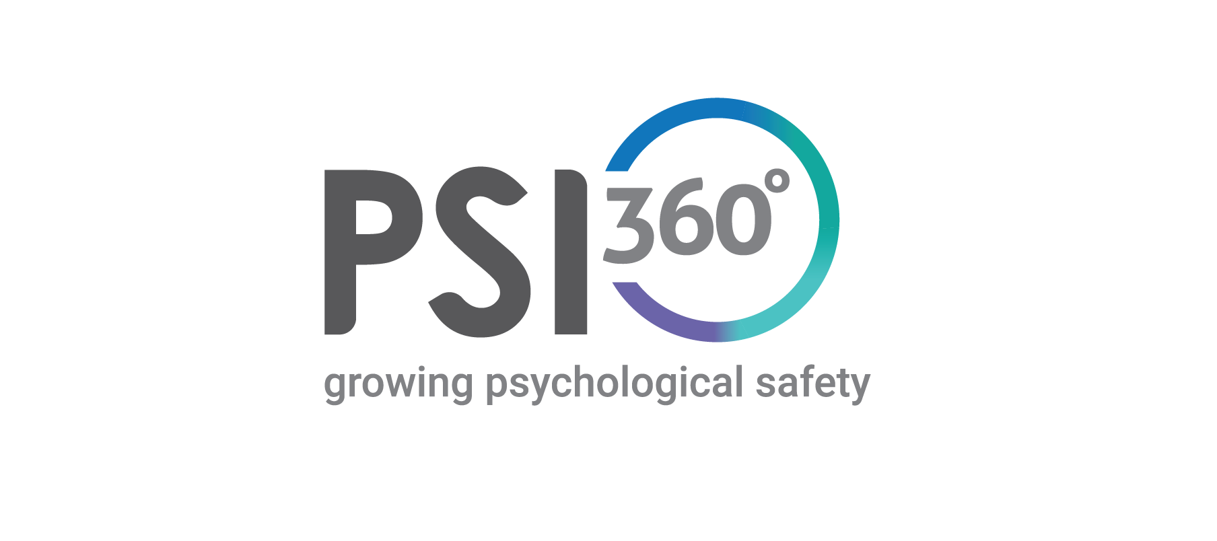
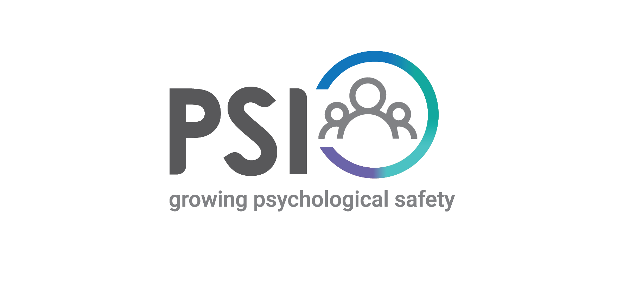
RUNNING A PILOT
To finalize your Accreditation for PSI360 & PSI you must run a PSI & PSI 360Pilot.
1 participant minimum
You must record your virtual session or record voice only.
Up to 50 participants
You must record your virtual session or record audio on debrief session
Completed in 3-month time

Slide 76
Resources
Practitioners Resources - Data Drives Insight
Type into your browser: https://ddi-portal.datadrivesinsight.com/
Notes:
Show info about PowerBI and email templates

Slide 77
Psychological safety is everyone’s responsibility, but hinges on leadership valuing and facilitating it.
Over to you.
Contact
Olivia Pickering
Chief Executive Officer
+61 0449 288 391
olivia@datadrivesinsight.com

